Slide 1
Iran grain-May , 2022. Tehran Presented by Dr. Esmaeil Ahmadi
Subject:
The Effect of GAFTA Rules No.123 & 124 on grain and feed trade with Iran

Slide 2
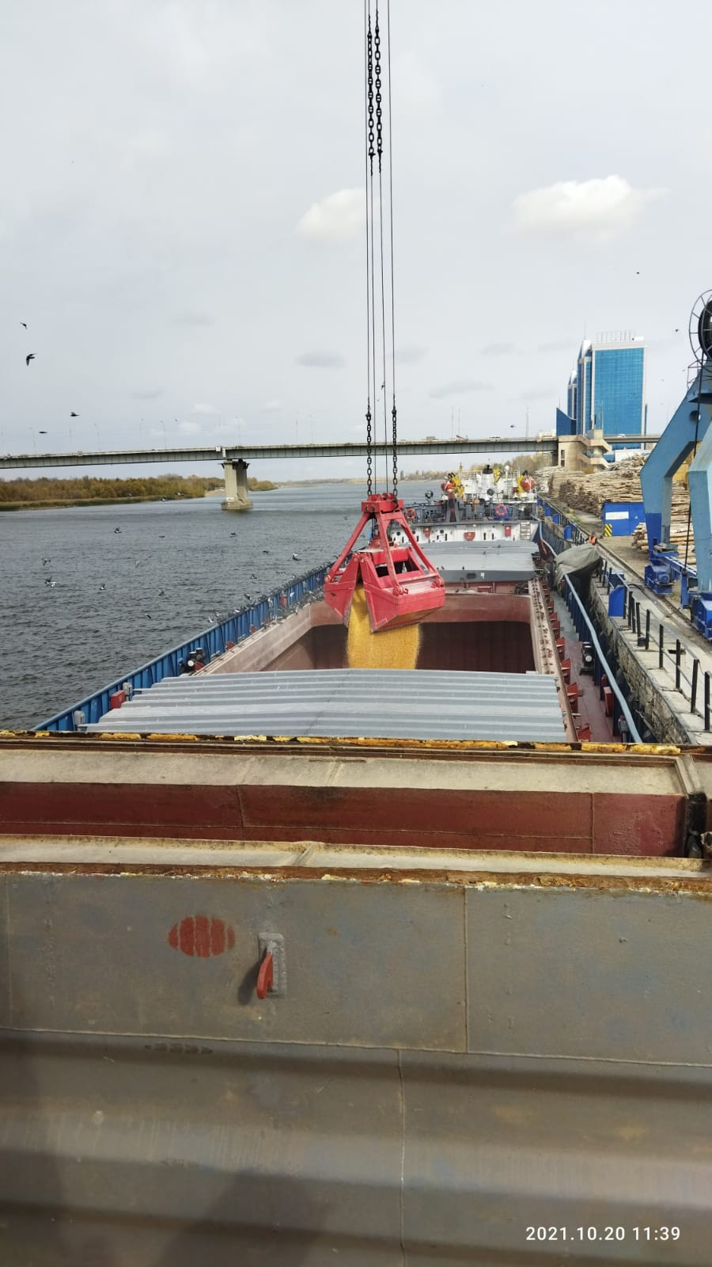
Presentation title
BSJ introduction
GAFTA Rule 123
GAFTA Rule 124
Importer’s Challenges regarding weight and sampling
Approach

Slide 3
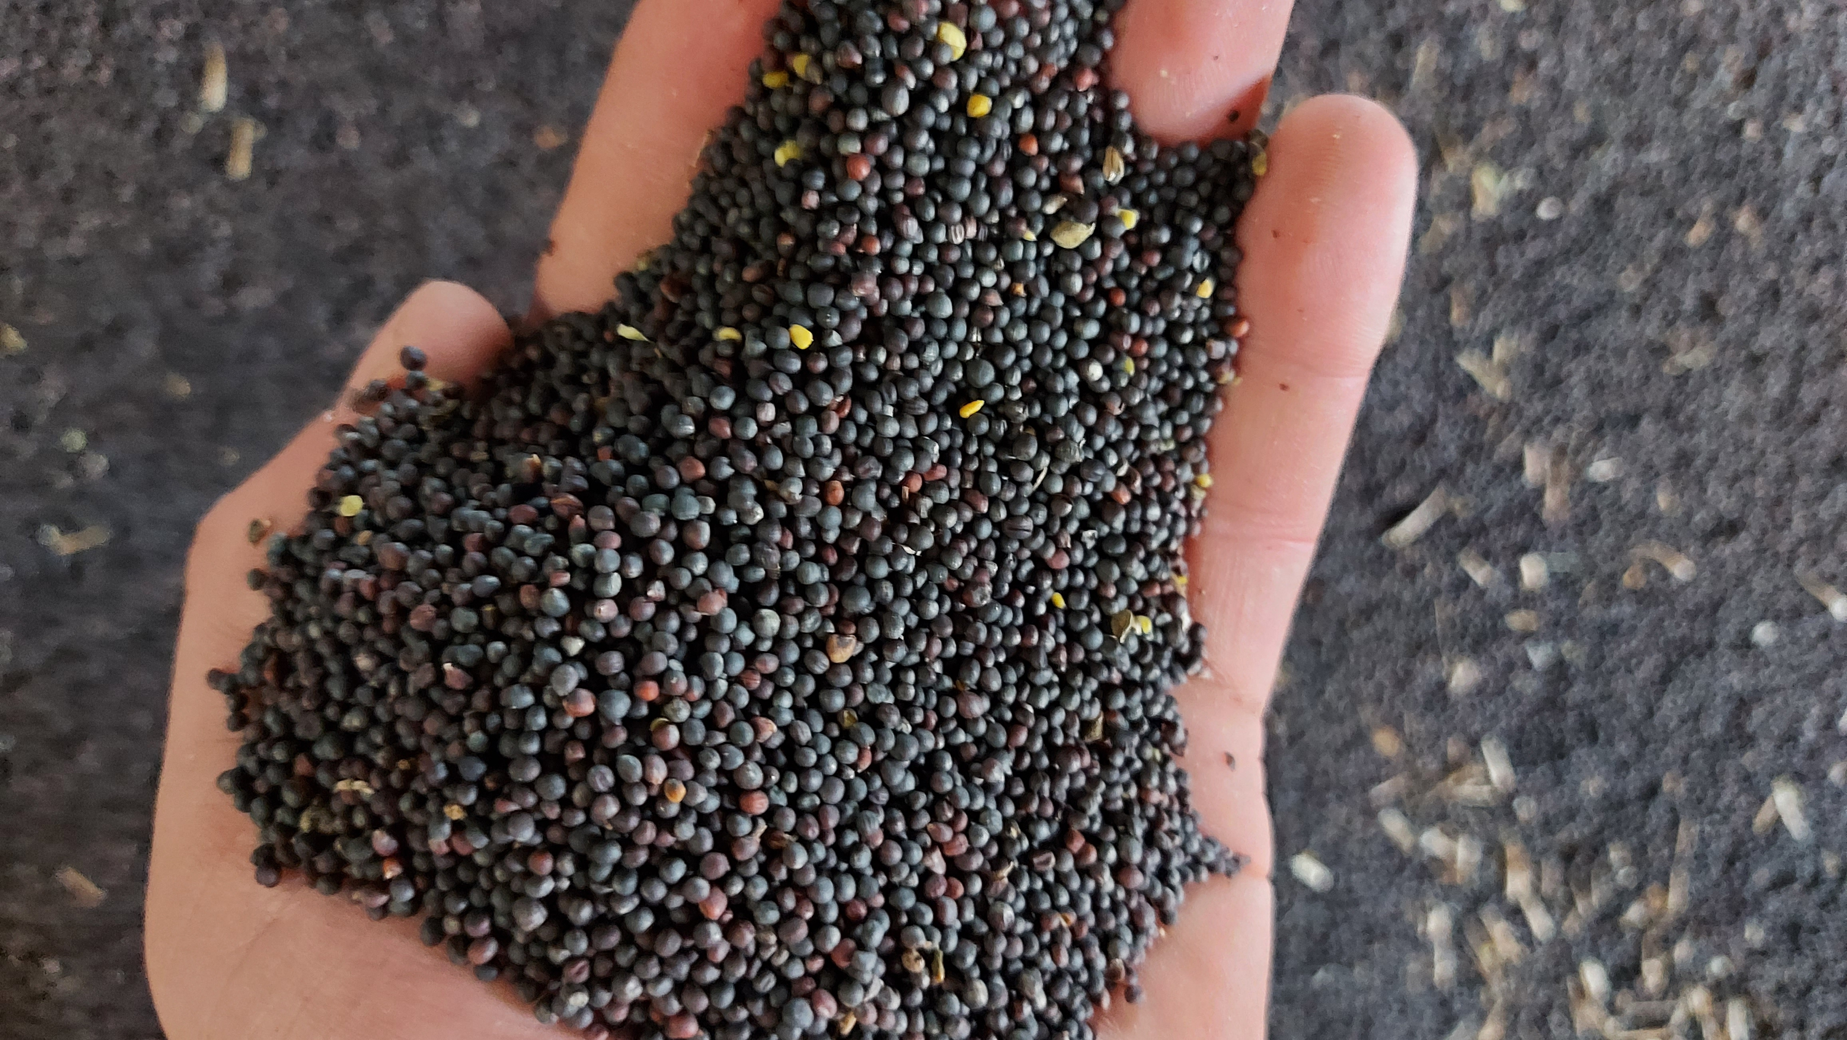
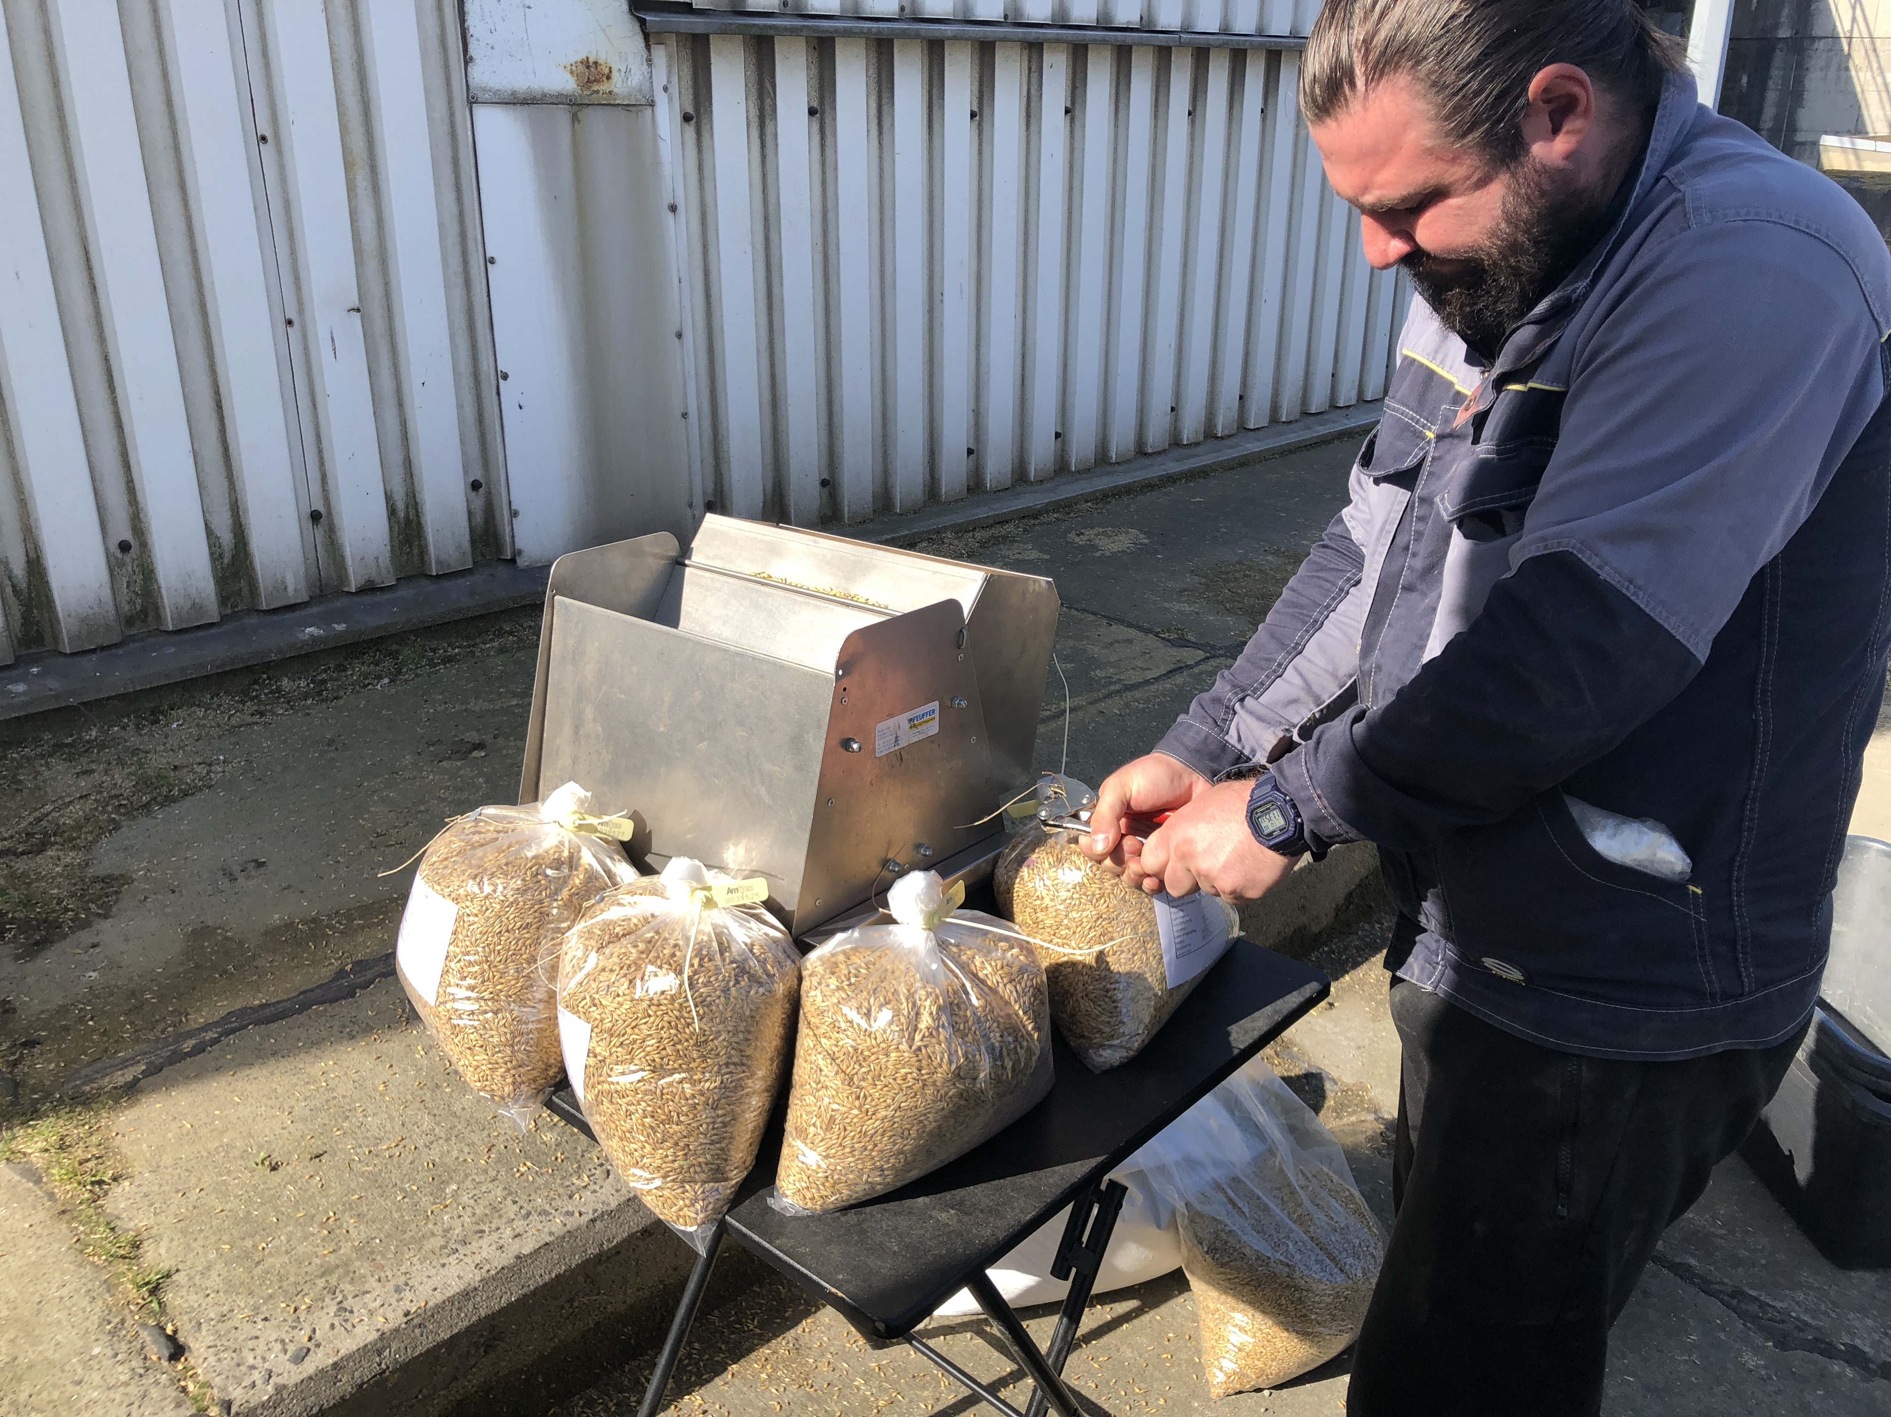
BSJ PROFILE IN GRAINS
BSJ has been established in Iran in 2004
Inspecting, sampling and testing Services
International branches and agents are holding GAFTA & FOSFA membership globally
Iranian approvals (INSO, NACI, CBI, PMO, Iranian Custom office)
17 active agents around the world
5 active branches in the Southern & Northern ports of Iran

Slide 4
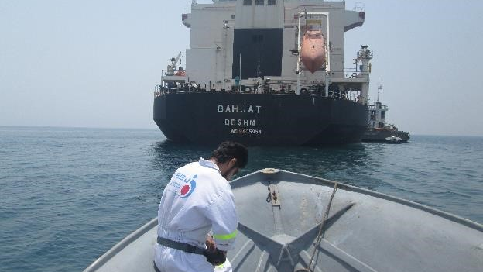
OUR EXPERIENCE IN THE INSPECTION OF GRAINS: - More than 5.7 million grains during last 3 years - Different countries (some main countries such as Brazil,, Argentina, Russia , Ukraine, Kazakhstan, Germany, Romania, Bulgaria, India , Etc.) - Getting appointed on the behalf of sellers, buyers, private & state sectors

Slide 5
Gafta -Weighing Rules No. 123
All contracts terms and conditions of GAFTA should be mutually agreed among both parties:
-The dock authorities or public sworn weighers
-Recognized by the local public or dock authorities
-The custom of the port or location designated in the contract
-Approved by the GAFTA superintendents
-Checking certificate & log on the weighing equipment
-National Authority acceptable tolerance level
-A dispute shall be referred to GAFTA arbitration Rules No.125.

Slide 6
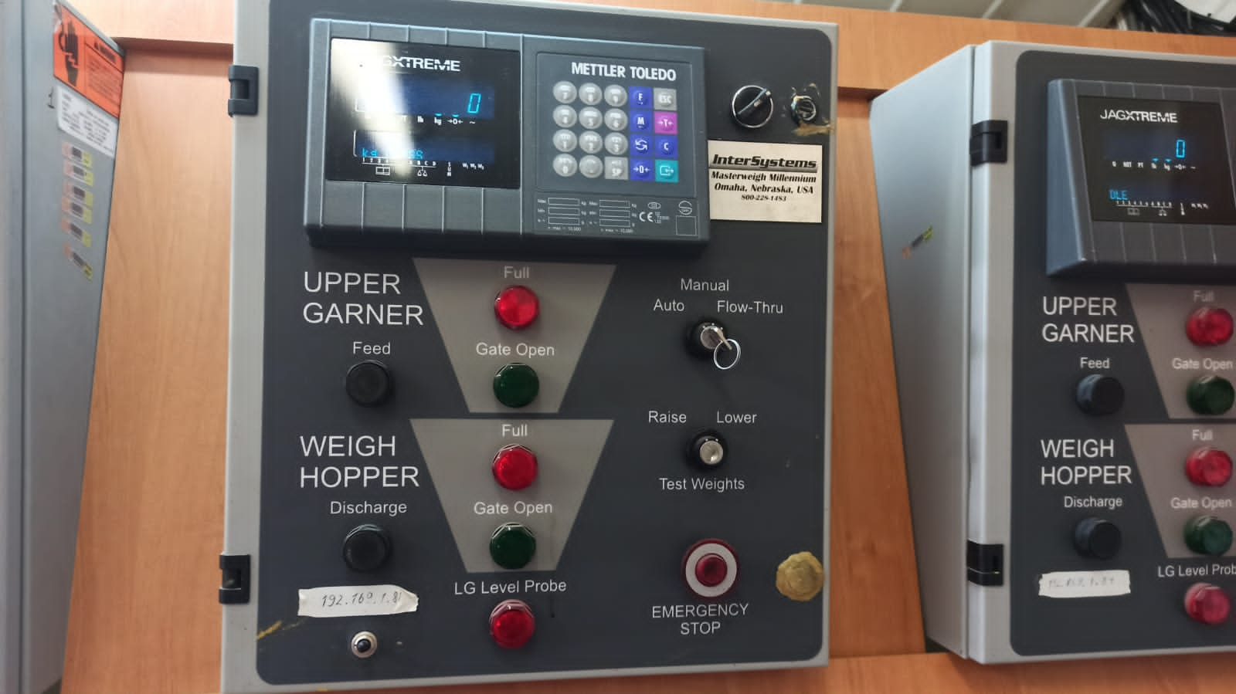
The kind of weighing method :
DISCONTINUOUS AUTOMATIC TOTALISING WEIGHERS (MECHANICAL OR AUTOMATIC HOPPER SCALES)
-Weighing scales must be certified to accuracy class 0.2%
-Weighing scales that are certified to the lower 0.5% accuracy classification
-Both parties to the contract explicitly accept this method of establishing the loaded and/or discharged weight in writing

Slide 7
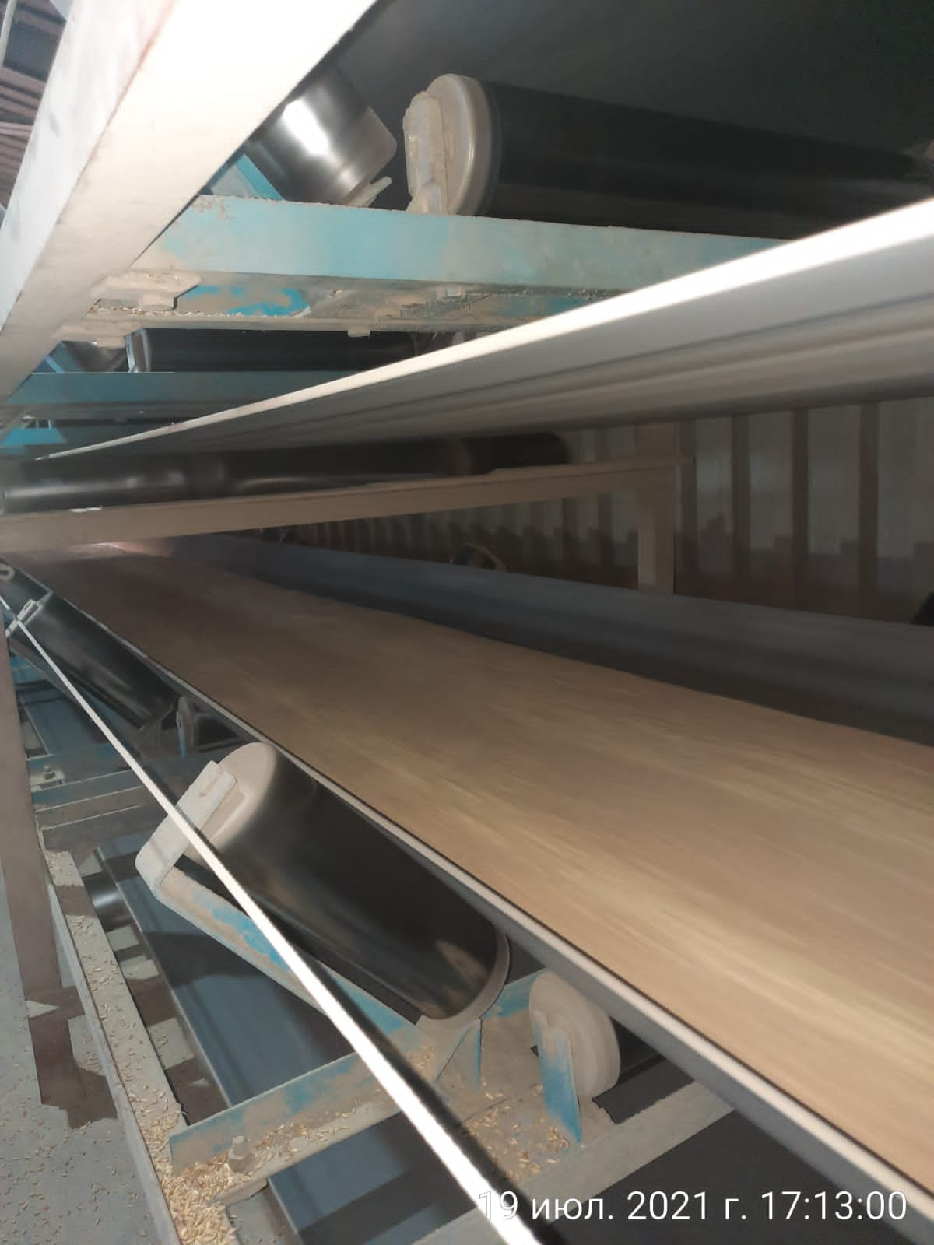
2.CONTINUOUS AUTOMATIC TOTALISING WEIGHING INSTRUMENTS (BELT WEIGHERS)
-Belt weighing is not considered a wholly accurate method of weighing
-Both parties to the contract explicitly accept this method of establishing the loaded and/or discharged weight in writing.
-The method of weighing shall be stated on the weighing certificate.

Slide 8
3. CRANE SCALES
-Cranes with an integrated scale that are classified/ certified to accuracy class 0.2%
-Crane scales certified to accuracy class 0.5%
-Both parties to the contract explicitly accept this method
-The method of establishing the weight shall be stated on the weighing certificate.

Slide 9
4. DRAFT SURVEYS
-Draft surveys are not wholly accurate methods
-Acceptable for contractual purposes
-Both parties to the contract explicitly accept this method in writing
- The method of establishing the weight shall be stated on the weighing certificate.

Slide 10
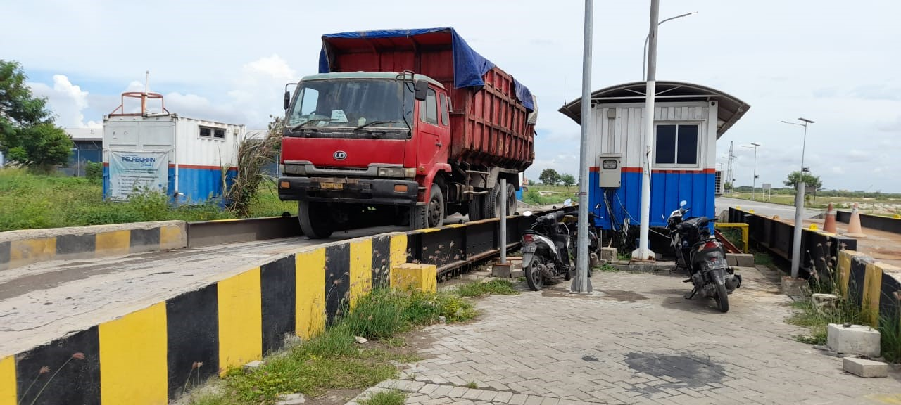
6. WEIGHBRIDGE - ROAD VEHICLES
- The weighing equipment should be balanced and/or zeroed when empty, and checked during the operation of weighing
- GAFTA approved superintendent is needed.
- Road vehicles over a weighbridge should be weighed gross and tare.

Slide 11
7. WEIGHBRIDGE - RAIL WAGONS
- The weighing equipment should be balanced and/or zeroed when empty, and checked
- GAFTA approved superintendent is needed.
- Any rail wagons having undergone only one weighing operation at the close of the working period, these wagons must be re-weighed at the commencement of the next working period.

Slide 12
8. LIQUIDS
Liquids to be weighed in accordance with the above Rules, otherwise in accordance with the custom of the trade/port.

Slide 13
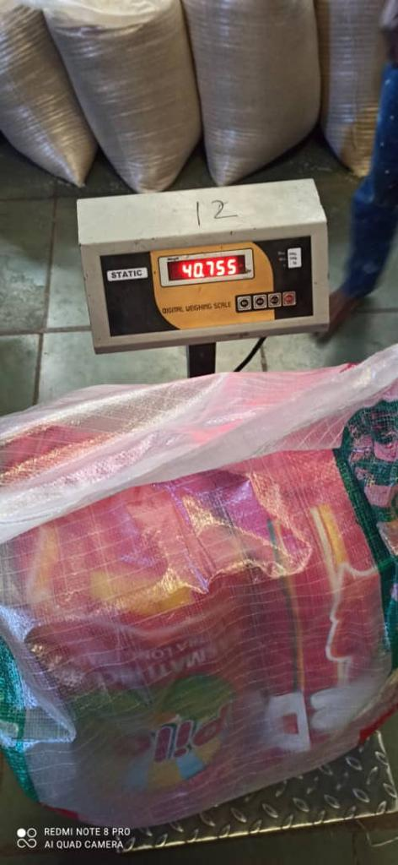
9. BAGS
Bags to be weighed in accordance with the above Rules, otherwise in accordance with the custom of the port on weighbridges and/or platform scales.

Slide 14
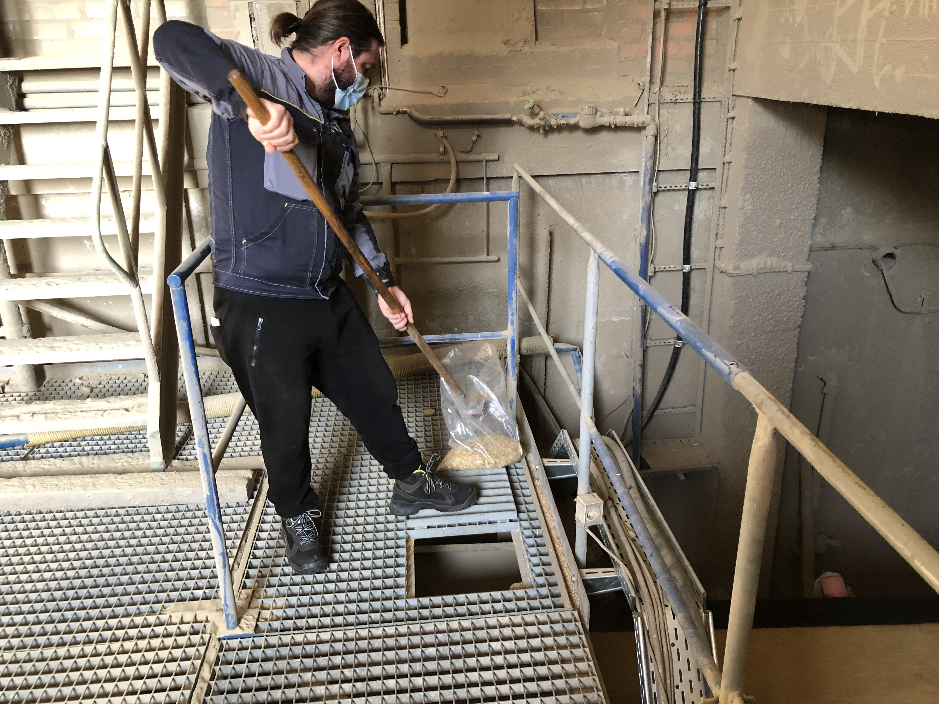
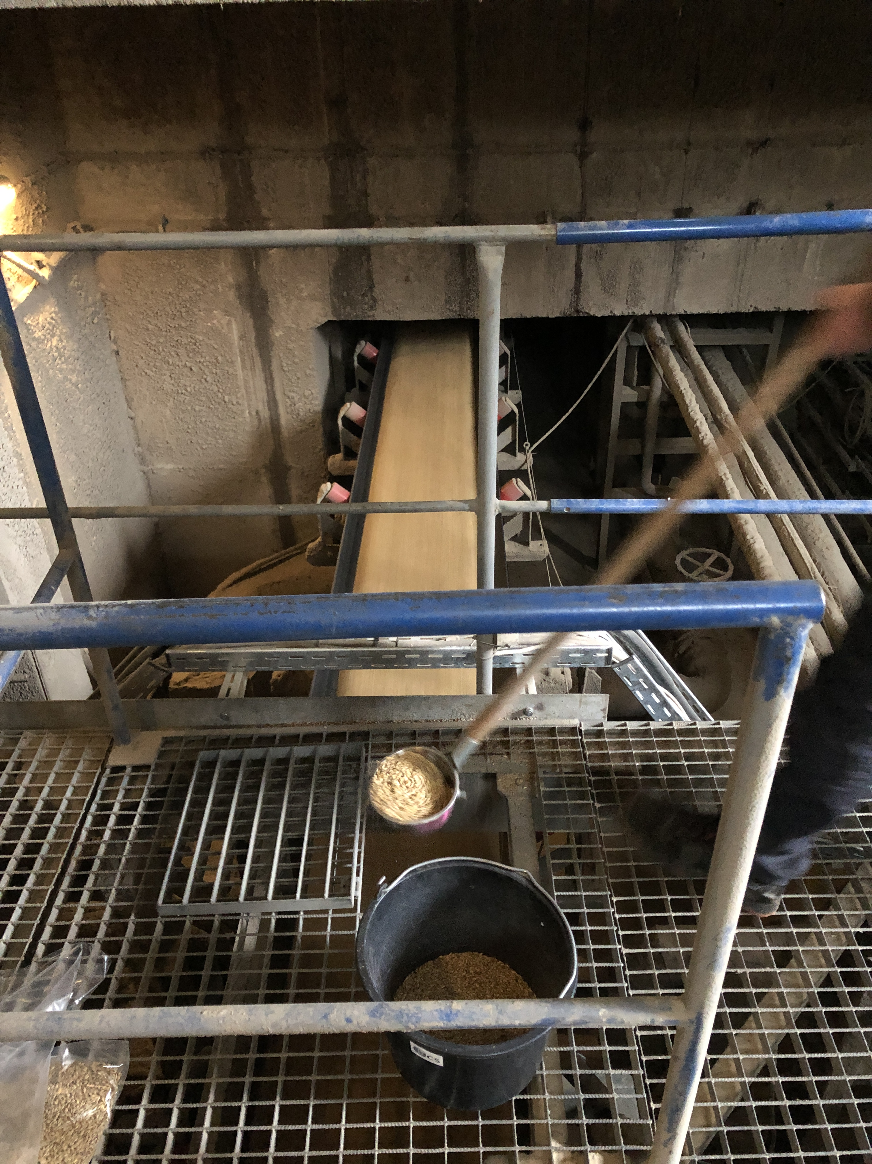
GAFTA Sampling Rules
No.124
-The Approved Register Gafta Superintendents should do sampling as set out in the Code of Practice for Superintendents.

Slide 15
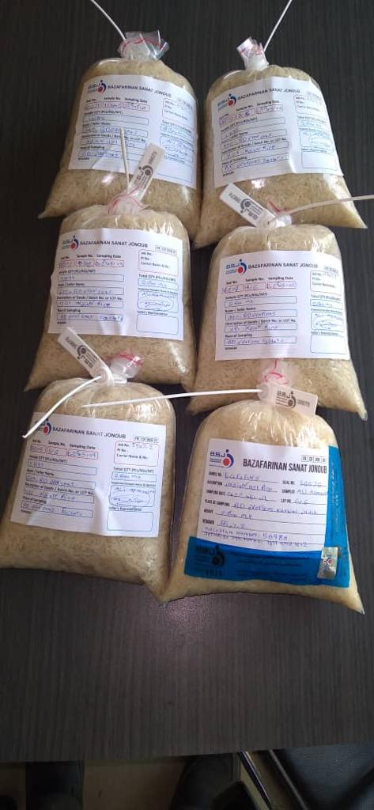
Increment Samples
-Samples taken by hand scoop (or whatever instrument appropriate)
-Not less than 1 kilogram in weight
Bulk (Aggregate) Sample
The accumulated, combined and well mixed total of all the increment samples of the contractual quantity.

Slide 16
Contractual Samples
-Samples reduced from the bulk sample by division
-Sealed into not less than 3 kilogram containers
Analysis Samples
-Sample(s) reduced from the contractual samples by the laboratories listed on the Gafta Approved Register of Analysts
Sample Containers
-Samples shall be packed in sample containers to the type of test/analysis

Slide 17
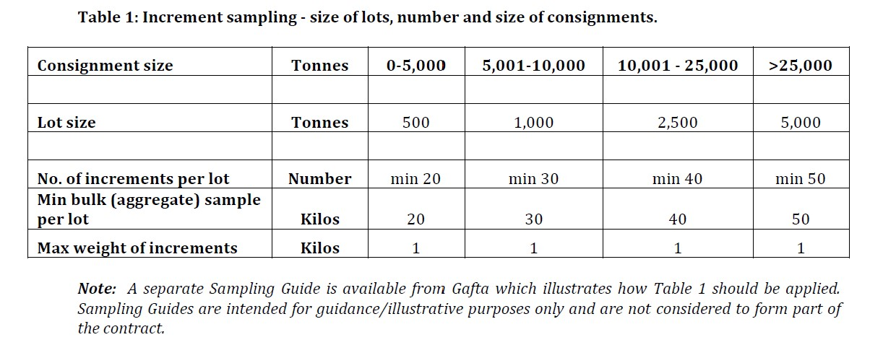

Slide 18
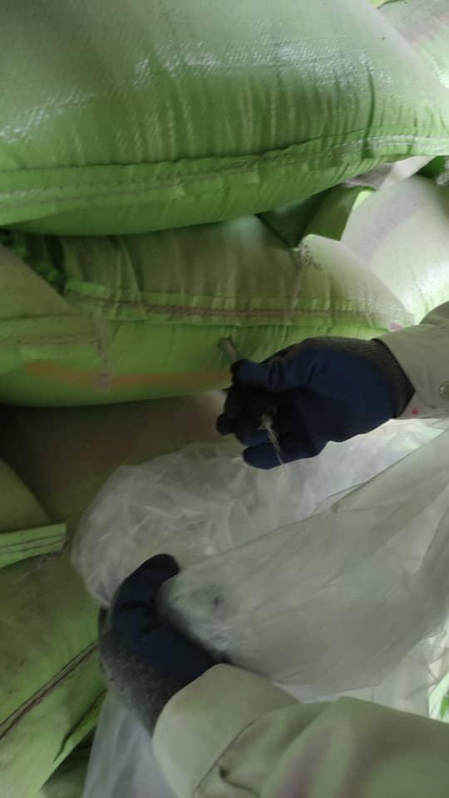
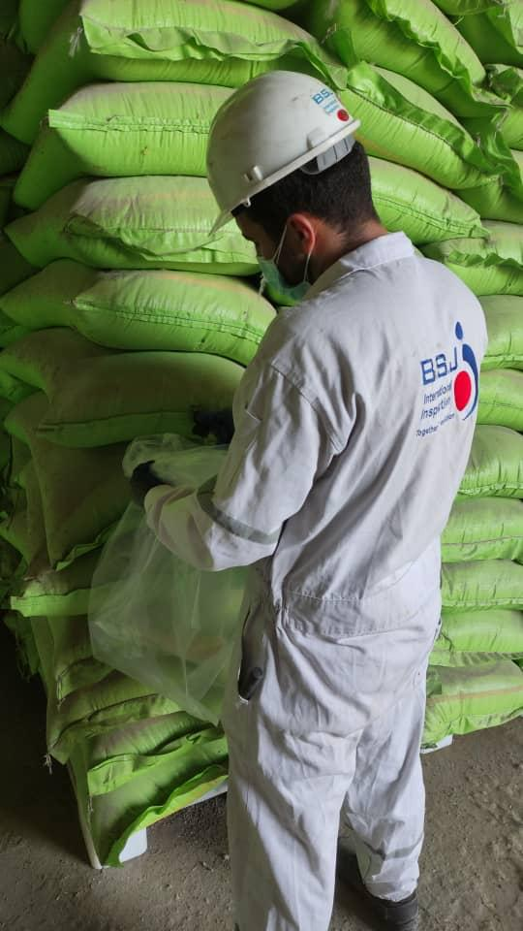
Arbitration Samples
Buyers and Sellers are entitled to attend at the point of loading or discharge and jointly seal a set of samples consisting of 3 kilograms per 5,000 tons for arbitration purpose

Slide 19
Sets of Samples
-Contractual sets of samples as the contract requires
-Any purpose shall be not less than 3 kilograms per 5,000 tons
-Contract samples shall be dispatched to one of the analysts listed on the Gafta Approved Register of Analysts within 14 consecutive days of sealing.

Slide 20
Retention/ Number of samples
2 samples for Buyers.
2 samples for Sellers.
3 Sample for analysis
1Sample for arbitration , if required
Maximum sample retaining time is 3 months

Slide 21
Importer’s challenges : Quantity : -Method of weighing for origin & destination ports -short landing from BL figure mostly northern port -cargo moisture vaporization - Broken kernel increase Quality : -Aflatoxin detection at the southern and the northern ports within recent years - Cargo discoloration at the southern ports -Different method of sampling in discharge port (static instead of dynamic sampling procedure)

Slide 22
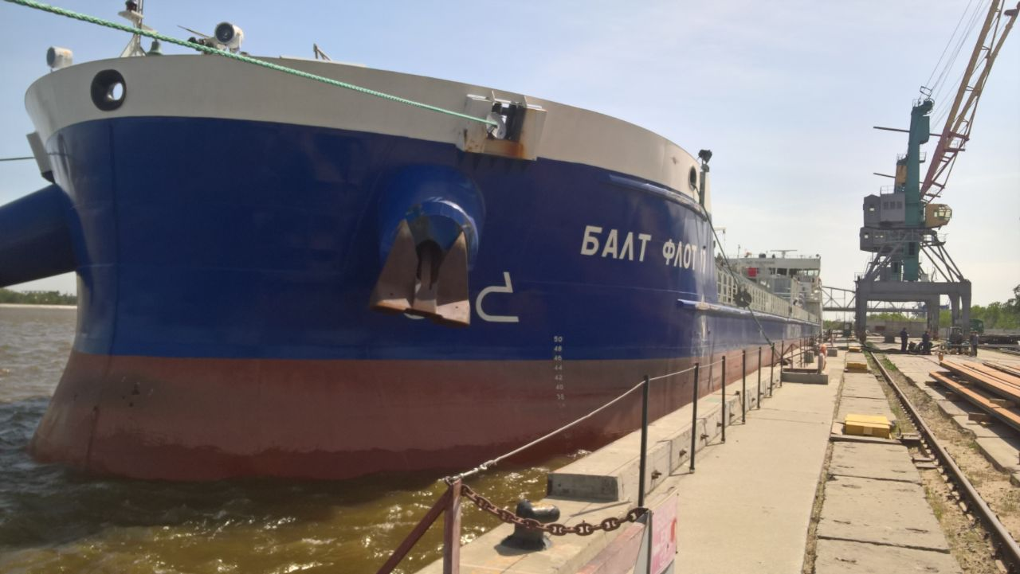
approach : - PSI inspection with considering PI spec. for any purchasing orders by one of GAFTA approved superintendent - Explicitly mentioning weighing system in their contracts - Sampling should comply with INSO standards and CBI rules - Adequate sampling by GAFTA approved superintendent at the origin - Precise analysis or continuous quick quality test during loading operation - To charter the box shape hold of bulk carrier vessel/decrease tween decker hold chartering - To use evacuator instead of grab for discharging - To stow the cargo in warehouse instead of open stock area - Calling P&I club to have LOI in case of dispute in quantity/quality at the origin/distination -Avoid to charter old vessels

Slide 23
Thank you
May 2022 - Tehran

