Slide 1
Changes in Consumer Behavior: Lessons from COVID-19 and Thoughts on Food Security
Merzad Jamshidi
KFF Mills - CEO
IAOM Middle East Africa Regional Chairman

Slide 2
CONTAGIOUSE DISEASE

Slide 3
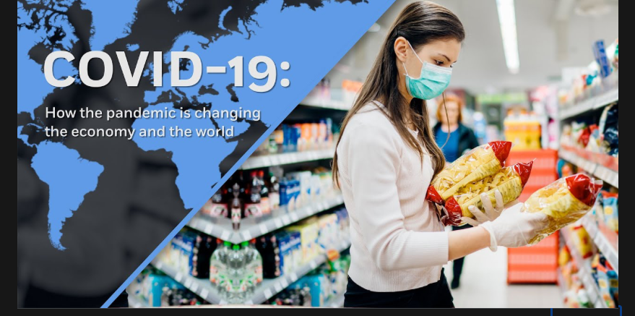
UNDERSTANDING THE IMPACT ON CONSUMER BEHAVIOR

Slide 4
With Disease Comes Disgust as Well as Fear
Being Disgusted: subconscious reaction is to withdraw-people would want to get away
Being Afraid: It brings about loss of control & makes people take Action

Slide 5
Fear – Take Action Buy Disgust – Pull Away from Unknown

Slide 6
The Emotions of Shopping During a Pandemic
Consumers respond to multiple emotions because it generates powerful, complex feelings & they turn to old standbys
Key word FAMILIAR

Slide 7
Focusing on Core Products
Presence of contagious disease increases consumers desire for familiar products
It pushes consumers towards what they KNEW

Slide 8
Innovation & Product Differentiation
Marketers adapting during a pandemic - companies should go back to their basic product line
Oreos, the traditional sandwich cookie sales increased
whereas the Unfamiliar Oreos (Mint, Thins) decreased by %44
McDonald reduced its menu items, sales increased by %33

Slide 9
Element of Fear & Disgust Dictating Behavior
Having Control
Knowing the outcome
Purchase the Familiar
Staying Home
Create & Maintain safe area
Requesting DELIVERY to maintain control zone

Slide 10
E-COMMERCE ON STERIODS

Slide 11
How Covid-19 has served as the ultimate catalyst to accelerate online shopping & service

Slide 12
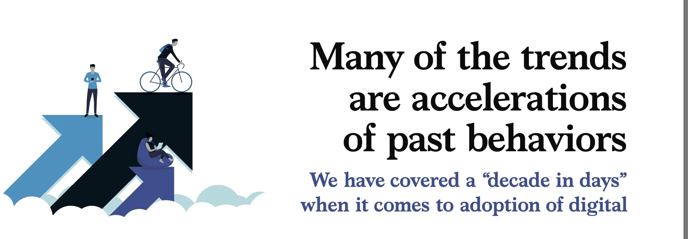
Fabius, Victor, et al. “How Covid-19 Is Changing Consumer Behavior--Now and Forever.” McKinsey & Company, McKinsey & Company, 21 Oct. 2020, https://www.mckinsey.com/industries/retail/our-insights/how-covid-19-is-changing-consumer-behavior-now-and-forever.

Slide 13
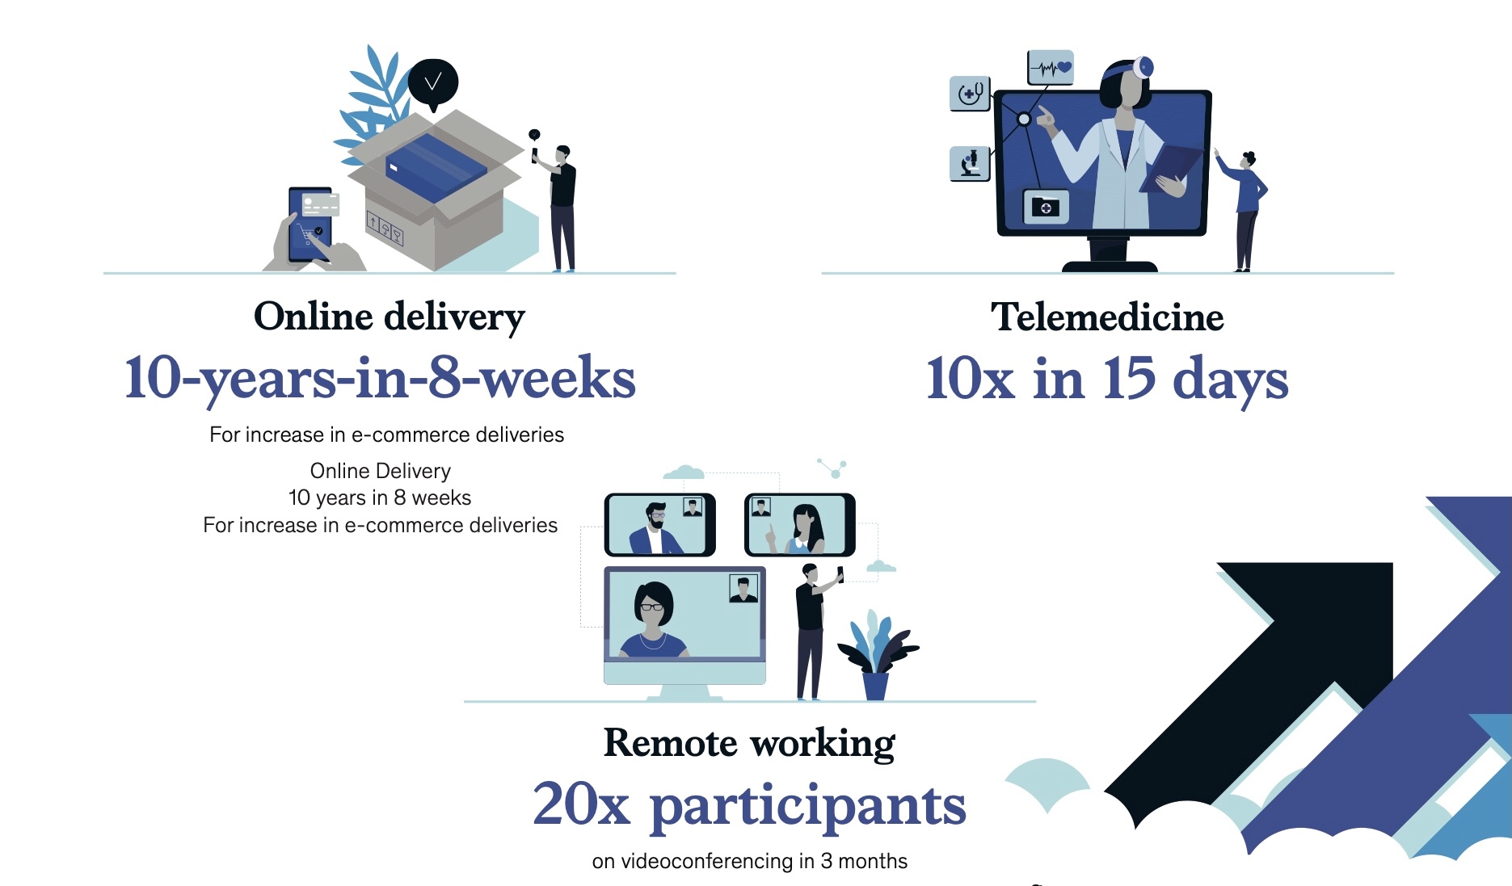
Fabius, Victor, et al. “How Covid-19 Is Changing Consumer Behavior--Now and Forever.” McKinsey & Company, McKinsey & Company, 21 Oct. 2020, https://www.mckinsey.com/industries/retail/our-insights/how-covid-19-is-changing-consumer-behavior-now-and-forever.

Slide 14
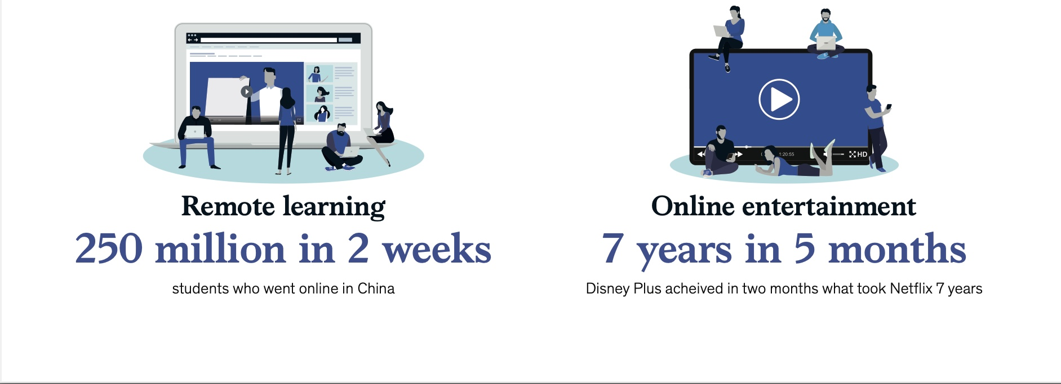
Fabius, Victor, et al. “How Covid-19 Is Changing Consumer Behavior--Now and Forever.” McKinsey & Company, McKinsey & Company, 21 Oct. 2020, https://www.mckinsey.com/industries/retail/our-insights/how-covid-19-is-changing-consumer-behavior-now-and-forever.

Slide 15
Fabius, Victor, et al. “How Covid-19 Is Changing Consumer Behavior--Now and Forever.” McKinsey & Company, McKinsey & Company, 21 Oct. 2020, https://www.mckinsey.com/industries/retail/our-insights/how-covid-19-is-changing-consumer-behavior-now-and-forever.

Slide 16
Online retailing has a significant share of the retail market in developing countries. The outbreak of COVID-19 has also led to an astonishing growth in some markets.

Slide 17
During the pandemic in Iran online platform such as digikala has experience more than 5% growth in FMCG ,also 80 % growth in general category.
Current condition have had consumers to an unprecedented onslaught of online shopping. Currently number of goods ordered in Digikala is averaging 300,000 per day, up from 200,000 a year ago.
Digikala executives say they have now set a goal of processing 500,000 products per day.

Slide 21
Purchasing pattern during 3 years of pandemic in Iran
The outbreak of the epidemic coincided with Nowruz (New Year holidays), a sharp decline rate occurred for semi-durable goods such as clothing and footwear, which were in high demand before Nowruz.
Non-durable goods suffered the least effect from the epidemic, and purchases of essential consumer goods such as food and beverages increased during quarantine in Iran.
We also find a large and persistent effect of the pandemic on preference for online purchasing which did not fade away after the relaxation of restrictions. In semi-durable and durable goods that online purchasing is more practical, we observe larger and more persistent effect on online shopping after the pandemic rather than non-durable goods and most of this purchasing comprises all transactions made via POS and online payment terminals in Iran.
To avoid unnecessary expenses, Iranian families began cooking essential ingredients such as bread at home and making bread, cakes and pastries to spend time in the quarantine.
https://link.springer.com/article/10.1007/s11150-021-09557-8

Slide 22
BAKING’S PANDEMIC POPULARITY

Slide 23
Different Landscape for Baking
From a declining sale since 2016 sales of home use flour and baking mixes rose by %25
US alone to $8.3 Billion
General Mills cake mixes and refrigerated dough increased by %22
In middle east the home baking sector has jumped from an annual %5 to %7 growth to a double digit

Slide 24
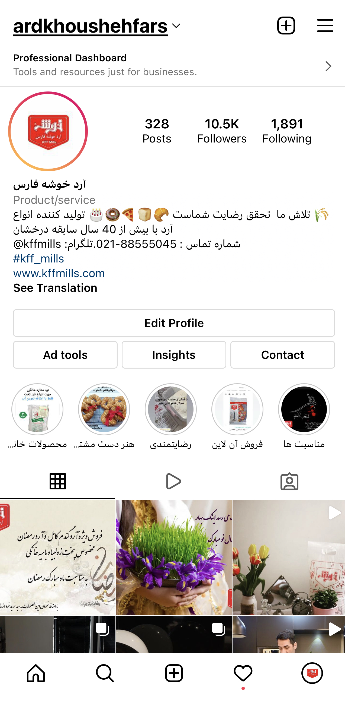
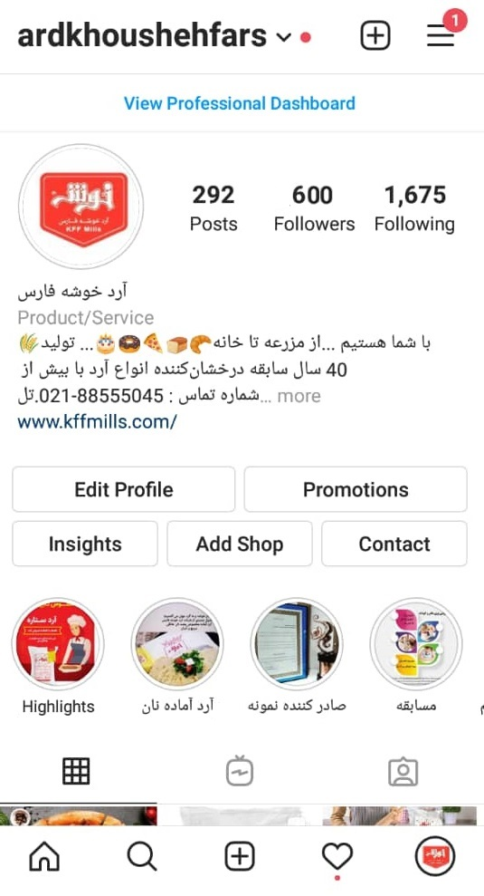
Number of Followers in 2019- 600
Number of Followers in 2022- 10,500

Slide 25
Covid Unexpected Star Bread & Baking
According to Google Trends, searches for “sourdough bread” have sharply increased over the past 12 months.
With much more time on their hands many people have begun to experiment with new hobbies and activities they hadn’t previously been able to do: one of which is baking bread.

Slide 26
Rise of the online bakery classes / Influencers
Specifically attracting the “less Experienced”
With online bakery classes comes online shopping for flour, baking ingredients such as additives & equipment
Number of Viewers has jumped by at least %25

Slide 27
Covid Unexpected Star Bread & Baking
During a recent 36 hour window #bread was used 30,000 times on Instagram
The third best seller on Amazons list of books “ Bread Baking for Beginners”
Uploads of “sourdough bread “ videos has jumped %55

Slide 28
Amaury Guichon –Swiss French
Instagram Followers 2,400,000

Slide 29
John Kanell - US
Our company
Instagram Followers 1,300,000

Slide 30
Amber Spiegel - German
Competitor
Instagram Followers 1,000,000

Slide 31
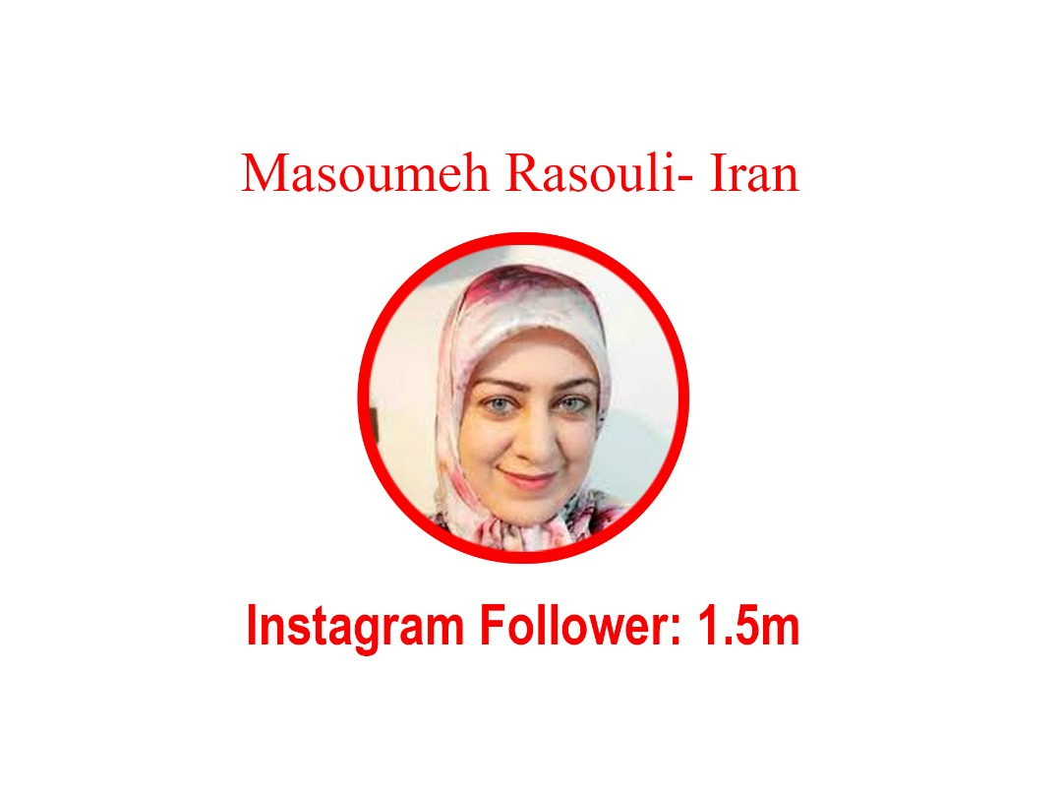

Slide 32
Top 10 Baking Instagrammers have over 13.5 million followers on Instagram

Slide 33
Sales Increase via online platforms -Is FLOUR a B2C Product ?
The two types of marketers have distinctive problems.
Often, the largest problem that B2B marketers have is a lack of content and the time to create content. executions.
With over %60 home bakers getting their information from Google – CONTENT is key

Slide 34
FOOD SAFETY- PUSHING THE RESET BUTTON

Slide 35
The meaning of food safety has changed – everyone is watching the safety protocols in the entire food chain Government Agencies cross the world are re-writing the framework of Food Safety
Re-writing the definition

Slide 36
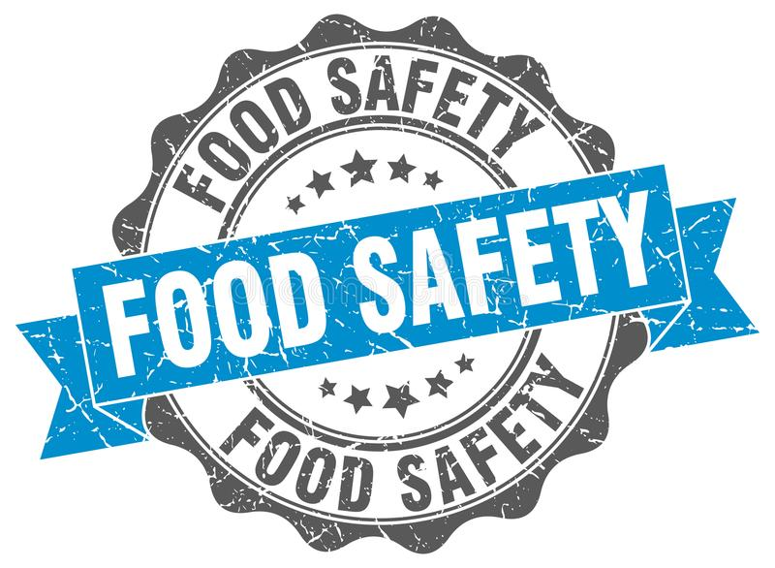
Food Safety - Modernization
Food safety is used as a scientific method/discipline describing handling, preparation, and storage of food in ways that prevent food-borne illness.
The entire view of food safety is changing from responding to foodborne illness to preventing it

Slide 37
What is food insecurity and what does it look like in America?
Food insecurity refers to USDA’s measure of lack of access, at times, to enough food for an active, healthy life for all household members and limited or uncertain availability of nutritionally adequate foods. Food-insecure households are not necessarily food insecure all the time. Food insecurity may reflect a household’s need to make trade-offs between important basic needs, such as housing or medical bills, and purchasing nutritionally adequate foods.

Slide 38
What is food insecurity and what does it look like in Iran?
Food security infected by farmers and also food marketers by cutting the connections between farmers and food markets, COVID-19 shocked the food supply chain and reduced food accessibility. COVID-19 affects the total food demand and supply system in Iran by creating imbalance due to the following factors:
Reduction of household demand due to an unwillingness to use the services sector for preventing the COVID-19 outbreak
reduction of consumer demand due to declining incomes for households who lost their jobs in lockdown restriction.
reduction of household demand for durable goods and increase of money-savings,
reduction of export due to border closure

Slide 39
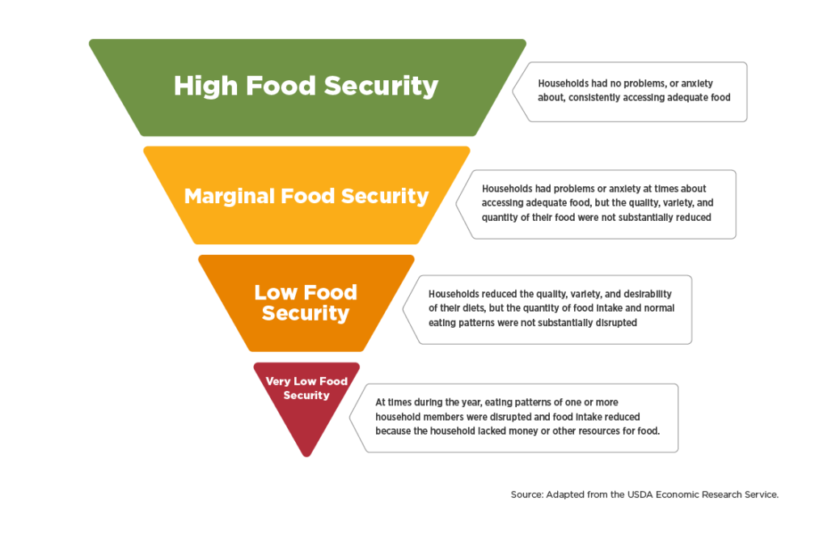

Slide 40
Iranian families reduced the consumption of some food groups during the outbreak of the disease due to new conditions. Therefore, COVID-19 can negatively affect food security by reducing people's incomes. As a result, inflation leads to food insecurity through the spread of poverty and declining incomes.

Slide 41
Below figure show that Food security depends on the economy, household income, employment, food supply chain, and healthy diet, and the impact mechanism of the lockdown restrictions and economic crisis on food security in Iran has also been indicated.

Slide 42
Focusing on Middle East & Africa – Food Security
In our region the definition of Food Safety includes
Security
Managing food crisis
Food Insecurity
The region remains one of the most vulnerable to food crisis

Slide 43
Food Security
Large Imports
Egypt and Iran will lead the import – to secure stock
Morocco and Lebanon will import large volumes due to decrease of production by %50
80% Yemen population need food assistance
Large Exporters
Overall conservatism over volume of Export
Lower Stock in premium quality wheat & low protein wheat
Freight – Huge challnge in receiving in timely fashion

Slide 44
According to International Monetary “Funds regional growth will remain at negative 3 percent”.

Slide 45
578,000,000
Total Population MENA
77,000,000
Conflict Afflicted Population
1,700,000
Palestinians are Food Insecure

Slide 46
Food Security – New Dilma
MEA countries are among the worlds largest food importers
Unsustainable role of governments in pursuing cheap stable foods and self sufficiency in cereal production
Instead international market driven solutions
Its also the most water stresses region – Reduction in oil demand and lack of tourism have reduced revenues –Not including sanctions

Slide 47
Post COVID-19 the New Normal

Slide 48
Merzad Jamshidi
KFF Mills CEO
IAOM Middle East Africa Regional Chairman
Thank You

