Slide 1
Syngenta Introduction
2019

Slide 2
Who we are
A leading agriculture company helping to improve global food security by enabling millions of farmers to make better use of available resources.
World-class science and innovative crop solutions.
28,000 people in over 90 countries working to transform how crops are grown.
Committed to rescuing land from degradation, enhancing biodiversity and revitalizing rural communities.
90
countries
107
production and supply sites
119
research and development sites
27,810
employees
Notes:
Notes:

Slide 3
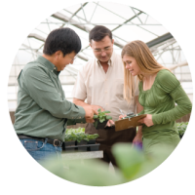
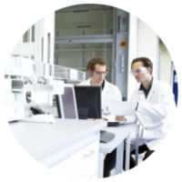
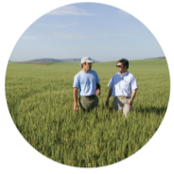
With passionate people and a comprehensive capability
$1.3 billion
R&D investment in 2016 and more than 5,000
R&D staff
28,000
employees
in some 90
countries
$12.8bn
sales in 2016
Notes:
Notes:
We invested $1.3bn in R&D in 2016 and are engaging more than 5,000 R&D professionals worldwide.
With 28,000 passionate employees in more than 90 countries.
Delivering local solutions worth $ 12.8 bn sales in 2016.

Slide 4
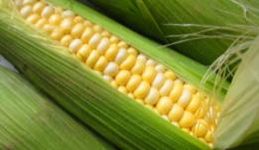
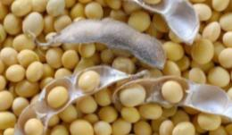
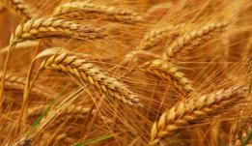
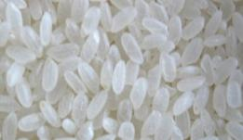
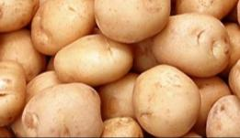
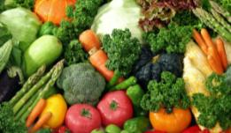
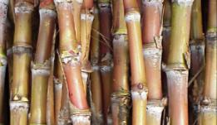
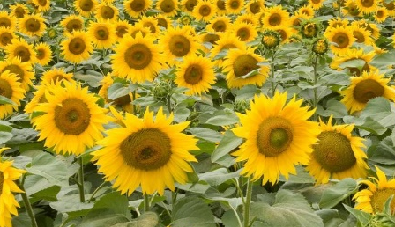
  Supporting key crops with Crop Protection and Seeds offers
Corn
Soybean
78%
Cereals
Rice
22%
Specialty crops
Vegetables and flowers
Seeds
Crop
Protection
$12.8 bn
Group sales 2016
Sugar cane
Diverse field crops
Notes:
Syngenta covers 9 key Crop businesses
Corn
Soybean
Cereals
Rice
Sugar cane
Diverse Field Crops
Vegetables
Specialty Crops
Lawn & Garden

Slide 5
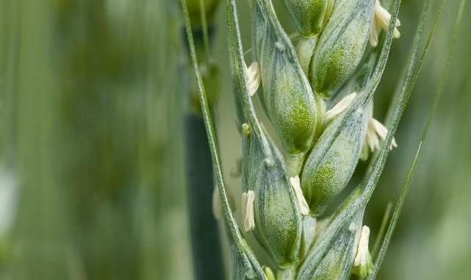
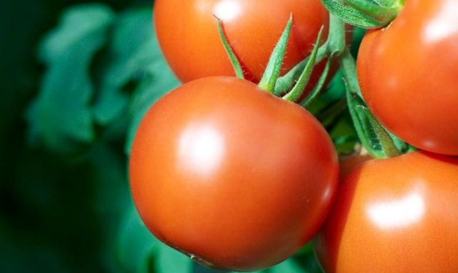
Syngenta has two core businesses
Crop Protection
Seeds
Selective herbicides
Non-selective herbicides
Fungicides
Insecticides
Seedcare
Corn & Soybean
Diverse Field Crops
Vegetables and Flowers
Notes:
5
Selective herbicides control particular weeds, but do not affect crops. Syngenta selective herbicides include AXIAL® (pinoxaden) and CALLISTO® (mesotrione).
Growers use non-selective herbicides to control weeds in fields with crops resistant to them, such as glyphosate-tolerant corn. They also use non-selective herbicides when preparing fields for new plantings, thus avoiding the need to plow the land. “No-till agriculture” of this sort maintains soil structure and thus prevents erosion, as well as reducing the emissions from plowing tractors. Syngenta non-selective herbicides include GRAMOXONE® (paraquat) and TOUCHDOWN® (glyphosate).
Our fungicides include AMISTAR® (azoxystrobin) and RIDOMIL® GOLD (metalaxyl).
The insecticide range includes ACTARA® (thiomethoxam) and KARATE® (Lambda-cyhalothrin)
Major Seed Care brands include CRUISER® (thiomethoxam) and AVICTA® (abamectin).
Home Care covers Materials Protection, (home) Pest Management and Vector Control (which mainly focuses on malaria).
“Diverse” Field Crops provide seeds for oilseed rape, sunflower, wheat, barley, corn in Europe, and sugar.

Slide 6







The Good Growth Plan
We’ve made six commitments to help grow more food using fewer resources, while protecting nature, and at the same time helping people in rural communities live better lives
More food
Less waste
More biodiversity
Less degradation
More health
Less poverty
Make crops
more efficient
Rescue more farmland
Help biodiversity flourish
Empower smallholders
Help people stay safe
Look after every worker
Increase average productivity of the world’s major crops by 20% without using more land, water or inputs
Improve the fertility of 10 million hectares of farmland on the brink of degradation
Enhance biodiversity on 5 million hectares of farmland
Reach 20 million smallholders and enable them to increase productivity
by 50%
Train 20 million farm workers on labor safety, especially in developing countries
Strive for fair labor conditions throughout our entire supply chain network
One planet. Six commitments.
Notes:
Notes:
Our planet is facing the challenge of feeding 9 billion by 2050, and our resources are ever more stretched. So Syngenta has made six commitments to help grow more food using fewer resources, while protecting nature, and at the same time helping people in rural communities live better lives.
We call this The Good Growth Plan.
Make crops more efficient. Syngenta will increase the average productivity of the world’s major crops by 20 percent without using more land, water or inputs. That means that we will grow more food without increasing the land area under cultivation. Yield will increase. The volume of water and pesticides used will not.
Rescue more farmland and help biodiversity flourish. Syngenta will improve the fertility of 10 million hectares of farmland currently on the brink of degradation through practices such as minimum tillage and crop rotation. And we will enhance the biodiversity on five million hectares of farmland with the introduction of buffer strips and species protection programs.
Improve health and reduce poverty among smallholder farmers, and improve worker safety. Over the next seven years Syngenta aims to reach 20 million smallholders and to enable them to increase productivity by 50 percent. Syngenta will train 20 million farm workers, especially in developing countries, on labor safety. And Syngenta aims to look after every worker by striving for fair labor conditions throughout our entire supply chain network.

Slide 7




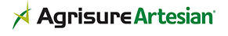




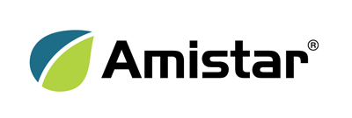
Our product brands: helping plants reach their potential
Selective herbicides
Insecticides
Non-selective herbicides
Seeds
Crop enhancement
Seedcare
Fungicides
Vector management

Slide 8

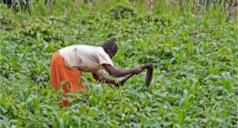
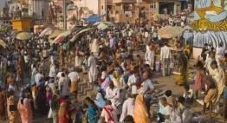


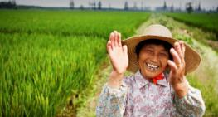
Strategic collaborations – improving our freedom to operate
New vision of agriculture
Emphasizing the important role of smallholders in achieving global food security and the need to help them around the world to improve rural prosperity
WBCSD – Syngenta is a member company of WBCSD and a co-chair of Climate Smart Agriculture
Working together with value chain partners to scale-up ground actions to enhance productivity of food systems and strengthen the climate resilience of farming communities
United Nations Convention to Combat Desertification
Promoting the adoption of soil conservation and good soil management practices in policies and decision making frameworks by building a network linking research institutes, universities and key decision-makers through the Soil Leadership Academy
Notes:
Notes:
Engaging with our strategic partners we are well equipped to use strategic platforms such as the World Economic Forum (WEF), the World Business Council for Sustainable Development (WBCSD) and the UNCCD to position the need of collaborating across boundaries to tackle one of the world’s biggest problems: Global food security.

Slide 9
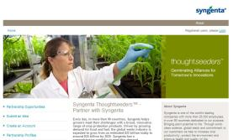
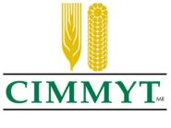
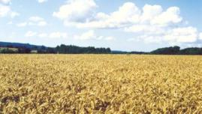
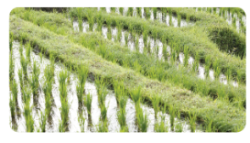

R&D collaborations – broadening the scope of our innovation
Germinating Alliances for Tomorrow’s Innovations™
Online portal helping to identify new opportunities by offering partners a forum to share new technologies and ideas
Industry-leading partnership to advance wheat and corn research
Joint R&D on hybrid wheat and corn. Combining seeds and crop protection: accelerating plant yield performance and offering agronomic and safe use advice
Business collaboration on plant biotechnology
Partnership to reduce poverty through improved, diversified and sustainable rice-based systems.
Notes:
Notes:
R&D collaborations help to broaden the scope of our innovation and also that of the industry.
Syngenta THOUGHTSEEDERS™ is our new online portal for helping to identify new opportunities and gives potential partners a forum to share new technologies or ideas with us. This opens the business to completely new initiatives. We also use this platform to pose specific challenges to a broad audience using an external open innovation network. We are broadening our culture of collaboration to work across boundaries inside Syngenta. New tools and networks are helping us to engage all the expertise within Syngenta, particularly the grower insights of our commercial teams.
CIMMYT: Complementary skills: phenotyping and genotyping, Complementary assets: germplasm diversity for breeding and hybrids, Complementary reach: emerging/developed markets, smallholders/large farms
IRRI – International Rice Research Institute: IRRI develops new rice varieties and rice crop management techniques that help rice farmers improve the yield and quality of their rice in an environmentally sustainable way. Working with Syngenta on national agricultural research and extension systems in major rice-growing countries to do research, training, and knowledge transfer. The social and economic research also informs governments to help them formulate policy to improve the equitable supply of rice.

Slide 10

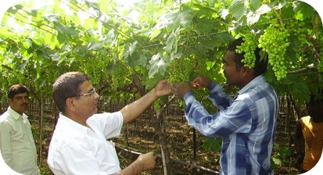

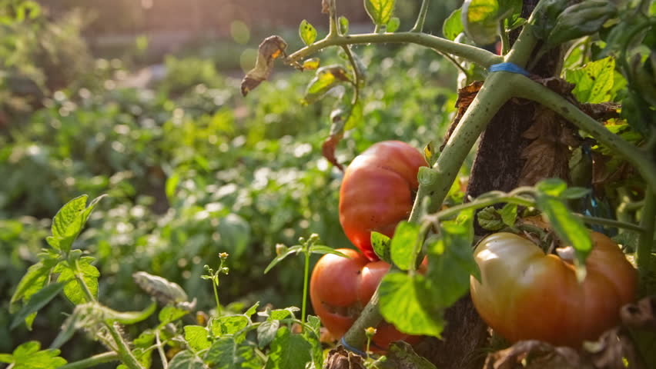


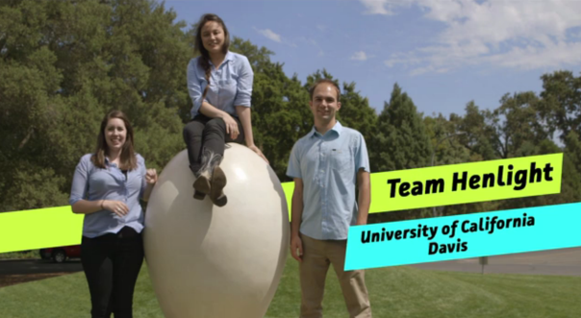
Engaging up and down the food value chain
The sustainable trade initiative
Increasing the sustainability of grape production and export in India by decreasing risk and increasing quality with exporters, suppliers and businesses
The sustainable food lab
A partnership supporting the supply of safe, high quality vegetables in Latin America: social entrepreneurship at multiple levels
Thought For Food
Empowering next generation innovators from around the world to develop and scale new startups in food and agriculture
Notes:
Notes:
Sustainable trade initiative: Increasing the sustainability of grape production and export in India by decreasing risk and increasing quality with exporters, suppliers and businesses
The sustainable food lab: A partnership supporting the supply of safe, high quality vegetables in Latin America: social entrepreneurship at multiple levels
Thought for Food: Syngenta launched a bold new initiative challenging students from leading European universities to help tackle the world’s escalating food issues (read more at www.tffchallenge.com) - we are working with 8000 innovators in 130 countries – and growing every year!

