Slide 1
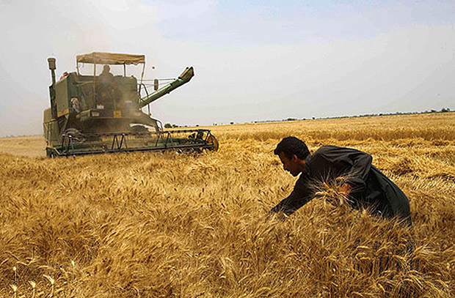
Iran’s Grain Industry and the Way Forward

Slide 2
1. Role of Chamber of commerce in Iran’s economy
3. INSTEX
4. Iran’s relation with Eurasia
2. A brief introduction to the agriculture sector in Iran

Slide 3
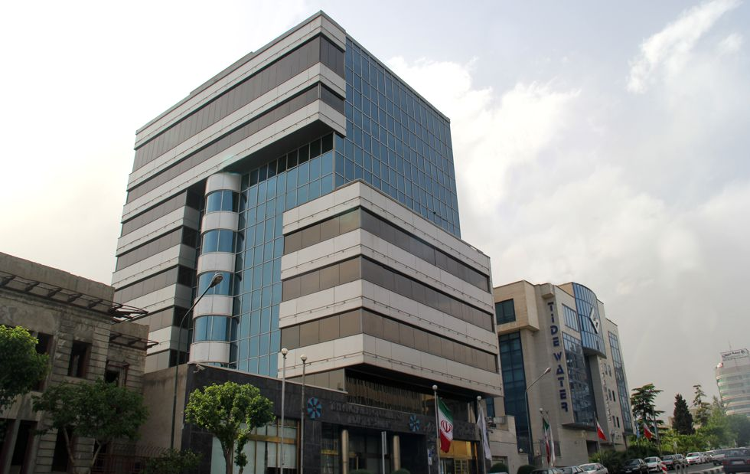
Tehran Chamber of Commerce, Mines and Industry (TCCIMA)
Largest chamber in Iran
40% contribution to GDP
19,000 members
The Investment Center

Slide 4
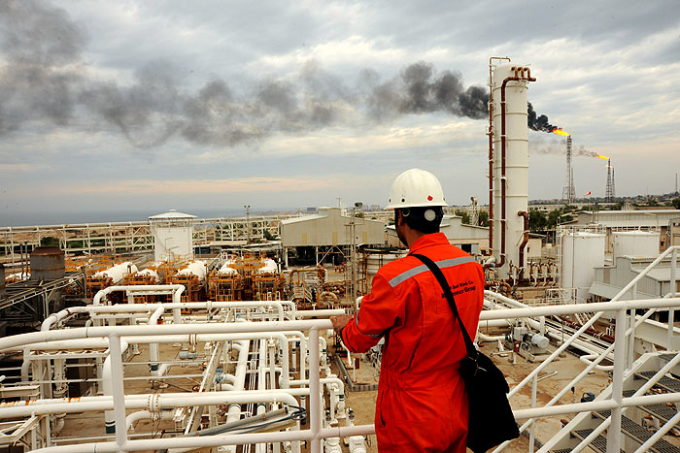
Provide a platform for networking, cooperation, sharing and dissemination of ideas and information
Hold necessary business training courses
Specify priority economic sectors and identifying the opportunities within each sector
Provide consultation to investors on related issues
Outline Iran’s current landscape for investment attraction
Identify regulation gaps, and proposing mechanisms for facilitating investment processes
Facilitate more active participation of private sector in the economy
Investment Center’s Missions and Visions:

Slide 5
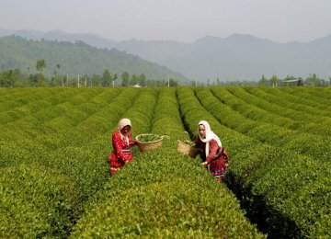
Iran’s Agriculture
Third country (alongside Turkey) in the world in terms of diversity of agricultural products (FAO)
15 million hectares total cultivated area
Around $80 billion worth of contribution to the country’s GDP
To create an estimated of 250,000 jobs by 2035 (McKinsey and co)

Slide 6
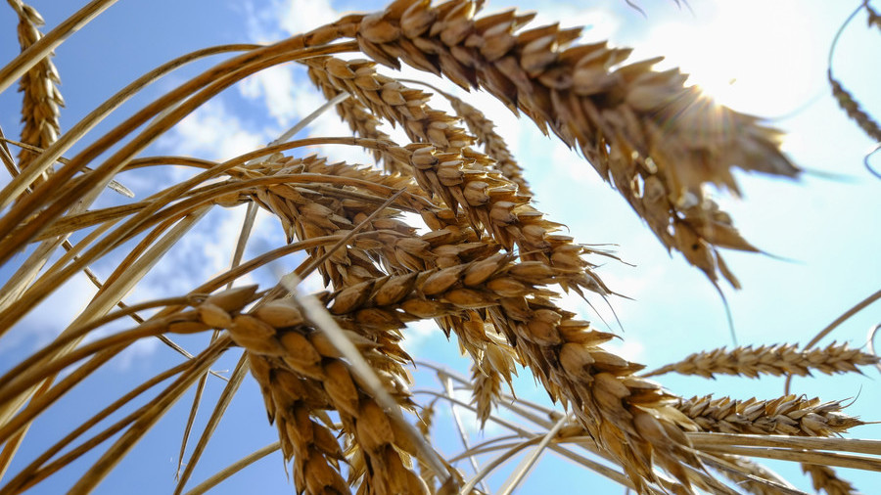
Iran’s Grain Industry
Became Self-sufficient in wheat production in 2016
15th biggest wheat producer with an annual production of 11.76 million tons worth of wheat
Wheat is the most important grain in Iran and accounts for 70 percent of the grain production
Iran’s total import of grains in 2019-20 is forecasted at 13.3 million tones, up from 12.5 million the previous year
Iranians are among the biggest consumers of bread in the world with an average consumption of 160 kilograms of bread a year per person
Iran’s total grains production in 2019-20 will come to 19 million tones, up from 18.5 million the year before (IGC)

Slide 7
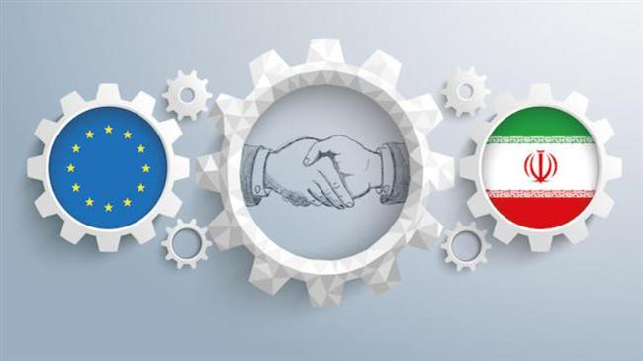
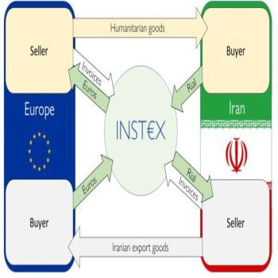
International Sanctions on Iran and the EU proposal
The US withdrawal from JCPOA
EU’s effort to contain JCPOA
INSTEX creation
France hosting INSTEX

Slide 8
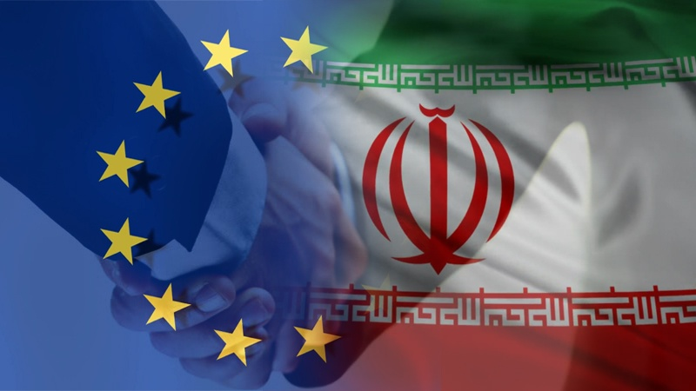
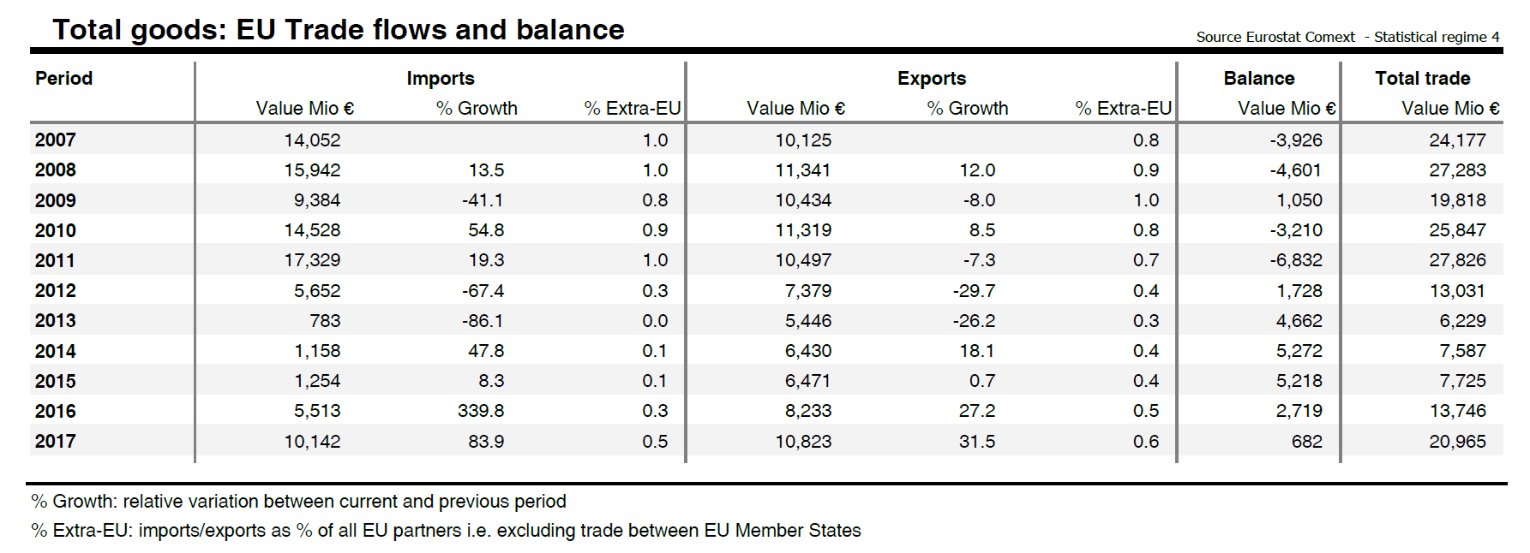
Iran-EU Bilateral Trade Situation

Slide 9
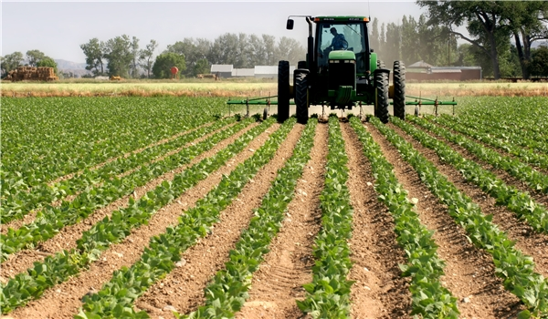
Iran’s and EAEU strengthening their ties
Formation of EAEU in 2014 with Russia, Kazakhstan and Belarus and later Armenia and the Republic of Kyrgyzstan
$1.09 billion worth of agri/food trade between Iran and EAEU in 2018-2019

Slide 10
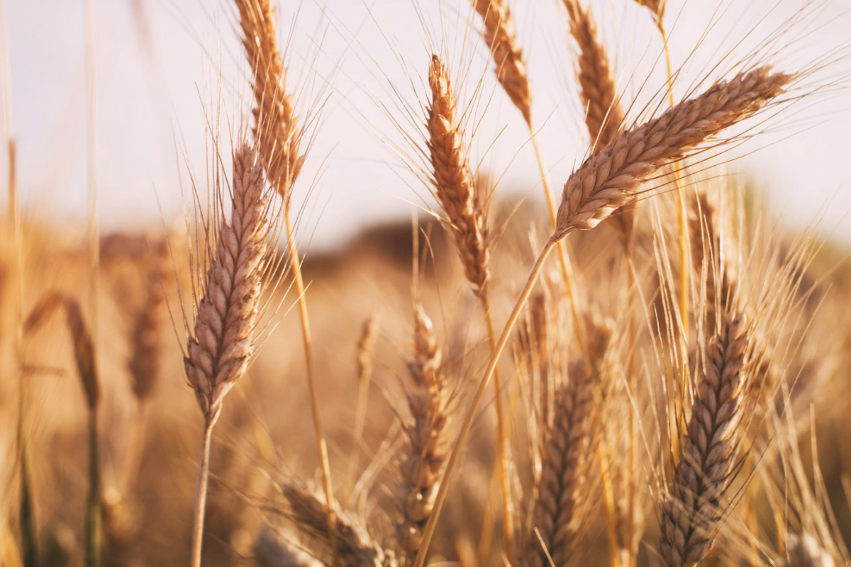
Iran and EAEU latest developments
October 27th 2019
An initial Free Trade Agreement (FTA) was signed which allows for preferential trade on 862 products all of which will be exempted from tariff concessions or subject to stipulated reduced tariff rates
November 11th 2019
A trade and business agreement was signed between Iran and EAEU enabling Iran to join EAEU within a 3 year framework
Sep 2019
Trade agreement was signed between Business Council of the Eurasian Economic Union and Iran Chamber of Commerce, Industries, Mines and Agriculture
A meeting between the president of Armenia Chamber of Commerce and Industry in a meeting and the head of Iran Chamber of Commerce, Industries, Mines and Agriculture (ICCIMA)
November 27th 2019
An agreement on transit and swap of wheat was signed with Russia and Kazakhstan

Slide 11
Thank you for your attention

