Slide 1
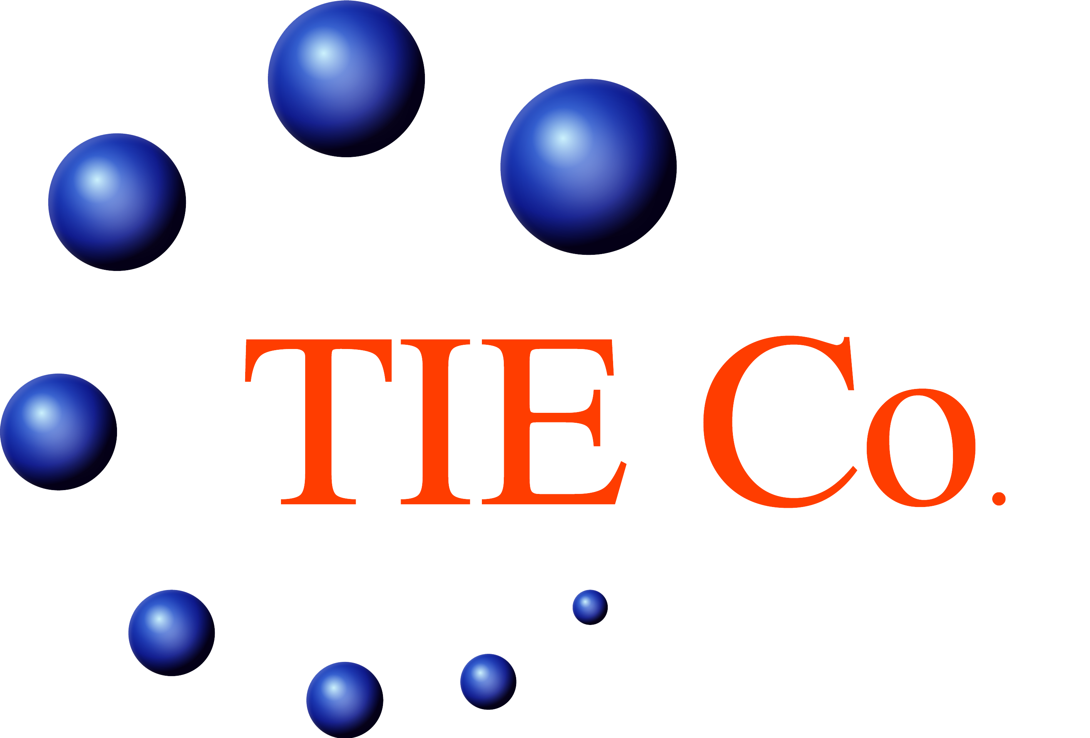
Vahid Mohebi:
TEHRAN INTERNATIONAL EXPERTS CO .
-IFIA Accredited Inspector
IFIA: (International Federation of Inspection Agencies)
-INSO Recognized Expert
-Accredited surveyor of marine and ship surveyor society in BENELUX region (Belgium- Netherlands-Luxemburg)
-Independent Cargo Inspector
-TIE-CO. Product Certification Manager (Present)
-Member of commission of law and practice (CLP) of ICC
-Senior P&I club advisor
-Independent Claim adjuster
www.tie-co.com

Slide 2
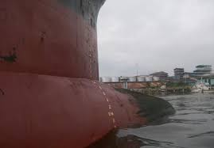
www.tie-co.com
TEHRAN INTERNATIONAL EXPERTS CO .
DRAFT SURVEY, THE ACCURACY AND FACTORS EFFECTING TO CARGO WEIGHT
(CARGO SHORTAGES)
Sometimes the accuracy of Draft Survey is a big question, especially when the cargo loaded or discharged from the vessel shown extremely different weight with the references Weight Scale or Counter Weight. Unfortunately, the parties concerns would be doubt on to the weight resulted by Draft Survey, as they have been relying upon the mentioned scales for many years.

Slide 3
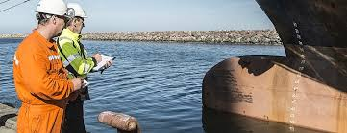
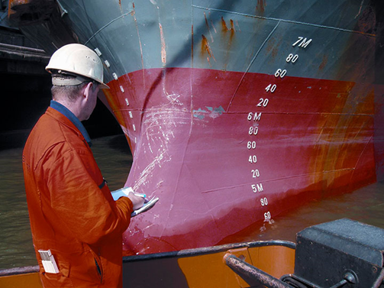
TEHRAN INTERNATIONAL EXPERTS CO .
The Draft Surveyors as the person in charge should be solve this issue to prevent any claim in the future. Where the doubt is came from? The next investigation is required to calm down these issues.
www.tie-co.com

Slide 4
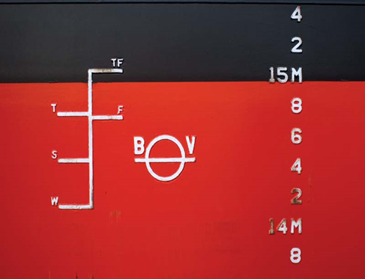
1- INCORRECT HYDROSTATIC INFORMATION OR DRAFT MARKS:
TEHRAN INTERNATIONAL EXPERTS CO .
Investigations carried out in specially performed draft surveys have indicated that there can be significant errors in the determination of displacement due to typographical errors or arithmetical errors in the ship’s hydrostatic tables. This could be improved if the tables furnished to the surveyor bore an approval stamp by the flag government or the classification society. A number of years careless re-painting of draft marks, especially if they have not been permanently marked on the hull, can cause erroneous readings. If there is any doubt, the draft marks should be re-sited at the next dry-docking.
www.tie-co.com

Slide 5
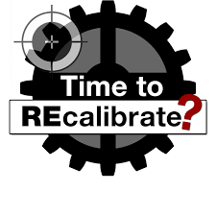
2- INCORRECT TANK CALIBRATIONS:
TEHRAN INTERNATIONAL EXPERTS CO .
This is normally ascertained after a number of draft surveys when a constant error may appear. It may be verified by a careful draft survey when just the tank(s) in question are filled or emptied with no other weight changes. Classification societies, upon request of the ships owners, may however issue the special calibration certificates for each compartment of the vessel.
www.tie-co.com

Slide 6
3- MUD AND/OR SCALE IN BALLAST TANKS:
TEHRAN INTERNATIONAL EXPERTS CO .
The quantity of mud and/or scale will increase over a period of years, depending on the sediment in any ballast taken, on the extend of scale formation and on the cleaning which is carried out. It is very difficult to quantify. The effect on ballast calculations can be minimized unless there are reasons to the contrary by leaving a measurable quantity of water in the ballast tank instead of pumping it dry. The calculation would then use a difference in known water quantities rather than assume that a tank is completely empty: in this way the error would be confined within the density differential of the mud and the ballast water. Regularly large bulk carriers arrive at unloading ports with a slight trim by the head as a result of burning fuel from the aft located fuel tanks during long sea passages. Since generally the sounding pipes are located aft only, dry soundings of ballast tanks do then not necessarily mean that no water is present, since any water will accumulate in the fore end. When the ballast tables are subsequently entered with zero sounding and the head trim, considerable quantities of residual ballast water are found. Again, this water does not actually have to be present. Consequently, when one assumes empty or tabulated quantities, both may be wrong.
www.tie-co.com

Slide 7
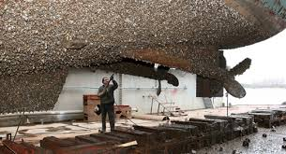
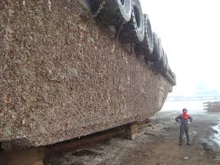
4- BOTTOM SHELL GROWTH:
TEHRAN INTERNATIONAL EXPERTS CO .
Marine growth on the bottom of the ship, especially if dry docking is delayed or if there is a failure in the anti-fouling paint, adds weight to the ship. But, because this weight should not change between the start and finish surveys, it has no effect on the calculation of the cargo weight, unless the vessel is docked for a long period or the antifouling paint deteriorates.
www.tie-co.com

Slide 8
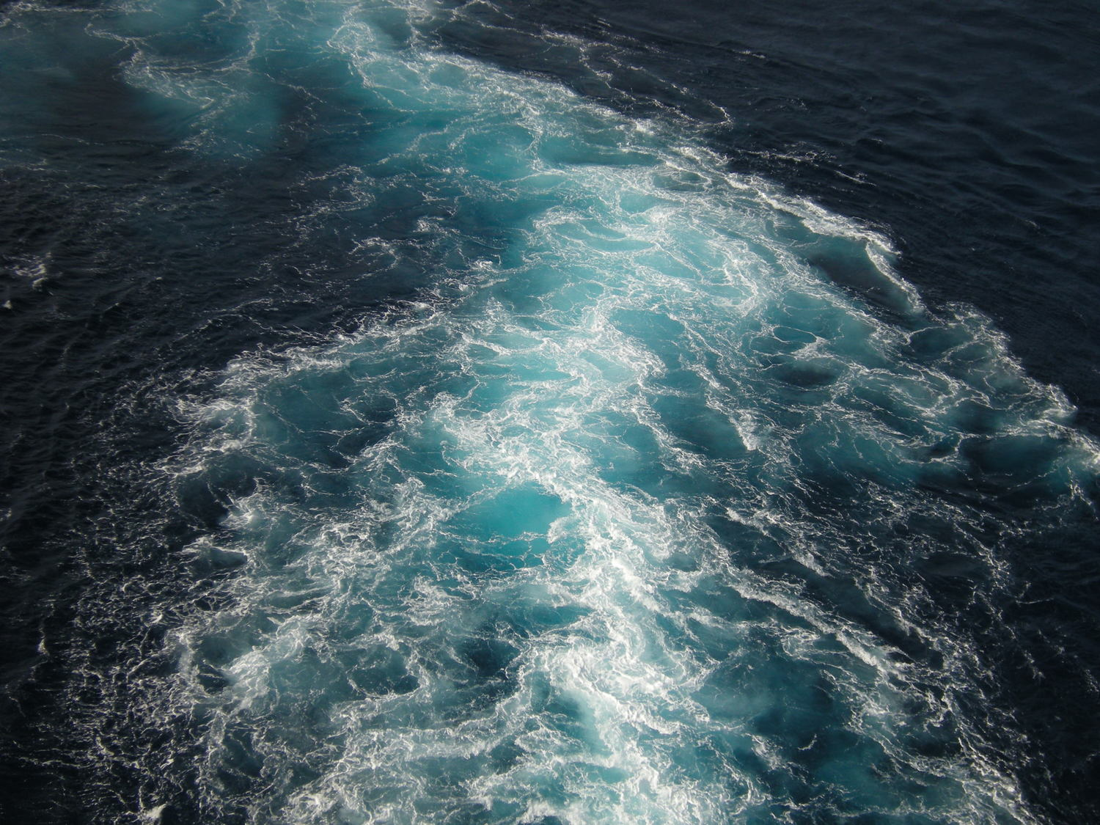
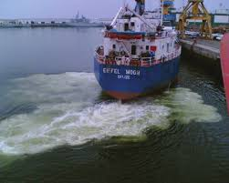
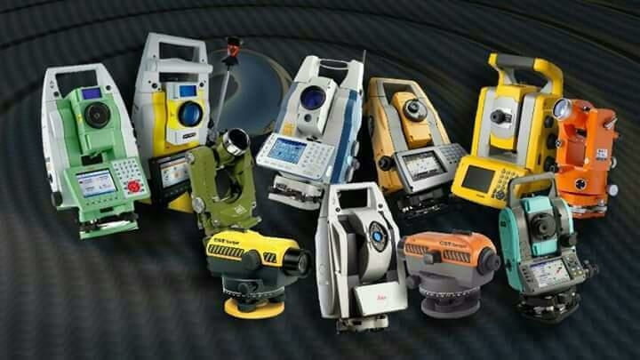
5- WATER DISTURBANCE:
TEHRAN INTERNATIONAL EXPERTS CO .
Normally due to wind, swell or passing traffics. Accurate reading of the draft requires the use of a draft reading tube.
www.tie-co.com

Slide 9
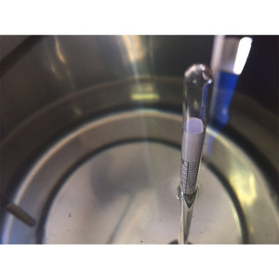
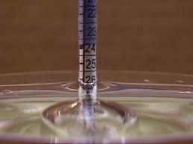
6- VARIATIONS IN SEAWATER DENSITY:
TEHRAN INTERNATIONAL EXPERTS CO .
If a loaded vessel has a small under keel clearance, the seawater may hold mud/sediment in suspension, or chemicals in solution could affect its density. This may be apparent from the bottom layer sample. If it is suspected, a sea water sample should be taken from the maximum draft as a check. In river ports or in proximity of river mouths or of industrial plants, there may be numerous layers of water with differing densities, which may substantially affect the accuracy of the water samples unless properly detected.
www.tie-co.com

Slide 10
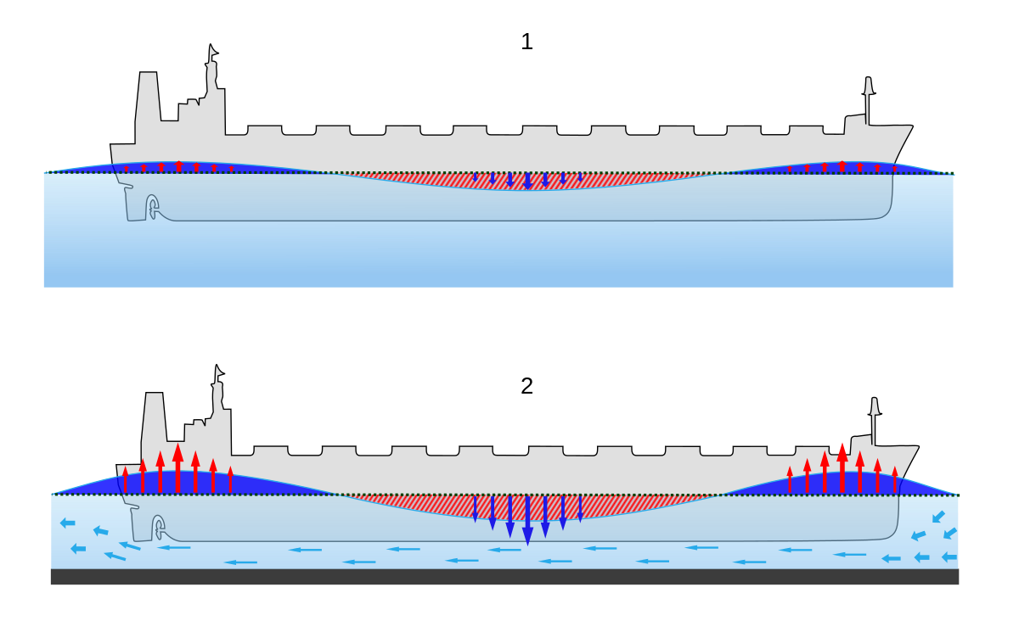
7- VESSEL SQUAT:
TEHRAN INTERNATIONAL EXPERTS CO .
When a vessel is moored in a tidal stream or a fast flowing current, in shallow water, it will squat in the water, i.e. its draft will increase. This is due to the fall of the pressure of the water between the bottom of the hull and the seabed. The sinkage is due to a number of complex factors due to the hydrodynamic properties of the hull, especially where under keel clearance is small and which cannot be accurately determined by theoretical calculations. There appears to be no effect at current speeds below 2,5 knots. If conditions are inductive to squat, the surveyor and the master should monitor carefully that the vessel is fully afloat and not touching the bottom and for best accuracy, consider waiting for slack water, or shifting the vessel to another berth where the effect of squat are known to be less or absent.
www.tie-co.com

Slide 11
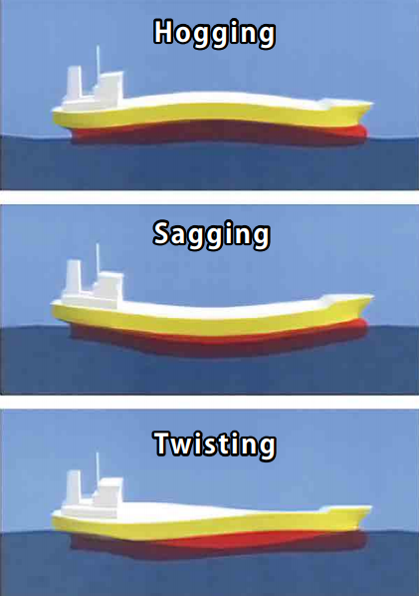
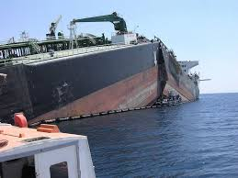
8- ASYMMETRICAL HULL DEFLECTIONS:
TEHRAN INTERNATIONAL EXPERTS CO .
If the mean draft amidships differs from the mean of the forward and after drafts, it is assumed that the deflection of the hull shape takes the form of a parabolic curve. This assumption is inherent in the two-thirds and quarter-mean methods of correcting for hull deflection. If there is no difference between the mean draft mid ships and the mean of the forward and after drafts, it is assumed that the hull shape has not been deflected. Both assumptions may be incorrect. In practice, the hull deflection may not be a parabolic curve or there may be deflections between the ends of the vessel and the mid ship points (i.e. as a modified sine curve). If the draft is not read at all six draft marks, the hull may be twisted without the fact being known.
www.tie-co.com

Slide 12
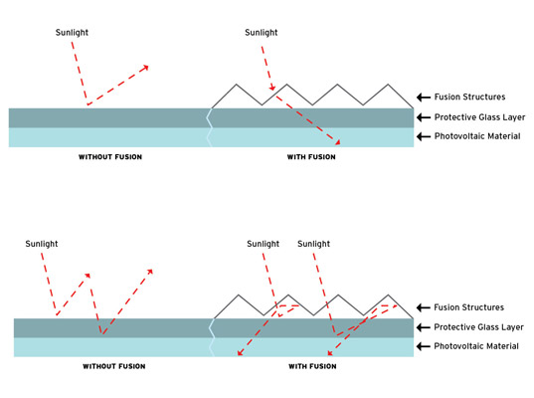
9- SOLAR BENDING:
TEHRAN INTERNATIONAL EXPERTS CO .
Vessels of approximate 50,000mt deadweight and upwards, may be subject to hull deflections caused by solar bending of the deck and structure above the waterline. The effect would normally be a hogging which can be appreciable. Some readings taken on a 74,000mt dwt bulk carrier and reported in “Seaways” (March 1987), showed that the fully loaded vessel was sagged 5cms at 07.00hrs and 27,5cms at 17.00hrs on the same day with no movement of weight within the vessel (apart from normal oil/water consumption for an anchored vessel).
www.tie-co.com

Slide 13
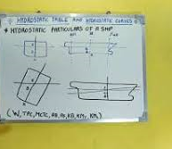
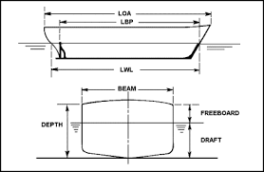
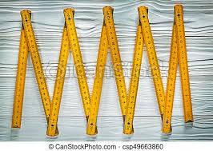
10- USE OF APPROXIMATE METHODS FOR CORRECTIONS:
TEHRAN INTERNATIONAL EXPERTS CO .
The mathematical methods used to correct for trim and/or hull deflections, if these conditions exist, are approximations because of limitations of time, expense and the work site. However, if the same methods are correctly and uniformly employed in all surveys, the resultant error in the exact cargo weight will be minimal. However, if in better equipped ships, correction tables for trim and/or hull deflection are available, then such tables should be used instead of the approximate methods.
www.tie-co.com

Slide 14
11- DRAUGHT GAUGES:
TEHRAN INTERNATIONAL EXPERTS CO .
Draught gauges may be very helpful as a check, but should never replace the reading of draughts using the fixed draught marks on the ship’s hull.
www.tie-co.com

Slide 15
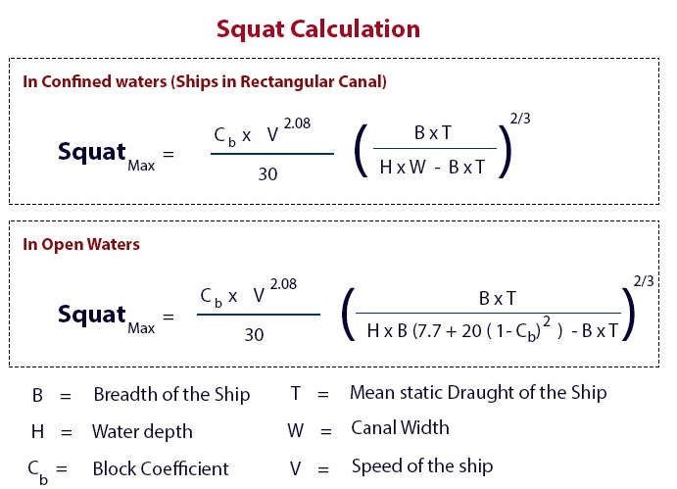
12- WATER SQUAT:
TEHRAN INTERNATIONAL EXPERTS CO .
While measures the draught, when there is a strong current running and there is water depths of less than twice the draught of the vessel, the draught readings may be misleading, due to the effects of squat. The survey report should include reference to Possible Squat Effects, even if a suitable correction to the draught readings cannot be determined.
www.tie-co.com

Slide 16
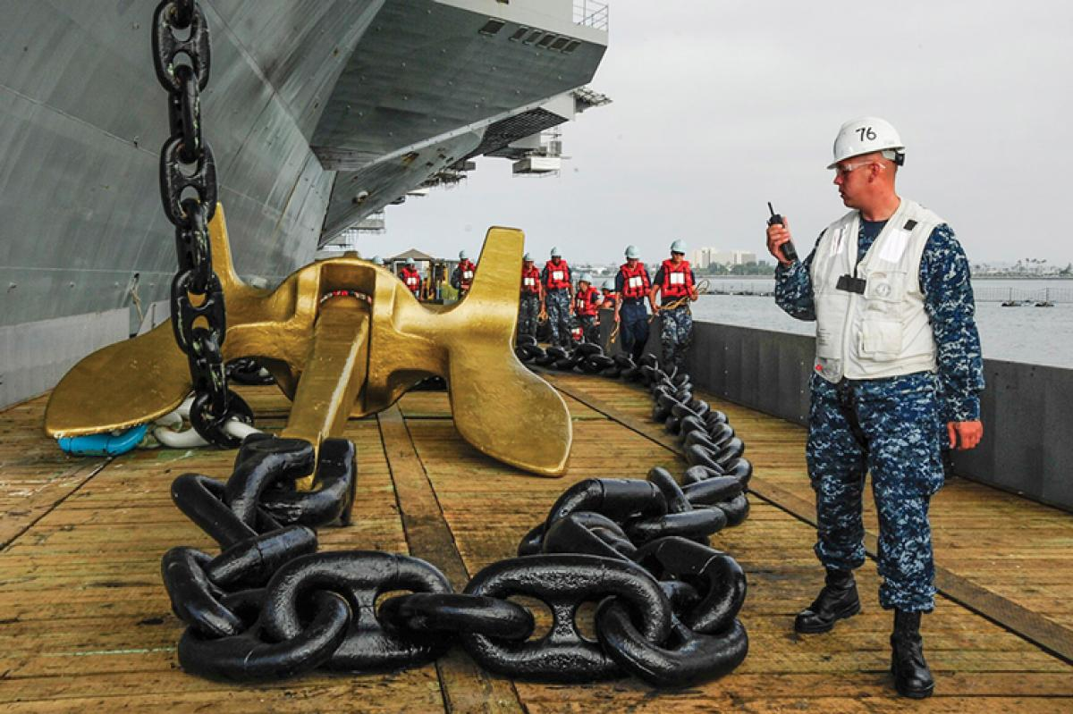
13- ANCHORS AND CHAINS:
TEHRAN INTERNATIONAL EXPERTS CO .
The anchors may be in the housed position, where they contribute to the lightship, or they may have been used in the mooring of the ship. Then the anchors will be on the sea bed along with a given length of cable. The loss of weight due to its removal is weight taken from the light displacement; this amount should therefore be added to the quantity of cargo. There should be information available on board to enable the surveyor to establish or calculate the weight of the missing anchor and cable.
In case of the chain cable, it can be calculated with reasonable accuracy by the following formula:
Weight per shackle (Ton) =
15 x (link diameter in cm)2 x 3,87
1000
www.tie-co.com

Slide 17
THANKS FOR YOUR ATTENTION Contact: 021-74612 (Ext. : 131 and 333) Mob: 0912 204 5668 vahid.mohebi@tie-co.com
www.tie-co.com

