Slide 1


IRAN GRAIN 2019 TEHRAN

Slide 2
IRAN GRAIN 2019 TEHRAN
PRESENTED BY: DR. ESMAEIL AHMADI, MANAGING DIRECTOR OF BSJ INT’L INSPECTION CO.
SLIDE 1: BSJ profile in grain inspection
SLIDE 2: Experience in grain inspection
SLIDE 3: Innovation & competitive advantages
SLIDE 4: Quality challenges
SLIDE 5: Quantity challenges
SLIDE 6: Important points for grain traders (particularly buyers)
SLIDE 7: Vision

Slide 3

1- BSJ PROFILE IN GRAIN INSPECTION:
BSJ stablished 2004 in Iran in BIK
Inspection, sampling and testing Services
International branches and agents are holding GAFTA & FOSFA membership
Iranian approvals (ISIRI, NACI, CBI, PMO, Iranian Customs)
Five (5) active branches at southern and northern ports of Iran

Slide 4

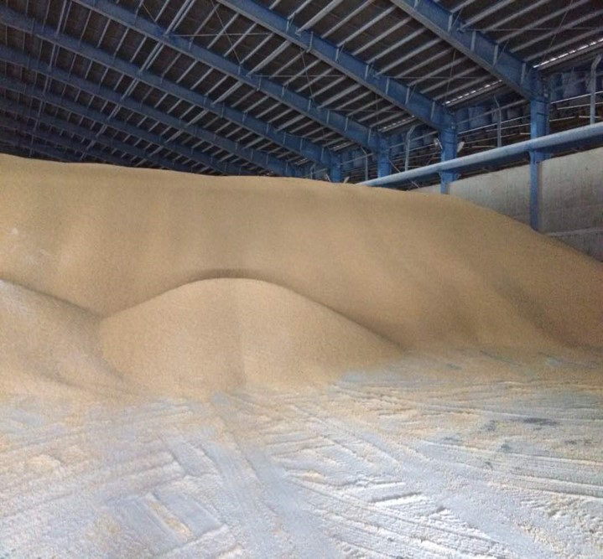
2- OUR EXPERIENCE IN GRAIN INSPECTION:
- More than 7 million tons imported grain cargoes during last 3 years
- Inspection in many countries (Brazil, Russia, Argentina, India, Kazakhstan, Germany, Romania, Bulgaria, Etc.)
- Inspection on behalf of sellers, buyers, private & state sectors

Slide 5
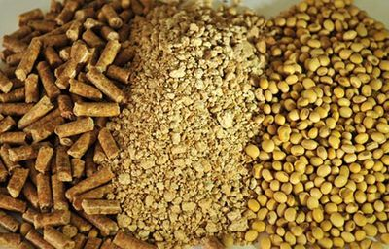
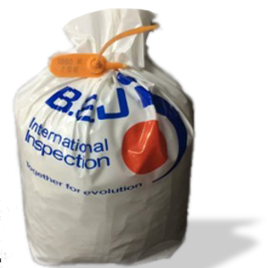
3- BSJ Innovation & competitive advantages:
- Testing at the origin ports before shipment
- Testing in Iranian lab before vessel arrival
- Authorized BSJ agents at the loading ports to issue the relevant certificates

Slide 6

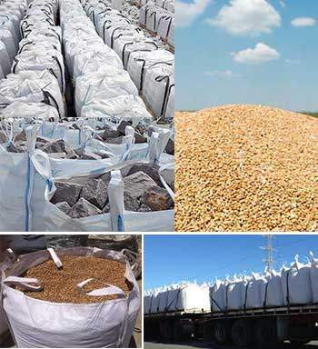
4- Quality challenges:
- GAFTA 124
- Dynamic sampling (custody transfer)
- Sub-committee recommended in ISIRI for merging GAFTA sampling method with Iranian standard No.7570

Slide 7
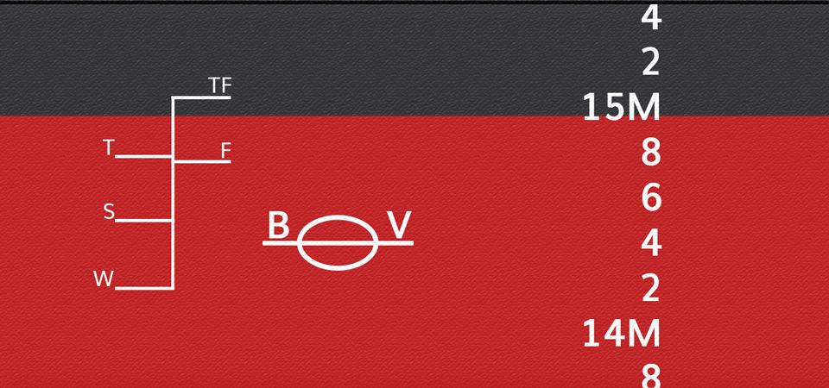

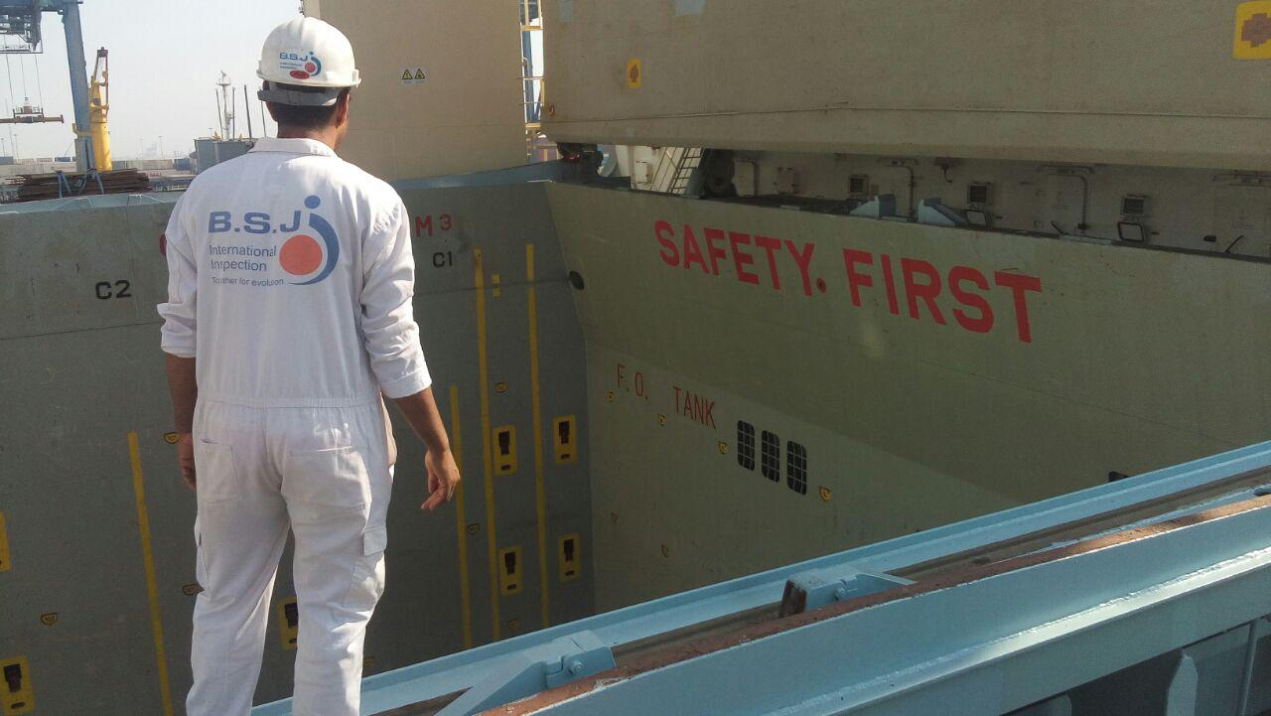
5- Quantity challenges:
- GAFTA 123
- Method of weighing
- Same method at the load and discharging ports

Slide 8
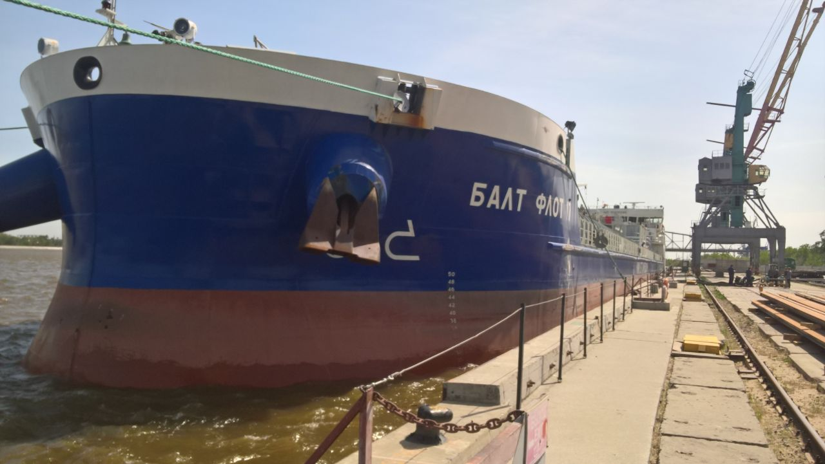
6- Important points for grain traders (particularly buyers):
- pSI inspection with considering PI specification
- Complying with INSO standards and CBI rules
- Adequate sampling
- Precise analysis in any accredited labs at origin before shipment
- Booking of less than 10 years old vessels

Slide 9
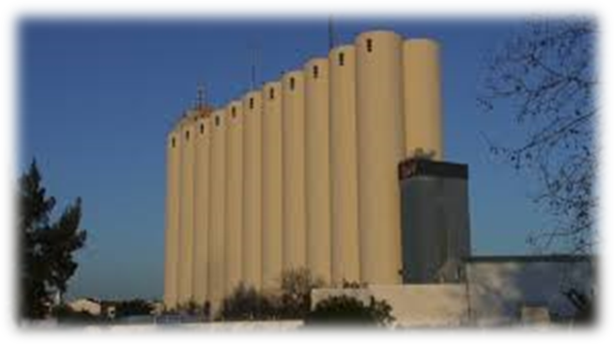
7- Visions:
- Building proper silo and warehouses at Amirabad and Anzali ports.
- Using of modern discharge equipment such as evacuators instead of grab and hopper method to avoid cargo loss and shortage

