Slide 1
An Introduction to Iran Feed Grains Market
Tehran - November 2019
Dr. Zayghami
Iran Feed Grains Union (AVANDA)

Slide 2
Congratulation on the due administration of the 1st Iran Grain event.
Iran’s grain trade prospect is indeed prosperous and promising in spite of sporadic up and downs arising from international developments.
Avanda as Iran’s single biggest Union of Feed Grain Importers is sure to play a more pivotal role in the future of grain trade both locally and internationally.

Slide 3
AVANDA Role in Iran’s Feed Grain Market

Slide 4
Major importers of agri-commodities in Iran in 2018-19
More than 61 member companies comprise Iran Feed Grains Importers’ Union ( AVANDA) .
AVANDA Union accounts for the importation of almost 70% of Iran’s imported feed requirement per annum.
More and more importers are embracing AVANDA membership and the Union is duly orchestrating their official affairs with the respective government offices .
State Livestock Affairs Logistics (SLAL) as a state corporation also accounts for the importation of almost 25%% of Iran’s feed requirements and practicing regulatory functions.

Slide 5
Precipitation Pattern of Iran
Iran’s annual grain production and imports vary widely from year-to-year due to erratic precipitation pattern.

Slide 6
Variation of grains import

Slide 7
Iran’s self- reliance plan for the production of grains
Thanks to Iran self –reliance plan for the production of grains, Iran could produce 19 million tons of grains in 2019-2018 that shows an increase of half a million ton to its preceding year.
Iran could meet its self-sufficency plan for the production of roughly 13 million tons of wheat per annum within the last few years.
Production of barley also came to the tune of 3/2 million tons that shows an increase of 400,000 mts to its previous year.

Slide 8
Iran wheat imports

Slide 9
Iran’s grains import potential

Slide 10
Iran as a major importer of grains
As of 2016 , Iran turned to be :
5th largest maize importer
5th largest barley importer
12th largest soybean importer
12th largest rice importer

Slide 11
Major feed grains growth vs US sanctions

Slide 12
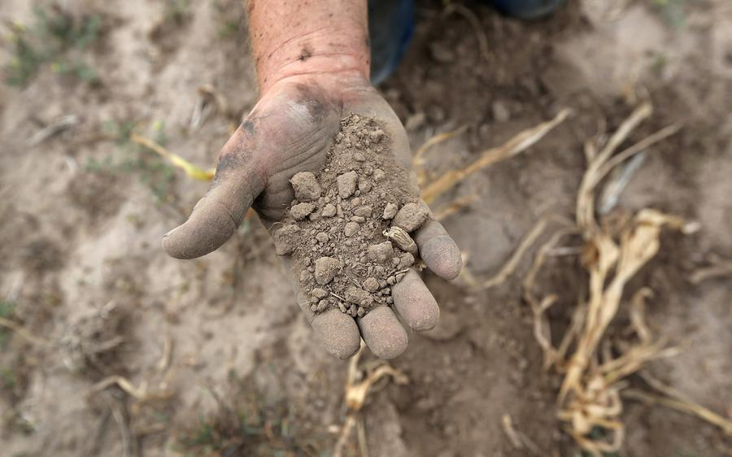
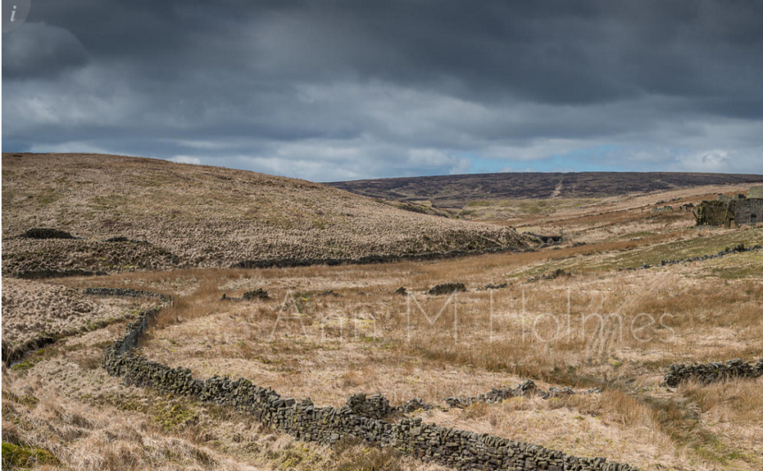
Falling precipitation and drought

Slide 15
Import from Russia , Kazakhstan and Ukraine

