Slide 1
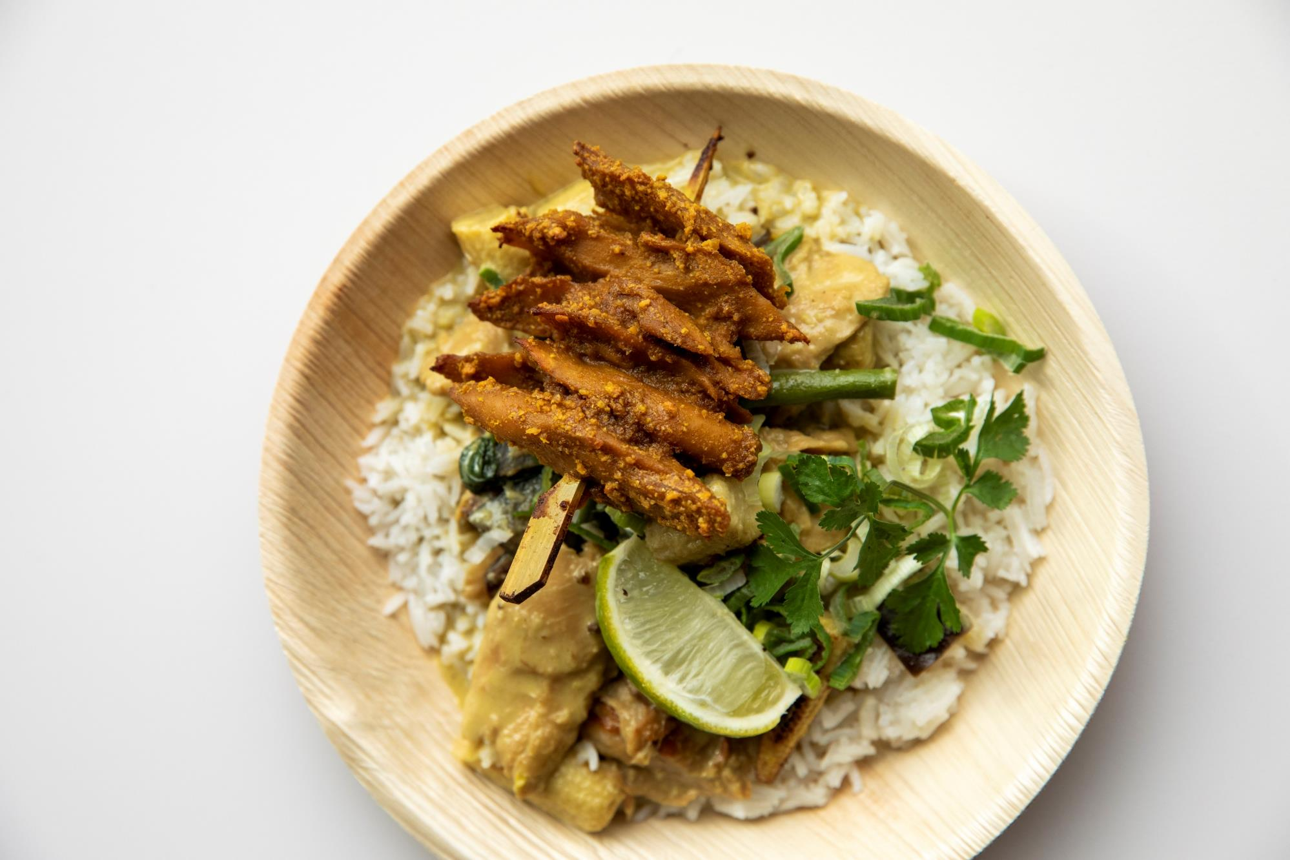
Alternative Protein Solutions
Iman Rahimi
May 2022
Innovations for a better world.

Slide 2
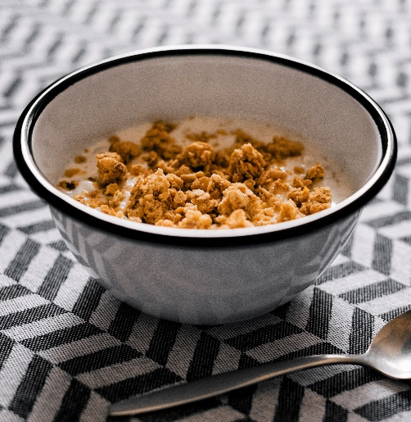
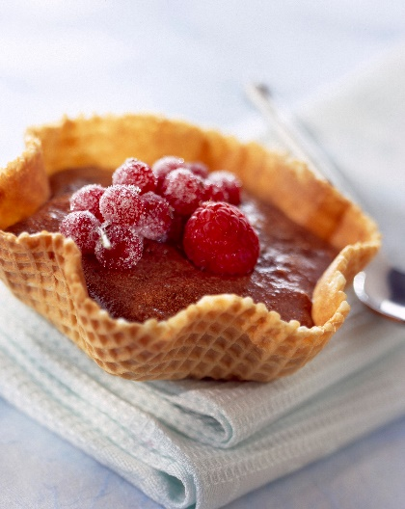
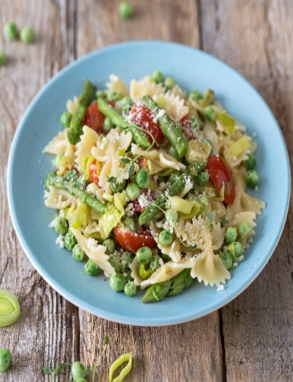
We Develop Manufacturing Equipment for Food and Mobility Billions of people come into contact with Bühler every day
Feeding 2 billion people every day
Moving 1 billion people every day
Bühler Annual Media Conference, Feb. 08, 2018, Swissmill, Zurich
Notes:
You may or may not be familiar with us, but we play a significant role in the food industry as a major machine & plant manufacturer for food producers, and we are also very involved in the automotive industry through our Advanced Materials division. We estimate that we are responsible for feeding 2 billion people every day. This is from our equipment in grain storage and handling, milling (so flour milling), but also in consumer products like chocolate, coffee, bakery, breakfast cereals, pet food and animal feed, and of course, alternative proteins & meat substitutes.

Slide 3
Urgency of global challenges is increasing. Business needs to become part of the solution.
The urgency of facing up to systemic challenges has intensified over the past year amid proliferating signs of uncertainty, instability and fragility.
WEF Risk Report 2019
Notes:
Mentioning global challenges (Drought and water shortage specially in Iran) and its effect on food industry.

Slide 4
Market Overview
1
Notes:
Now I’ll give you a brief overview of Buhler and what we do.

Slide 5
The cost of feeding the world today.
25%
70%
1/3
3/4
of global GHG emissions
is from agriculture
of total fresh water usage
for agriculture
of global energy
goes into food production from field to table
of all agricultural land
is used for meat & dairy (18% of all calories)
5
Notes:
Bring in the perspective of the Grain value chain. Where does our responsibility lie?
We owe our children a better legacy than this

Slide 6
Market: The Big Picture
The global food industry
is worth over
$6 trillion
The meat industry
is the biggest category in food, and it is globally worth
$1.4 trillion
Source: Barclays Analysis 2019
Notes:
Giving a landscape of the food industry and position of meat industry in it.

Slide 7
Global meat market forecast.
Novel vegan meat replacements
Source: ATKearney
Notes:
The plant-based meat market barely existed 10 years ago. Now, it is around 1-3% of the 2 trillion USD meat market and is projected to hit 10% in 2025. This might seem somewhat provocative but some groups predict that traditional meat could end up being overtaken by cultured meat, or cell-based. With plant-based meat close behind traditional meat. This is not just going to be driven by consumer interest but also by necessity – if we want to be able to feed 10 billion people in 2050 within the boundaries of our planet.

Slide 8
Bean to Burger
2
Notes:
Now I will give a short explanation of extrusion technology, maybe a quick refresher for those of you very familiar with extrusion.

Slide 9
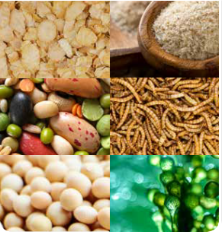
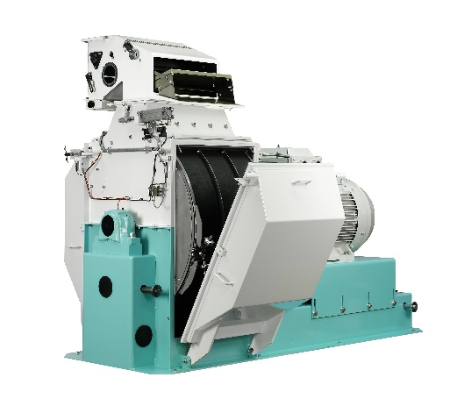
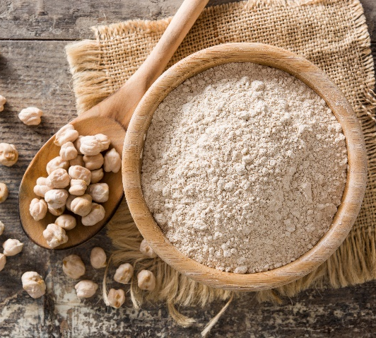
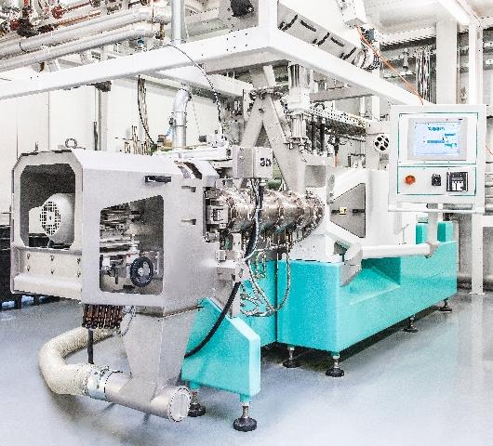
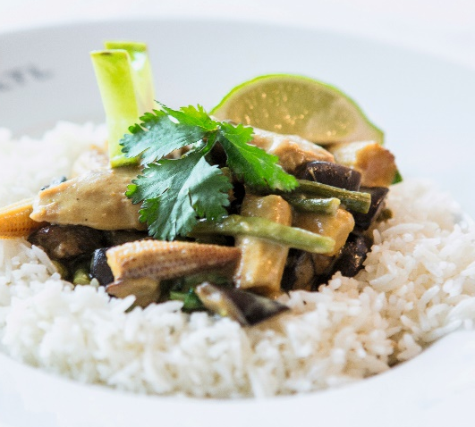
Solution provider along the protein value chain. Market leader from farm to fork.
Raw materials and novel
ingredients
Pre-grinding
Protein concentration /
isolation
Extrusion
Plant-based products
Notes:
Describe Buhler solution along the value chain for alternative protein. How to go from bean to burger!

Slide 10
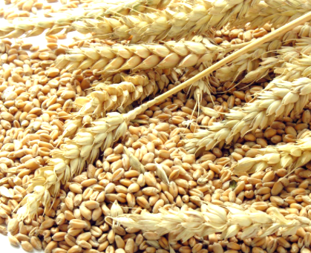
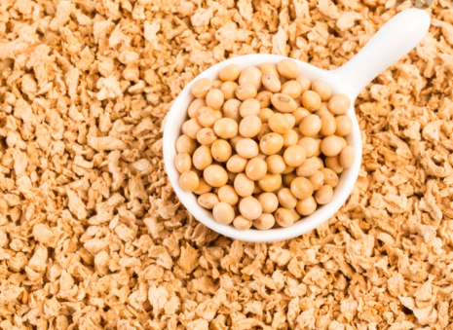
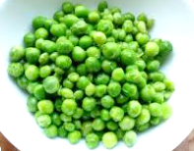
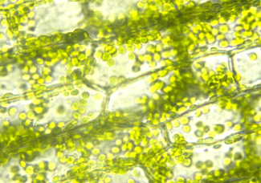
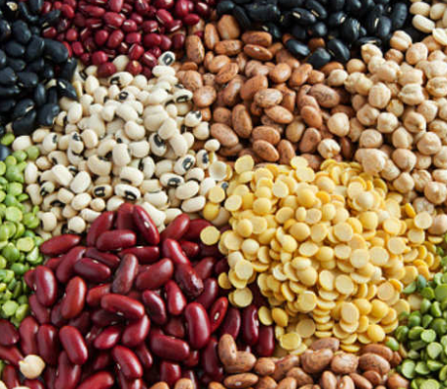
Common protein sources for meat analogues
WHEAT
SOY
PEA
MICROALGAE
PULSES
+ water, oils, flavors, fibers, salt, alkali/acid, …
Notes:
And many different options, and several suppliers, but the main ingredients we use are… and new sources are expected over the next 5 to 10 years…

Slide 11
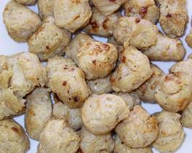
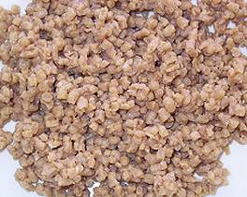
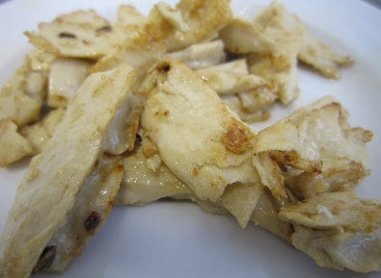
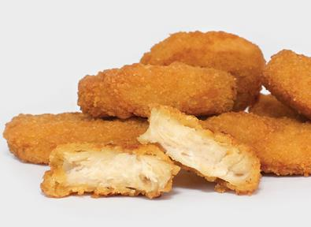
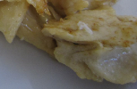
Types of extruded meat substitutes.
Dry Textured Products
Wet Textured Products
fibrous, spongy texture
fibrous, dense texture
shelf-stable, but rehydration
direct use, but chilled storage
End Products
Dry tex only
Wet tex only
Dry & wet tex
Meat & dry/wet tex
Notes:
There are two main types, dry and wet (or low moisture and high moisture)

Slide 12
Bühler Extrusion Solutions
3

Slide 13
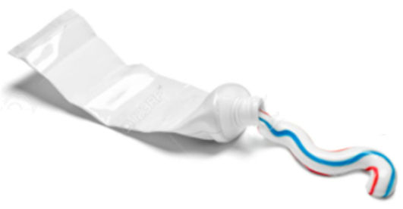
“A process by which a material is forced through a restricting orifice”
Powder + Water
Pressure
Die
Mixing
Cooking
Pressure build-up
Product Flow
Heat for cooking:
Screws turning: friction
Inject hot water + steam
Heat the barrels
Notes:
So basically extrusion is “a process…” One classic example of that could be a toothpaste tube where you apply pressure squeeze it out.
In extrusion we have the same concept, but we use turning screws inside of a barrel to apply the pressure. You mix together powder and water, and then inside the extruder you can mix the materials together, cook them to different temperatures, and then build up a pressure before the product exits the die at the end. For cooking, you generate heat by a few different ways - …
A bit later in this presentation we will go into a bit more detail into the heat addition.

Slide 14
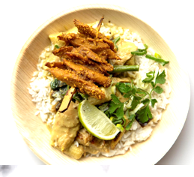
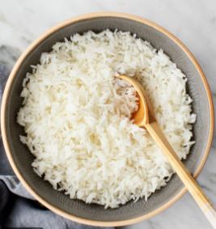
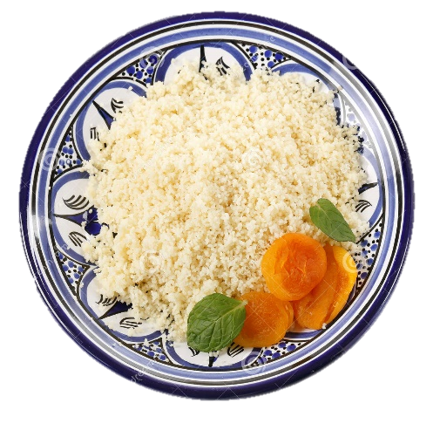
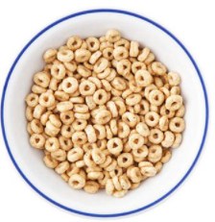
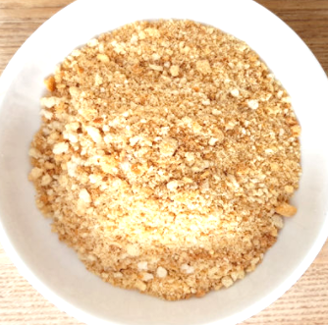
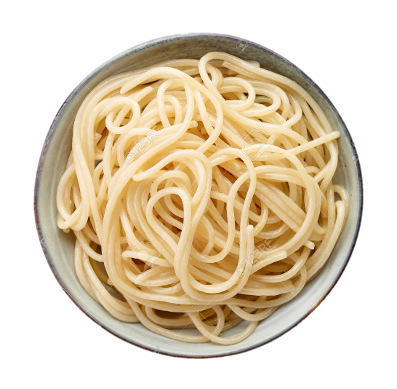
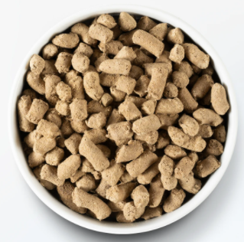
Extrusion at Bühler. Dozens of applications developed over the years
Cooking Extrusion
Cold Extrusion
Meat Analogues
Reconstituted Rice
Couscous
Breakfast Cereals
Pet Food
Breadcrumbs
Pasta and Noodles
Notes:
Extrusion is a quite versatile technology and you can make quite a lot of products. For example breakfast cereals, meat-substitutes from plant-based proteins, dog and cat food.
Recon rice – where you take the broken rice fragments and reconstitute it in an extruder (also while fortifying with vitamins). Breadcrumbs for frying, and much more.

Slide 15
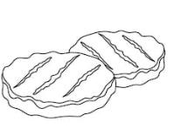
Dry textured meat substitute.
Water or steam addition
(optional precondition flavoring)
Drying
Protein
expeller cake, concentrate
Meat substitute
e.g. Hamburger
Dry premixing
Extrusion
Cutting
Rehydration and washing
Flavor
soaking
Gluing agent addition
Forming
mince, chunks or stripes
optional flavor and color addition
e.g. Methylcellulose or Transglutaminase
mix protein with flour and other ingredients
structure formation and reduction anti-nutrients
water addition to rehydrate the dry textrudates and remove anti-nutrients
for meat-like perception
Minced meat substitute or ingredient
e.g. for chili or curry
Dry textured products
Notes:
Dry textured meat substitute. Describe the process and what where can we interfere.
Small or big
Analog replaced by substitute

Slide 16
Wet textured meat substitute.
Water, steam and oil addition
(optional precondition flavoring)
Protein
concentrate
or isolate
Meat substitutes
e.g. shredded chicken
Dry premixing
Extrusion
Cooling die
Cutting
Forming
Freezing
Storage
Cooking
optional post-extrusion flavoring and seasoning
fibrous structure formation and reduction anti-nutrients
fiber addition
(optional iron or vitamin fortification)
to stabilize the created fibrous structure
Notes:
Wet textured meat substitute. Describe the process and what where can we interfere.

Slide 17
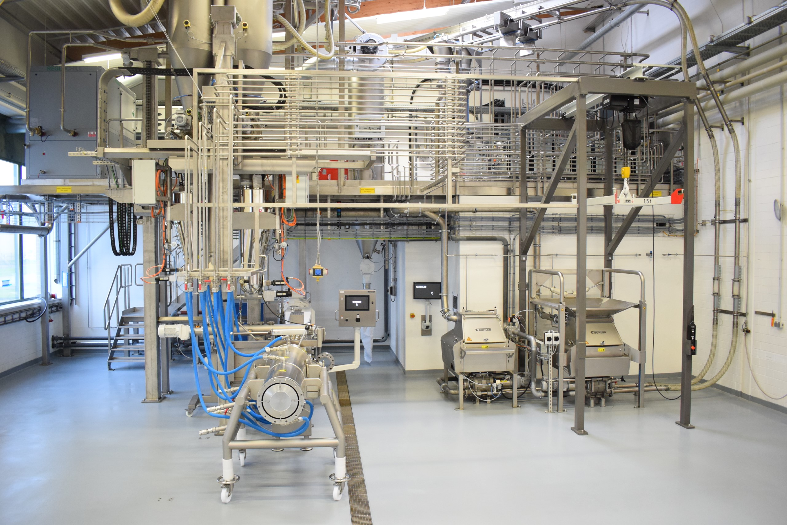
Notes:
Talk about the different phases … but the
Go through the line
Space between walls and line
Need spaces for big bags, moving carts around.
Not just footprint of the machines, also for general doing things
Problem of heat build-up if space is too small – that can also affect product quality
Nice waterproof ground, easy to clean (surface coating)
For cleaning – bring cooling die into wet room
But if there are leaks they have drainage system and slight slope so water drains properly
50-90 deg C for tempering water
Easy rollability… no obstacles.

Slide 18
Our Extruder Systems
 | BCTM | BCTL | BCTG | BCTF | BCTH
Screw diameter (mm) | 30 | 42 | 62 | 93 | 125
Throughput range dep. on product (kg/h) | 20-50 | 50-450 | 150-1400 | 500-4500 | 1000-8000
Notes:
Different size of our extruder and its capacity.

Slide 19
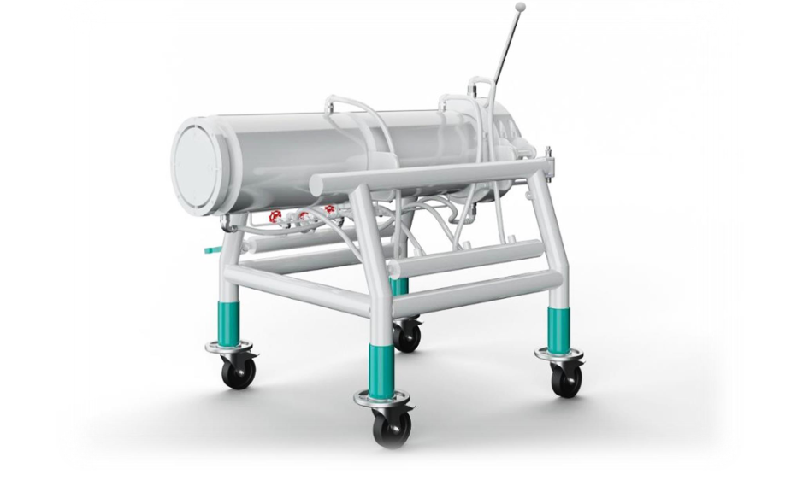
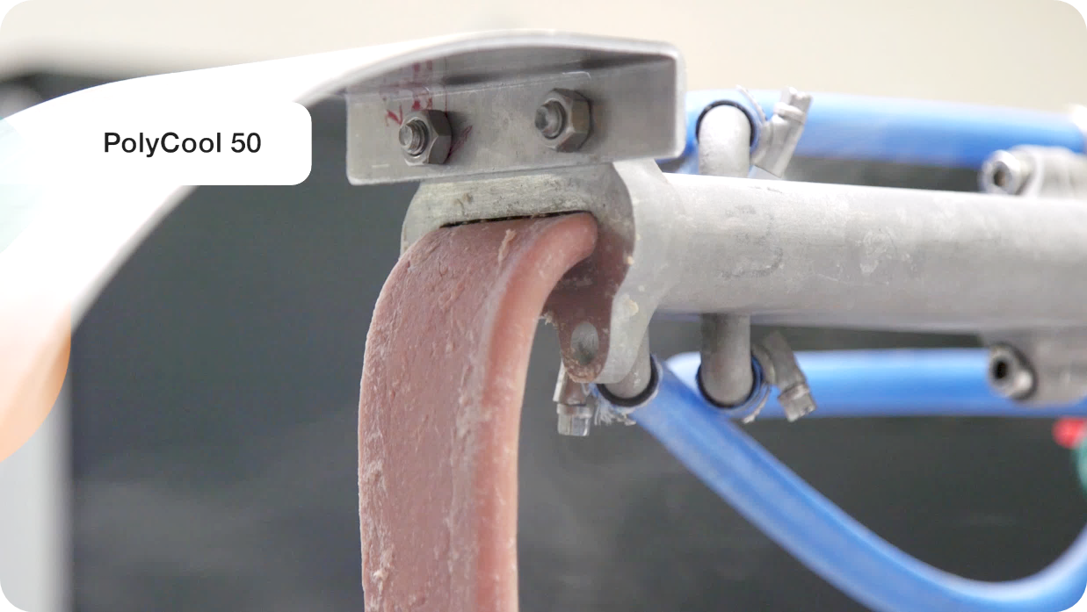
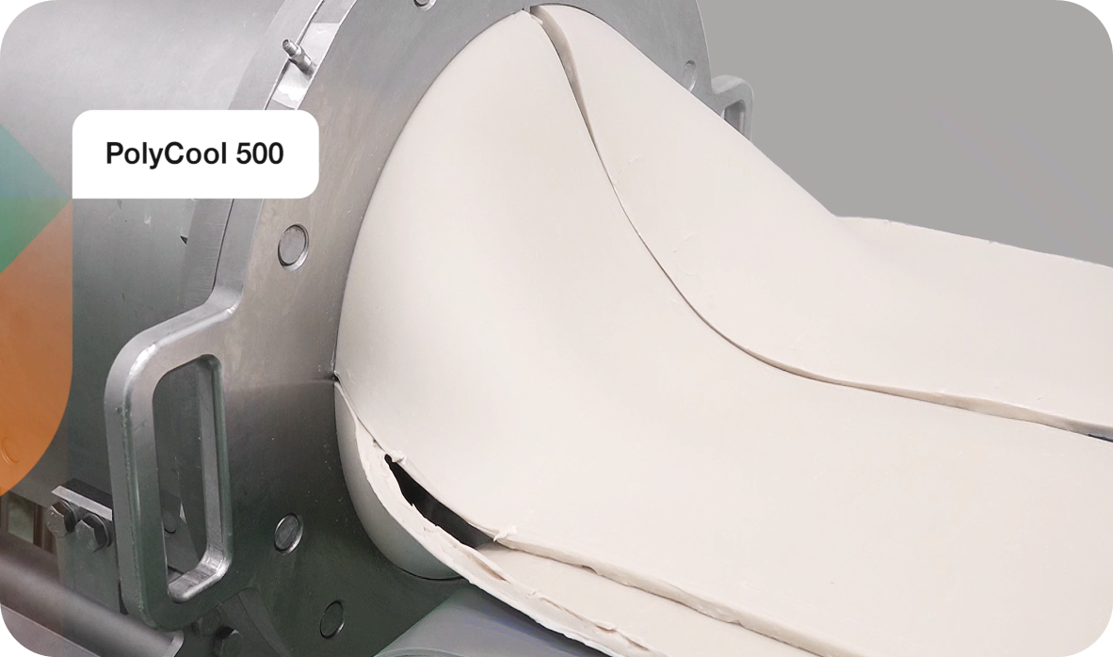
Our range of cooling dies. Bühler has the highest throughput solution on the market.
Extruder size | BCTM | BCTL | BCTG | BCTF | BCTJ
Screw diameter [mm] | 30 | 42 | 62 | 93 | 125
Polycool 50
Polycool 500/1000
~50 kg/h
~500 kg/h
~1000 kg/h
Notes:
Continue discussion on the capacity this time about the cooling die.

Slide 20
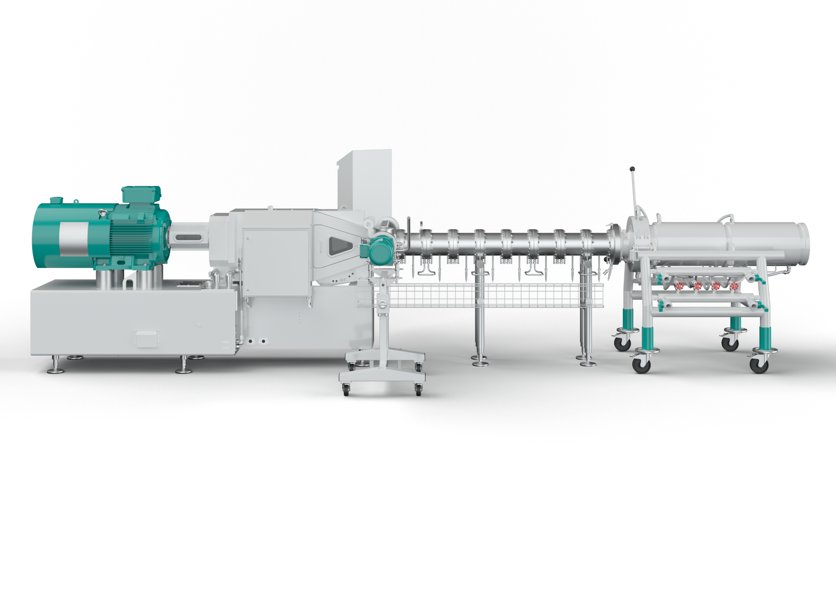
Cooling die, PolyCool 1000. Market leading solution.
High capacity: Throughput: 1000 kg/h (depending on product)
Precise output: Control individual cooling circuits
Flexibility: Wide range of raw materials
Maximized food safety: Easy to clean Electropolished surface
Fast installation: Easy to assemble
High profit: Industrial scale production in a growing high-demand market
Notes:
Talk about the cooling die feature advantages and benefit.

Slide 21
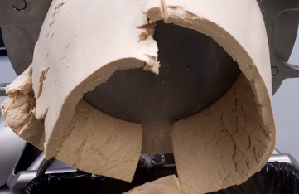
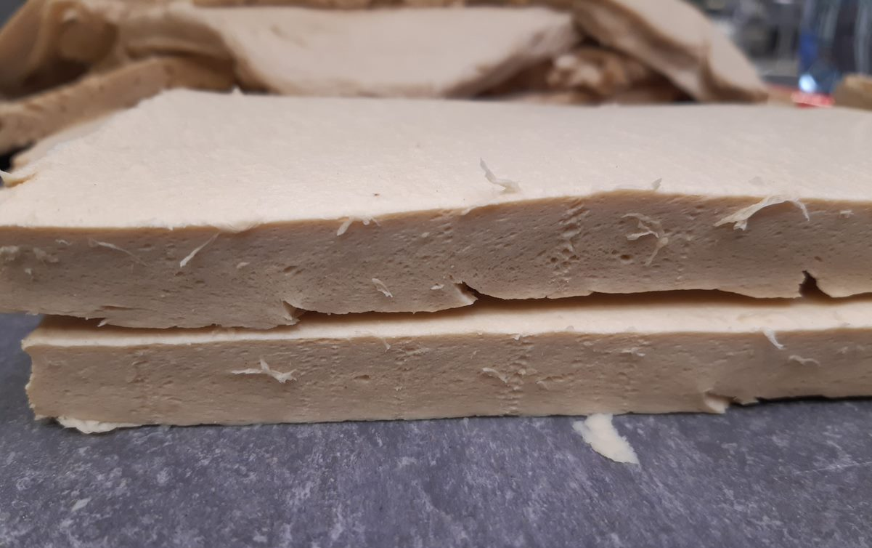
Protein Aeration Technology Added value in product characteristics
Microporous structure
Lighter colour - more like chicken
Thicker product
More flavour absorption
Biting properties and mouthfeel closer to meat
Reduced raw material costs – more volume and weight
Notes:
The protein aeration process and how it can result a better texture which is much closer to animal based protein.

Slide 22
Protein Aeration Technology
W/O Protein Aeration
0.05% Gas Injection
Notes:
The protein aeration process and how it can result a better texture which is much closer to animal based protein.

Slide 23
x

