Slide 1
ARCHEDA-PRODUCT
RELIABLE PARTNER IN EXPORT&IMPORT

Slide 2
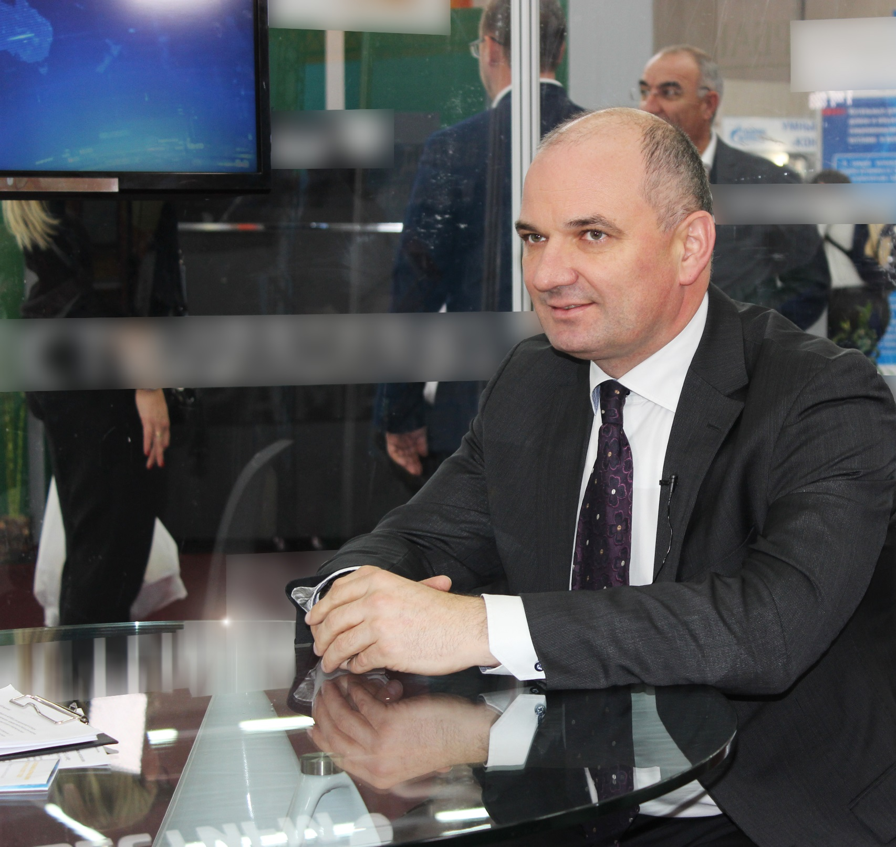
Owner of ARCHEDA-Product
Yury Goncharov
For more than 25 years of entrepreneurial activity
Since 1991, the founder of a holding company for the production of building materials
Since 2014, the founder of the waste paper collecting enterprise and the Green Leaf Ecological Culture Fund
Since 2020, the owner of Archeda-Product agricultural enterprise

Slide 3
Location

Slide 4
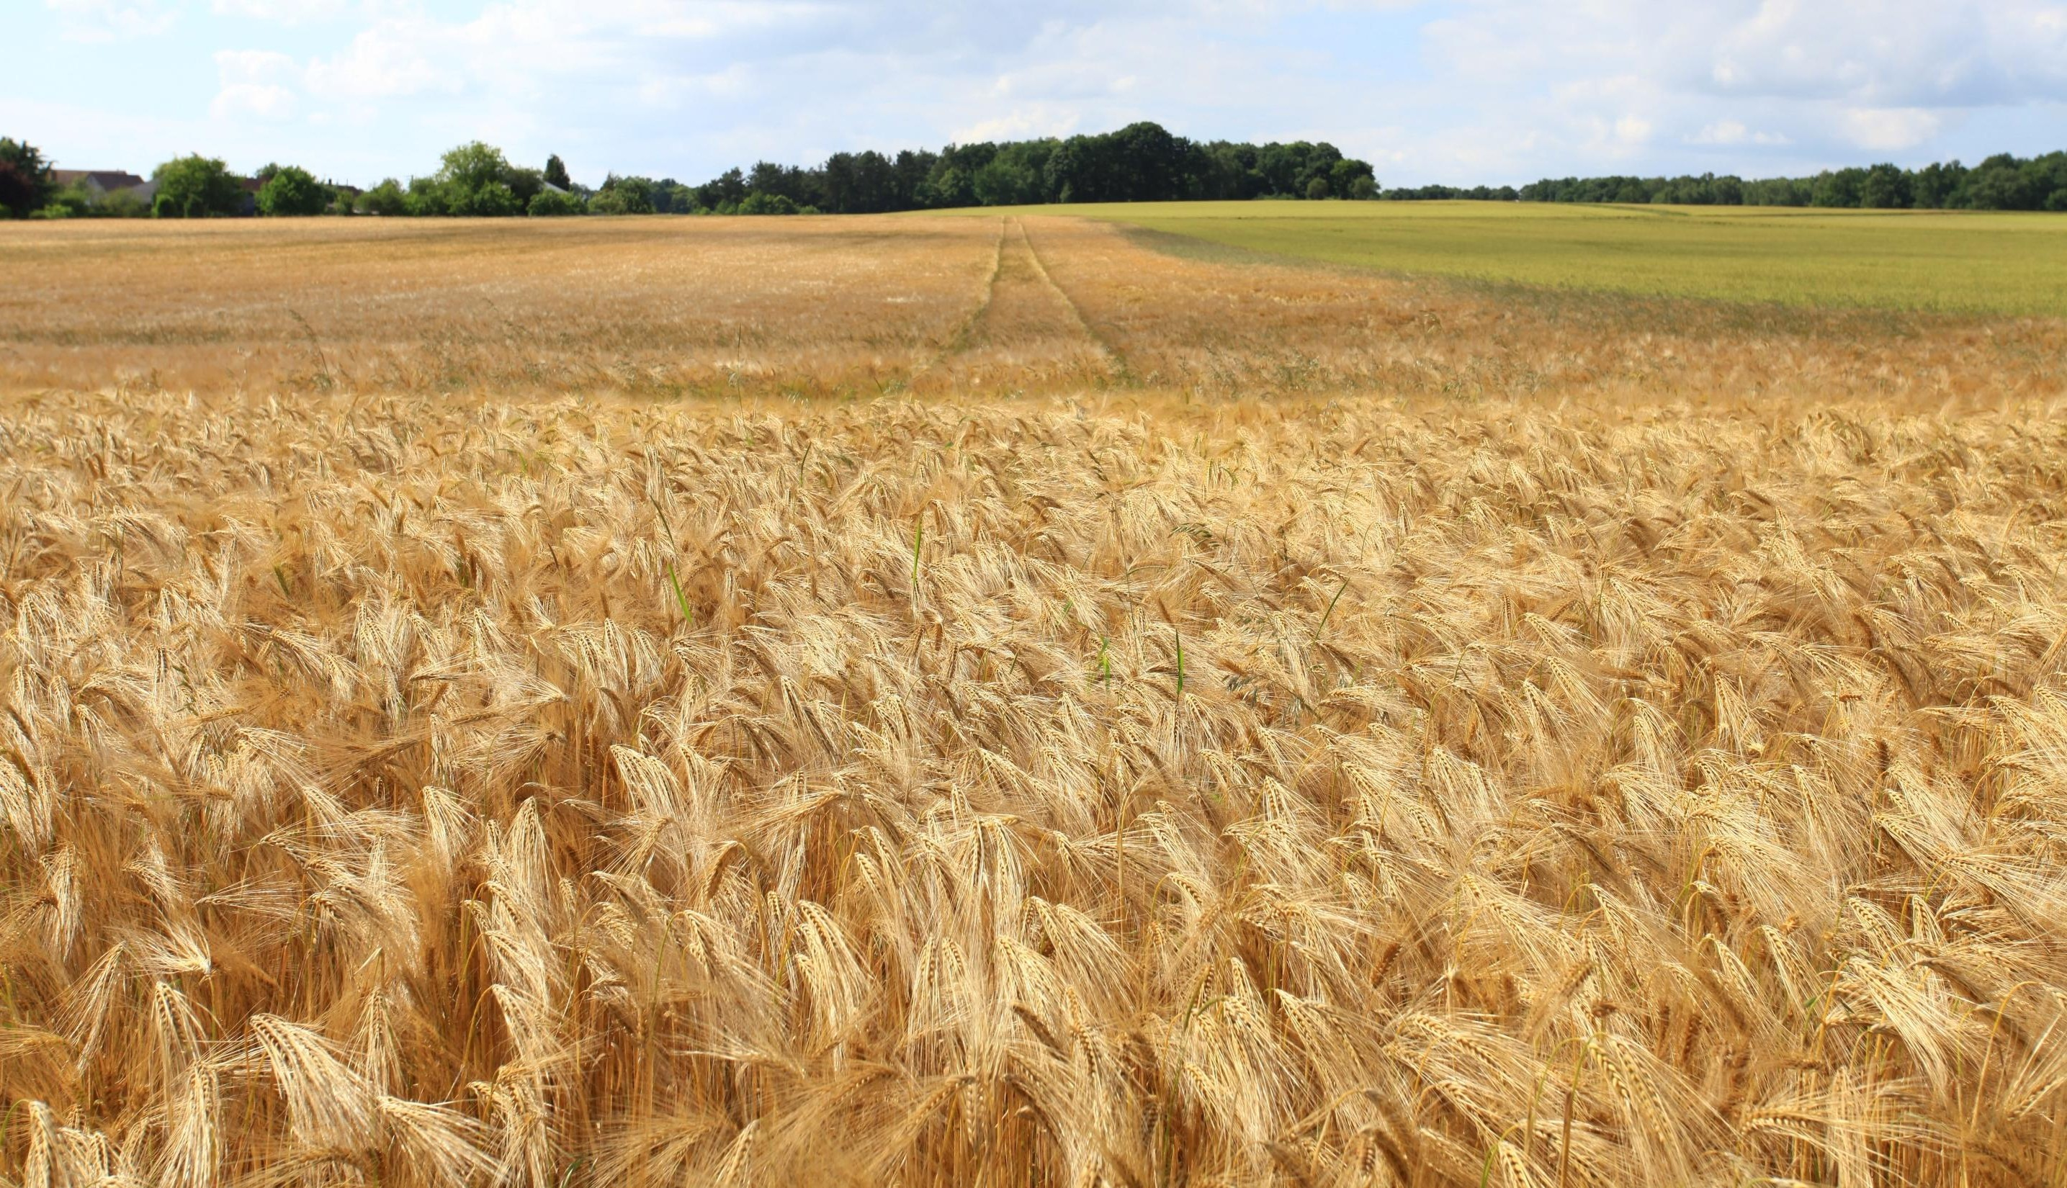
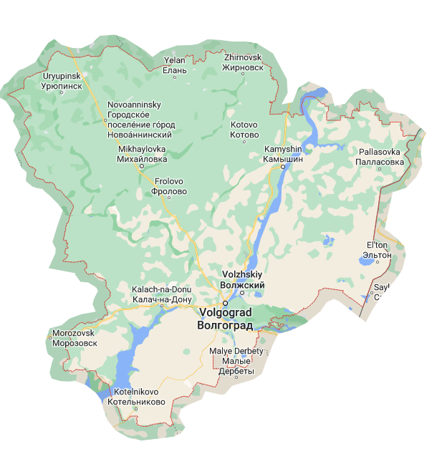
About Volgograd
region
The sown area of agricultural crops in the Volgograd region in
2021 amounted to 3077.1 thousand hectares,
forecast 2022 – 3171.00 thousand hectares.
Production of grain and leguminous crops:
2021 - 4126,1 thousand tons,
forecast 2022 – 4700,00 thousand tons.
Export in 2021 – 425.1 thousand tons
Production of oilseed crops:
2021 – 1473.9 thousand tons,
forecast 2022 – 1180.0 thousand tons.
Export in 2021 – 22.8 thousand tons
Volgograd region is an ecologically clean region of Russia and it is the 7th region in grain production in Russia

Slide 5
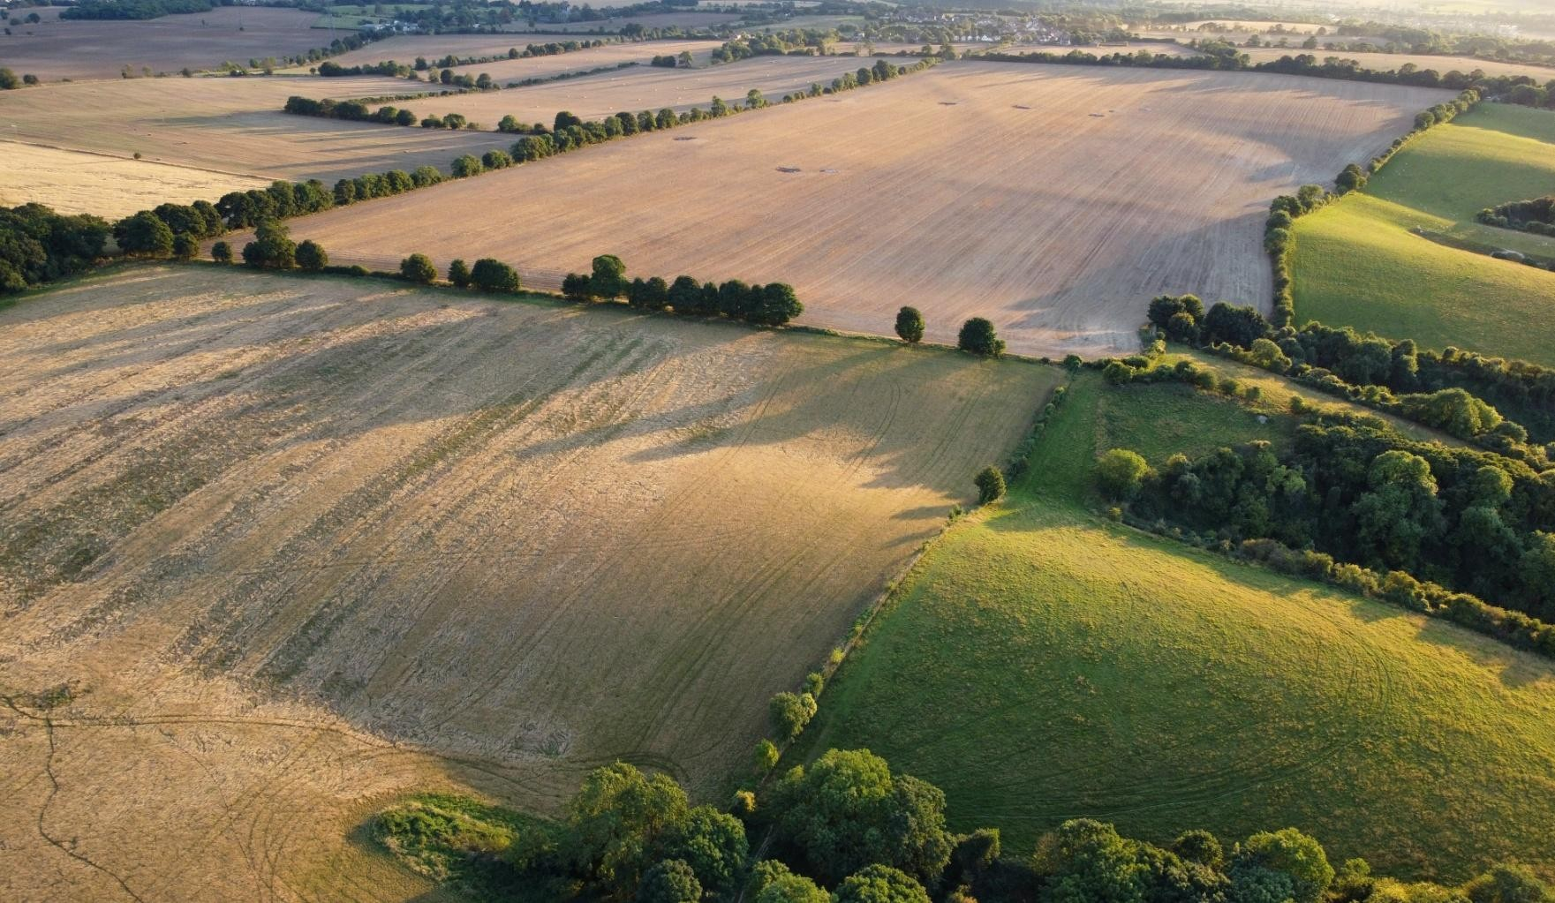
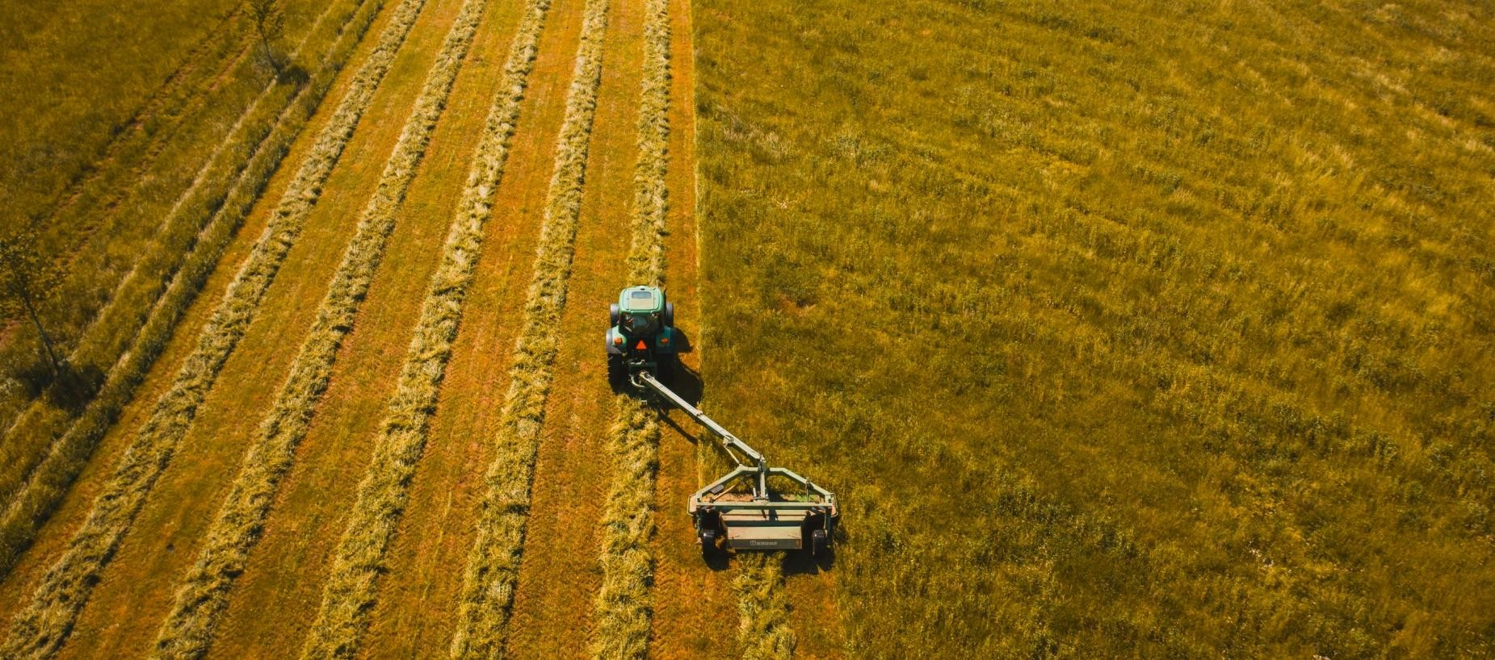
About Us Volgograd region
Sunflower seed
Acreage (thousand hectares) – 866.6 Milled (thousand tons) – 1349
Barley
Acreage (thousand hectares) -317.4
Milled (thousand tons) -544.9
Wheat
Acreage (thousand hectares) – 1551.5
Milled (thousand tons) – 3094.4
Corn
Acreage (thousand hectares)– 107,8
Milled (thousand tons) -364,8
Harvesting of all 4 crops Volgograd Region ranks
3rd in Russia in each category

Slide 6
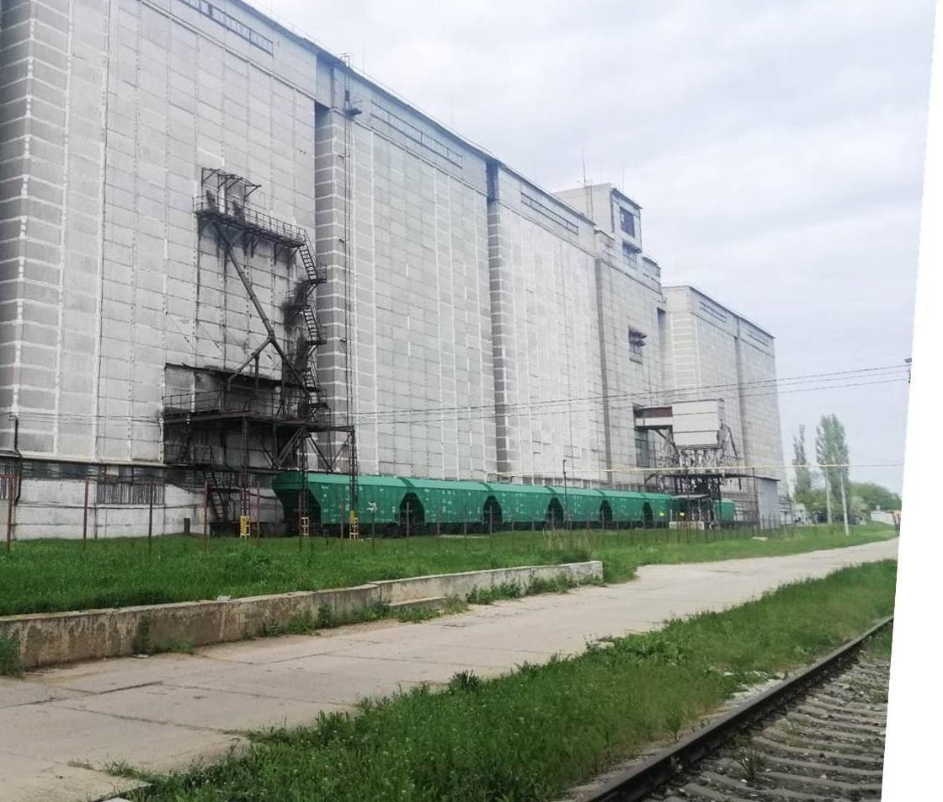
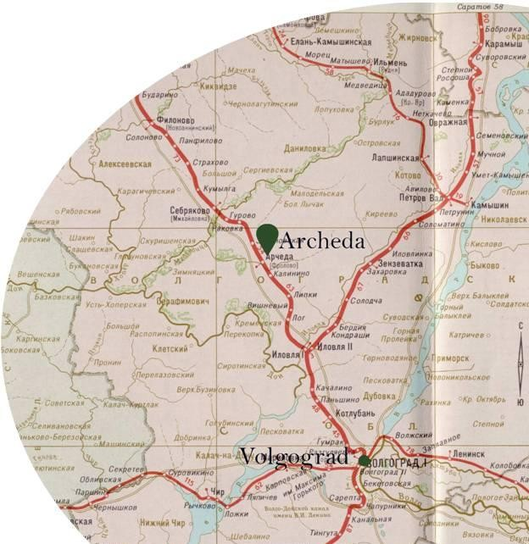
GRAIN ELEVATOR
Grain Elevator consists of 6 sections with 300 silos
Capacity: 63 000 t
Transport Access: railroad, motorway

Slide 7
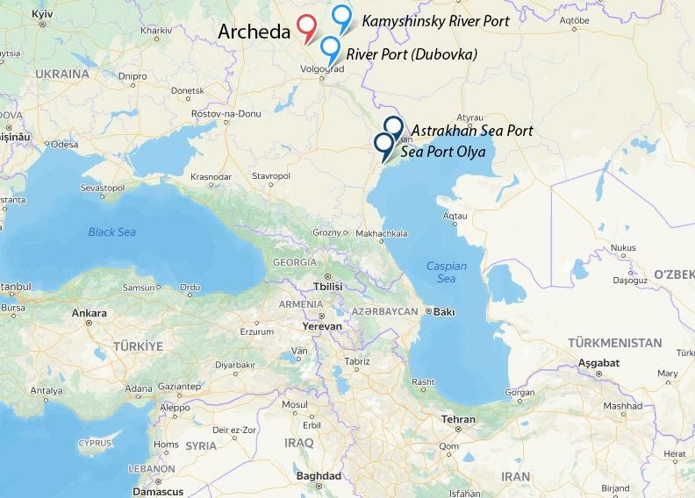
Convenient logistics
Location: Frolovo city, Volgograd region
550 km from Astrakhan Sea Port
660 km from Sea Port Olya
150 km from Kamyshinsky River Port
160 km from River Port (Dubovka)
Grain shipment by railroad and by sea
Cargo capacity of vessels – up to 3000 tons

Slide 8
OUR PRODUCT
High-quality cereal flakes (wheat, rice, barley, millet, rolled oat of different duration of cooking) instant porridges, various types of flour and muesli
Capacity: 20 000 t/year
Grain: wheat, barley, corn, millet, sunflower seed

Slide 9
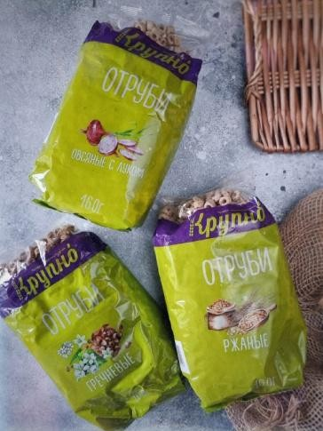
Product range under the brand
“KRUPNO”
11 types of single grain cereals
5 types of multi-grain cereals
4 types of flour
muesli
variety of bran
whole grain products in Boil-In-Bags

Slide 10
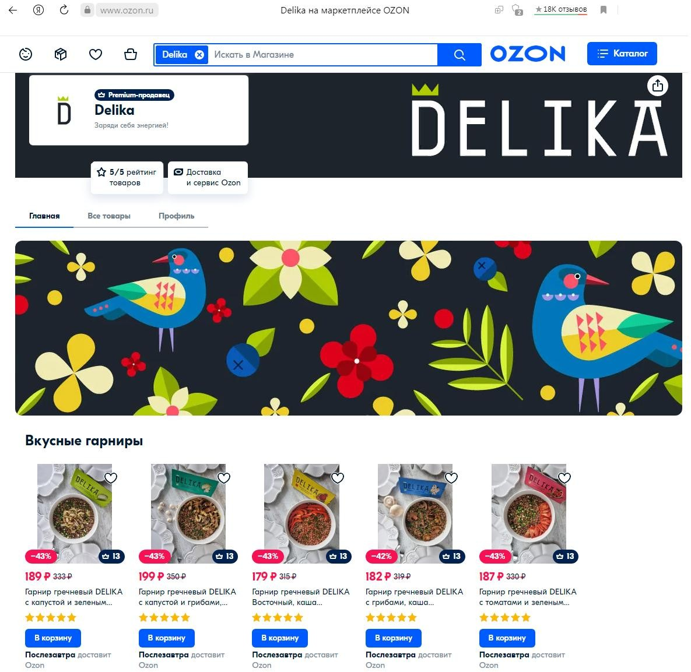
Product range under the brand “DELIKA”
Instant porridges and cereals
Instant side dishes

Slide 11
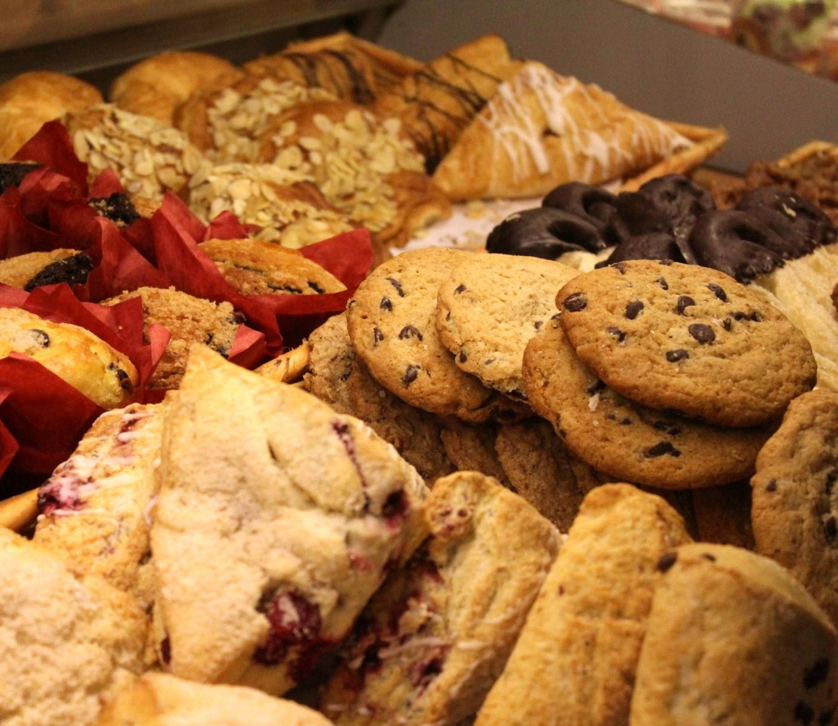
B2B opportunities
Rolled oat (or other grain flakes) supply in 25 kg bags for package under Your own brand and for confectionary production (biscuits, sweets)
Oat flour supply in 35 kg bags for confectionary and beverage production
Shipment in 20”and 40” containers

Slide 12
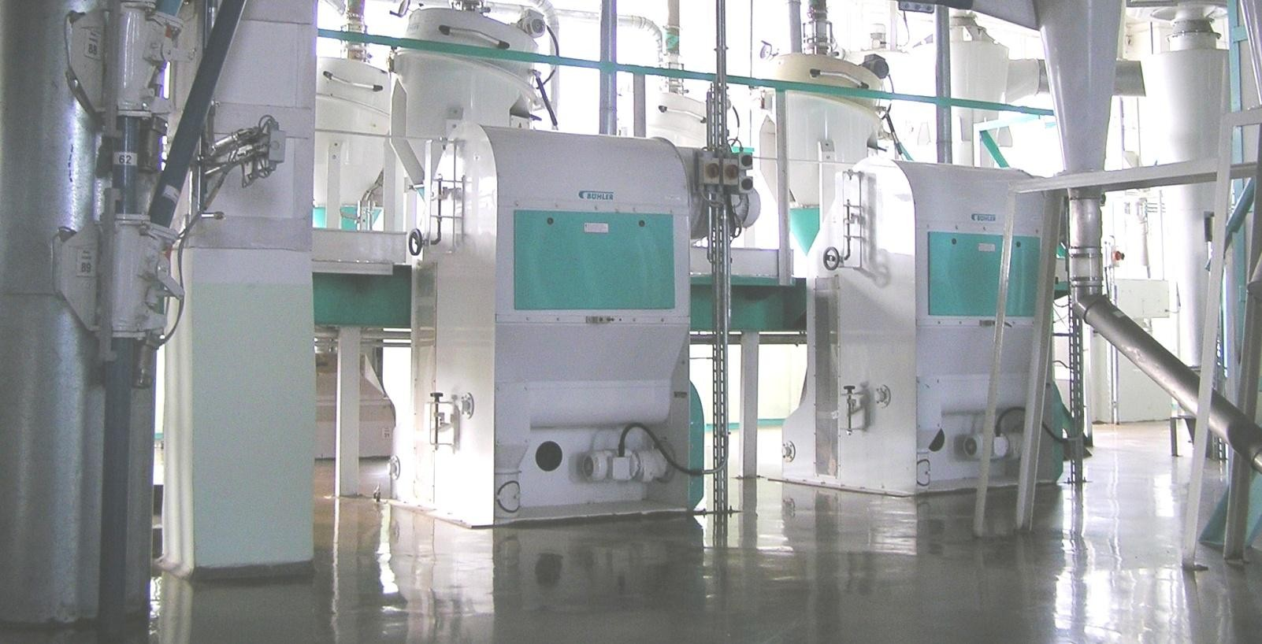
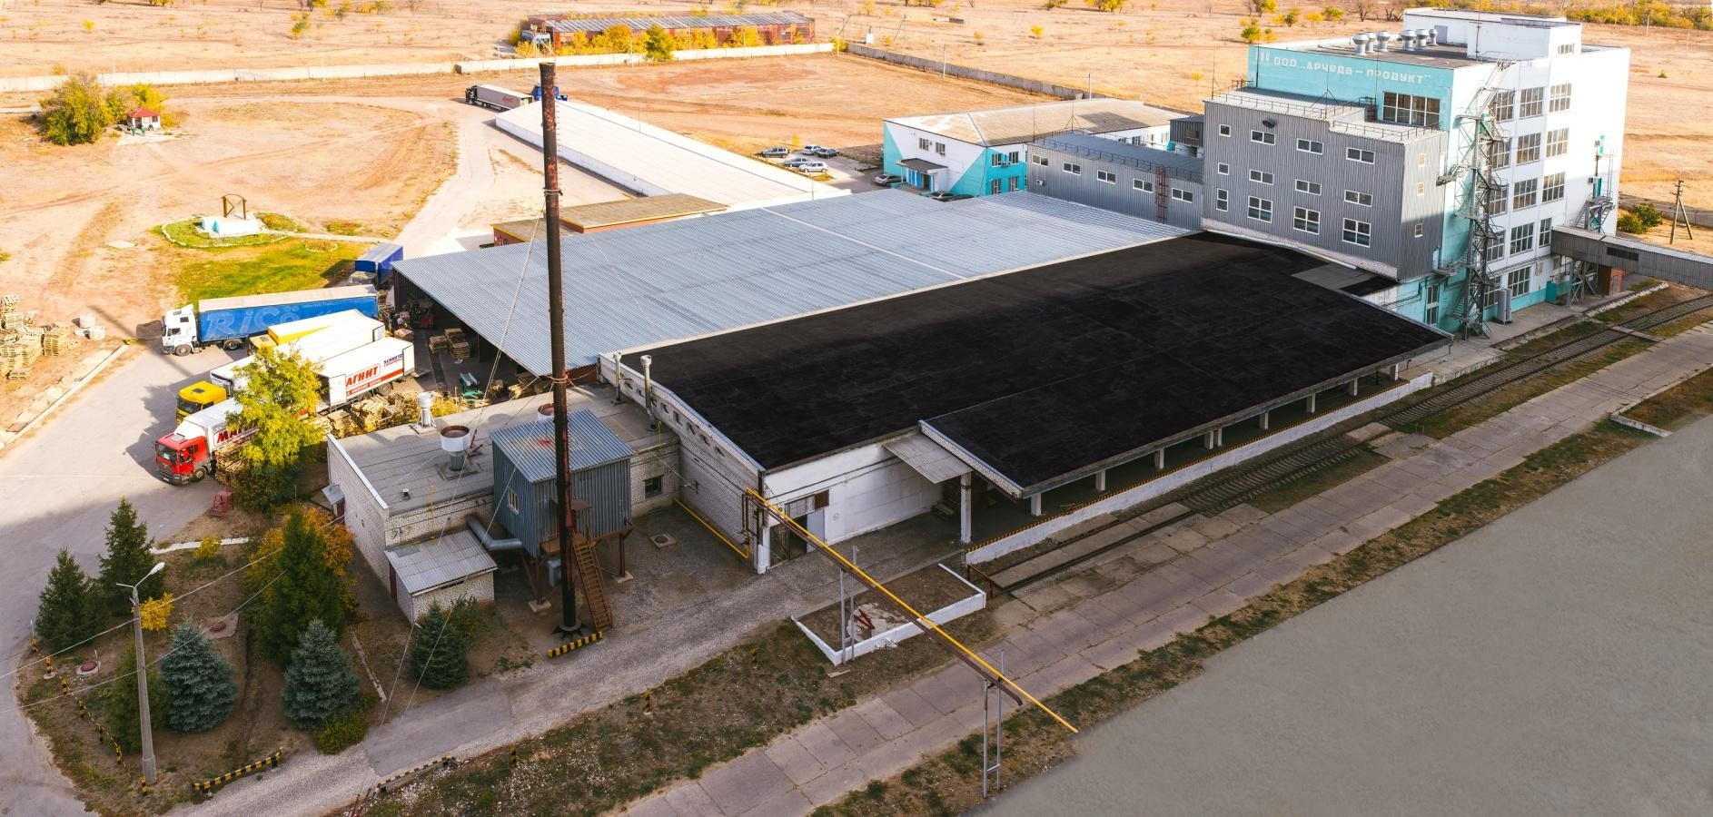
ARCHEDA-PRODUCT ADVANTAGES
High quality product is guaranteed due to up-to-date quality control system and European equipment (Buhler)
Direct contracts with farmers on the field
Archeda-Product is yearly awarded as the
best product in Russian market

Slide 13
Cooperation Opportunities
Oat flakes supply in small packaging under a well-known Russian brand or in Your packaging or in bags of 25 kg
Possible contractual relations for the grain export (wheat, corn, barley) as a Supplier

Slide 14
OUR CONTACTS
ARCHEDA-PRODUCT
Address: 403518 Russia, Volgograd region, Frolovsky district, territory of Suburban settlement, 15/2
Owner
Yury Goncharov, +79610570303
Managing Director
Svetlana Ovchintseva, +79033274799
Export & Import manager
Nataliia Tonkikh, +79608670409
secretar@archeda.ru
www.archeda.ru krupnodelika

