Slide 1
Blockchain & Agri-trading
Iran Grain
Filipe Pohlmann Gonzaga
May/22

Slide 2
Table of contents
What blockchain is
Blockchain in the grain value-chain
Focus on Iran
Overview of what is blockchain
How can this technology be used in grain trading
Specific uses of blockchain in grains
Real world cases
Pros & Cons
Questions?

Slide 3
What blockchain is
Blockchain in the grain value-chain
Focus on Iran
Overview of what is blockchain
How can this technology be used in grain trading
Specific uses of blockchain in grains
Real world cases
Pros & Cons
Questions?

Slide 4
What is blockchain?
Blockchain is a shared, immutable ledger that facilitates the process of recording transactions and tracking assets in a business network. An asset can be tangible (a house, car, cash, land) or intangible (intellectual property, patents, copyrights, branding). Virtually anything of value can be tracked and traded on a blockchain network, reducing risks and cutting costs for all involved.

Slide 5
BORING

Slide 6
Promises
Decentralized
Sometimes, someone would promise a product in exchange of something now.
Therefore, the villagers decided that all transactions would happen in front of everyone, and all would keep a record.
Scalability
Blockchain is like those recordings, but digital, in order to be scalable. The token, nothing more than this contract of a real asset.
Barter
Centralized
In a little village of 10 families, they would barter between them, to get all food they need.
As promises were not being held on, they put someone in charge of taking notes, but this person could be corrupted.

Slide 7
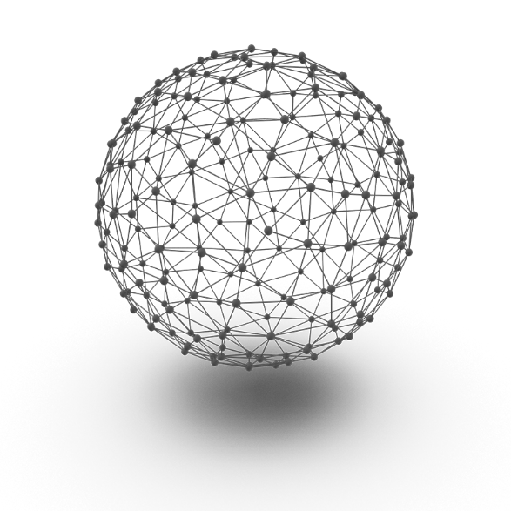
Blockchain ecosystem
Blockchain ecosystem
Cryptocurrency
Exchanges
Payments
Doc Authentication
Smart Contracts
Tokens
Peer to Peer transactions
De-centralization
Transparency / Traceability

Slide 8
Let’s get to what matters….

Slide 9
Bitcoin

Slide 10
& let’s all get rich by tomorrow

Slide 11
Sorry….

Slide 12
What is blockchain
Blockchain in the grain value-chain
Focus on Iran
Overview of what is blockchain
How can this technology be used in grain trading
Specific uses of blockchain in grains
Real world cases
Pros & Cons
Questions?

Slide 13
Applied blockchain: Grain Trading
Contracts
04
Trade
Finance
06
02
05
03
07
Marketplaces
08
01
Traceability
Immutability
Digital Representation
Payments

Slide 14
Beyond the surface: TOKENS
Digital representative of physical assets
Proof of originals
Documents inside the token, recorded on blockchain
Proof of ownership
Unique hashes to unique wallets
Transferability / Collateral
Digitalization
Ownership
The elimination of counterparty risk
Automatically payments according to contract conditions
Triggers to the contract’s payment execution
Strings & Circles: Automatization
Automatically settling strings and circles
Traceability of ownership
Smart Contracts
Paper Trade

Slide 15
Use cases examples

Slide 16
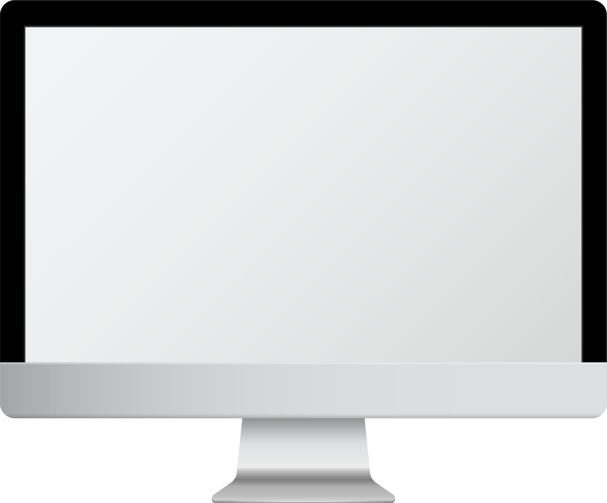
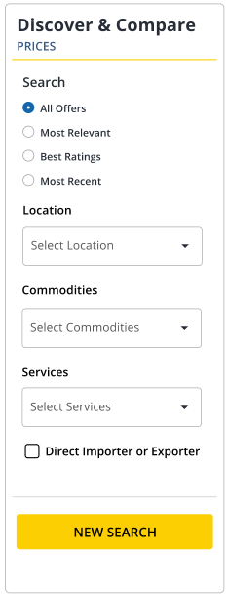
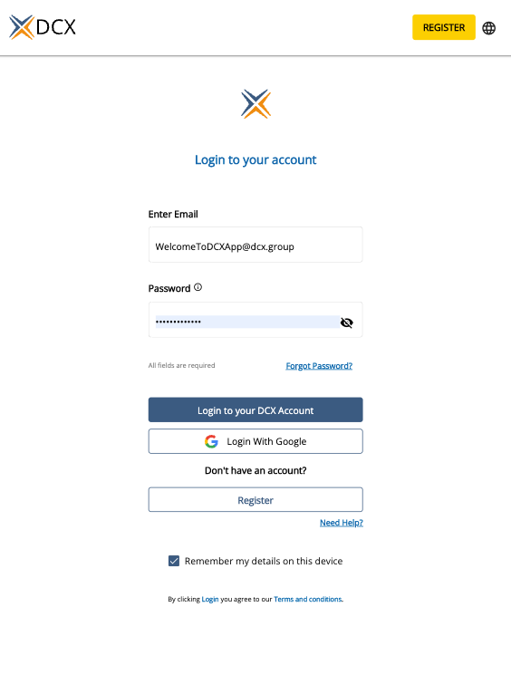
Case: DXC – Grains Marketplace

Slide 17
Case: Cerealia/Grupo Ceres/MYC
Weight
Extract of registry of
Incoming waybills
Quality
Quality Protocol
Cerealia
Tokenization
Token
FCR
Forward counter
receipt

Slide 18
Case: GreenEmissions
Farmers
GreenEmissions
Buyer
CO₂
Credit
Biomass Binding
Farmer
Receive
Cash for Tokens
Final Buyer
Create Tokens
Token
GE Satellite Motoring : automatic payment trigger
Notes:
Story tell the Mexico farmer business + Buyer; how it generates values to GE, Farmer, Client

Slide 19
What is blockchain
Blockchain in the grain value-chain
Focus on Iran
Overview of what is blockchain
How can this technology be used in grain trading
Specific uses of blockchain in grains
Real world cases
Pros & Cons
Questions?

Slide 20
Use cases
Price Discovery
Traceability
Marketplaces: online price catalog
Price comparison
- Easy to monitor, settle and verify
Hedging
Payments
Futures markets not focused on EM’s like Iran
Opportunities for futures-like contracts
Decentralized payment systems: no sanctions
Automated settlements
Contracts
Execution
Possibility of using digital e-templates: cost reduction
Document storage and verification
Fraud proof
Digital signatures
Certainty of original

Slide 21
Pros & Cons
Streamline execution and contracts
Legal enforceability: tokens & blockchain
ADVANTAGES
Reduction / elimination of counterparty risk
Blockchain: timing/ Internet/ access
DISADVANTAGES
Liquidity of existing marketplaces
Settlements

Slide 22
Blockchain & Agri-trading
Iran Grain
Filipe Pohlmann Gonzaga
filipepgonzaga@gmail.com
May/22

