Slide 1
Iran Grain July 2023
Shipping
and
Logistic Panel
Tehran July 2023

Slide 2
Iran Grain July 2023
Head of BOD of Seawaves Shipping Services
Fellowship & Official member of Institute of chartered shipbrokers UK (ICS).
MSe Shipping, Trade and Finance from Cass Business School , City University London, UK
MEng Mechanical Engineering from University of Birmingham, UK
Amir Mehdi Khoshoie

Slide 3
Shipping and Logistic Panel
Freight rates of Supramax and Panamax vessels
Spot voy from Brazil to Iran basis 8k/8k load Disch rates btw usd 40-48 pmt
TC rates are dropping less than USD 10,000 pdpr
Drop of demurrage rates on Panamaxes from Usd 30,000 to USD 20,000 within last 6 months
To be continued in future months
Iran Grain July 2023

Slide 4
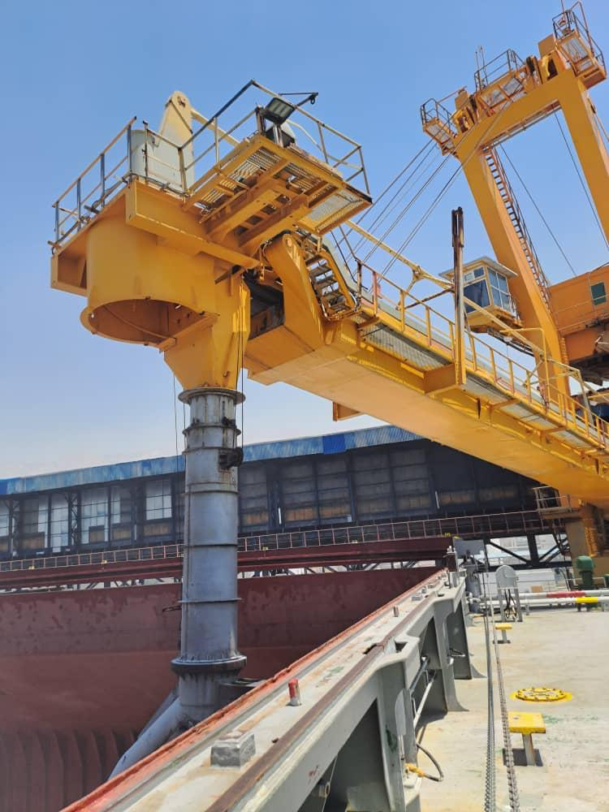
Shipping and Logistic Panel
Demurrage/Despatch
From 4000 mt to 5000 mt per day before
To 10,000 mt to 15,000 per day now
Max up to 22,000 mt per day as a record in BIK
Despatch happens in most cases now ; subject to have
clear financial and documents status
Ship Owners obstacles due to delay in discharge
Keeping their vessels in Oman & UAE
If in Iranian water anchorage , issues like Bunker VLSFO and VLSMGO
Ship Maintenances and issues
Iran Grain July 2023

Slide 5
Iran Grain July 2023
Shipping and Logistic Panel
Thank You

