Slide 2
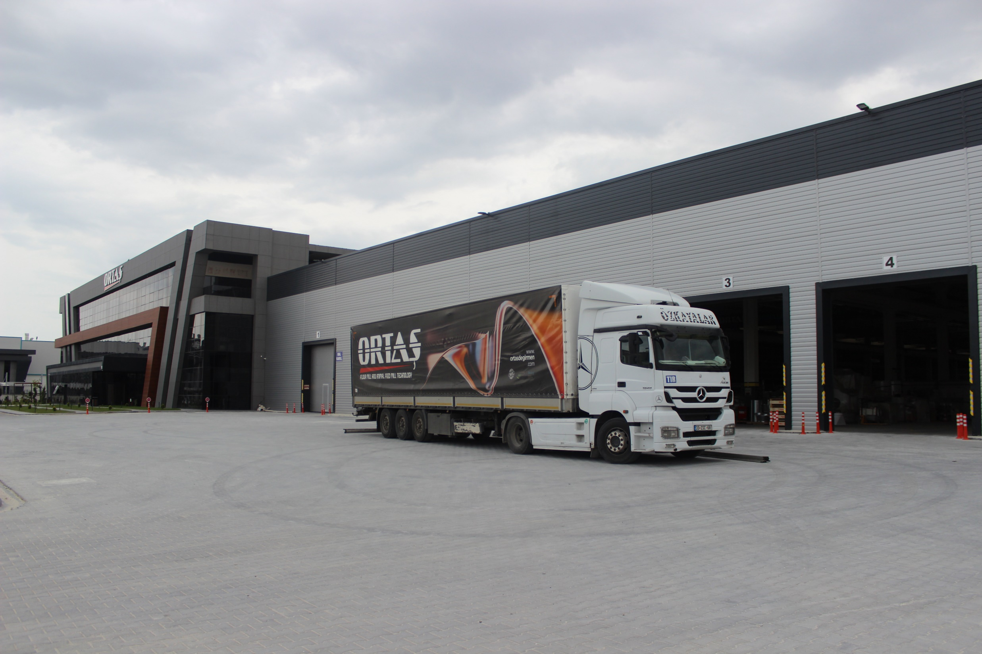
Ortaş Milling has managed to become a reliable company by producing competitive products with its technical infrastructure and experienced staff since its establishment in 1996. In accordance with the quality management procedures, Ortaş Değirmen constantly renews itself and follows the changing technology, examines and meticulously handles all project details from R&D, production of machinery, shipment and establishment. It fulfills the projects of flour, semolina and feed factories with standardized production, quality, durability and after-sales services.

Slide 3
«Ortas Milling» company provides services that include all processes:
• Turnkey multi-stage and compact production: wheat flour, animal feed, corn and semolina factories; • Construction of systems for storage and processing of grain; • Construction of steel structures; • Creating and improving diagrams; • Automation of production; • Analysis of production and equipment upgrades; • Laboratory equipment; • Guaranteed supply of spare parts for 10 years; • Training and consulting support for employees;

Slide 4
«Using our machinery and the latest technologies, we help grain processors to reduce energy consumption and increase the quality and quantity of finished products.»
Our individual work with each project and our group of engineers in the program format calculates the entire complex with an error of 0.3%.
The indisputable advantages of all models and modifications of our machinery are mobility and autonomy:
Low energy consumption;
Huge range of spare parts;
Warranty service;
Cooperation with European brands of components;
Experience from the past;
Commitment to future technologies;
Targeting customer satisfaction at the top level;
High quality with European standards at competitive prices;
Satisfaction with on-time deliveries;

Slide 5
Our Mission & Vision
• Mission: To maintain our understanding of service by offering the right quality-price for every product and service we offer to our customers with our new inspiration coming from the old tradition.
• Vision: To be the best in the industry with the most innovative technologies worldwide.

Slide 6
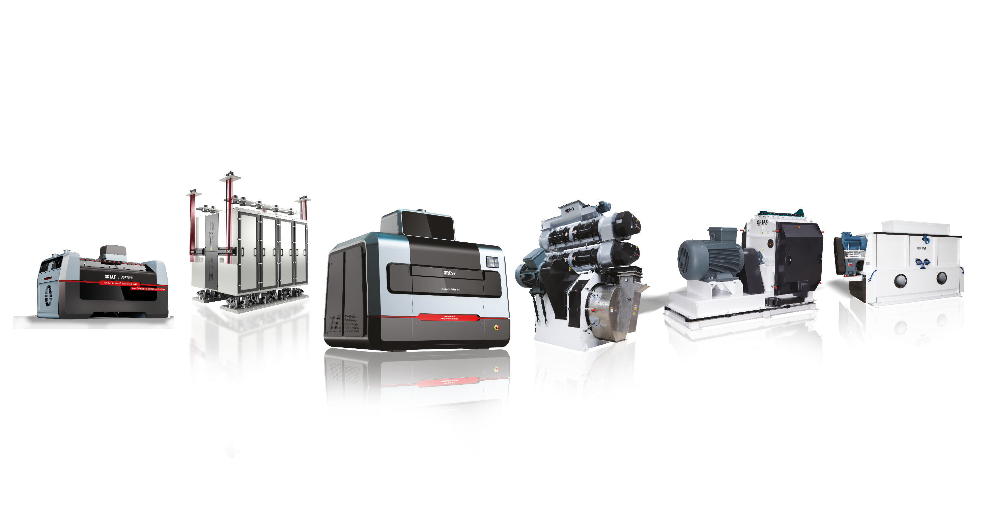
OUR PRODUCTS
Turnkey Flour and Semolina Factories
Multi Storey Milling Factories
Steel Construction Milling Factories
Pneaumatic Cylinders
Square Sifting Systems
Semolina Purifier
Cleaning Systems
Conveyor Systems
Automotion
Packaging Systems
Storage Systems
Milling Laboratuary Tools
Animal Feed Factories
Pellet Press
Animal Feed Mixers
Dosing Systems

Slide 7
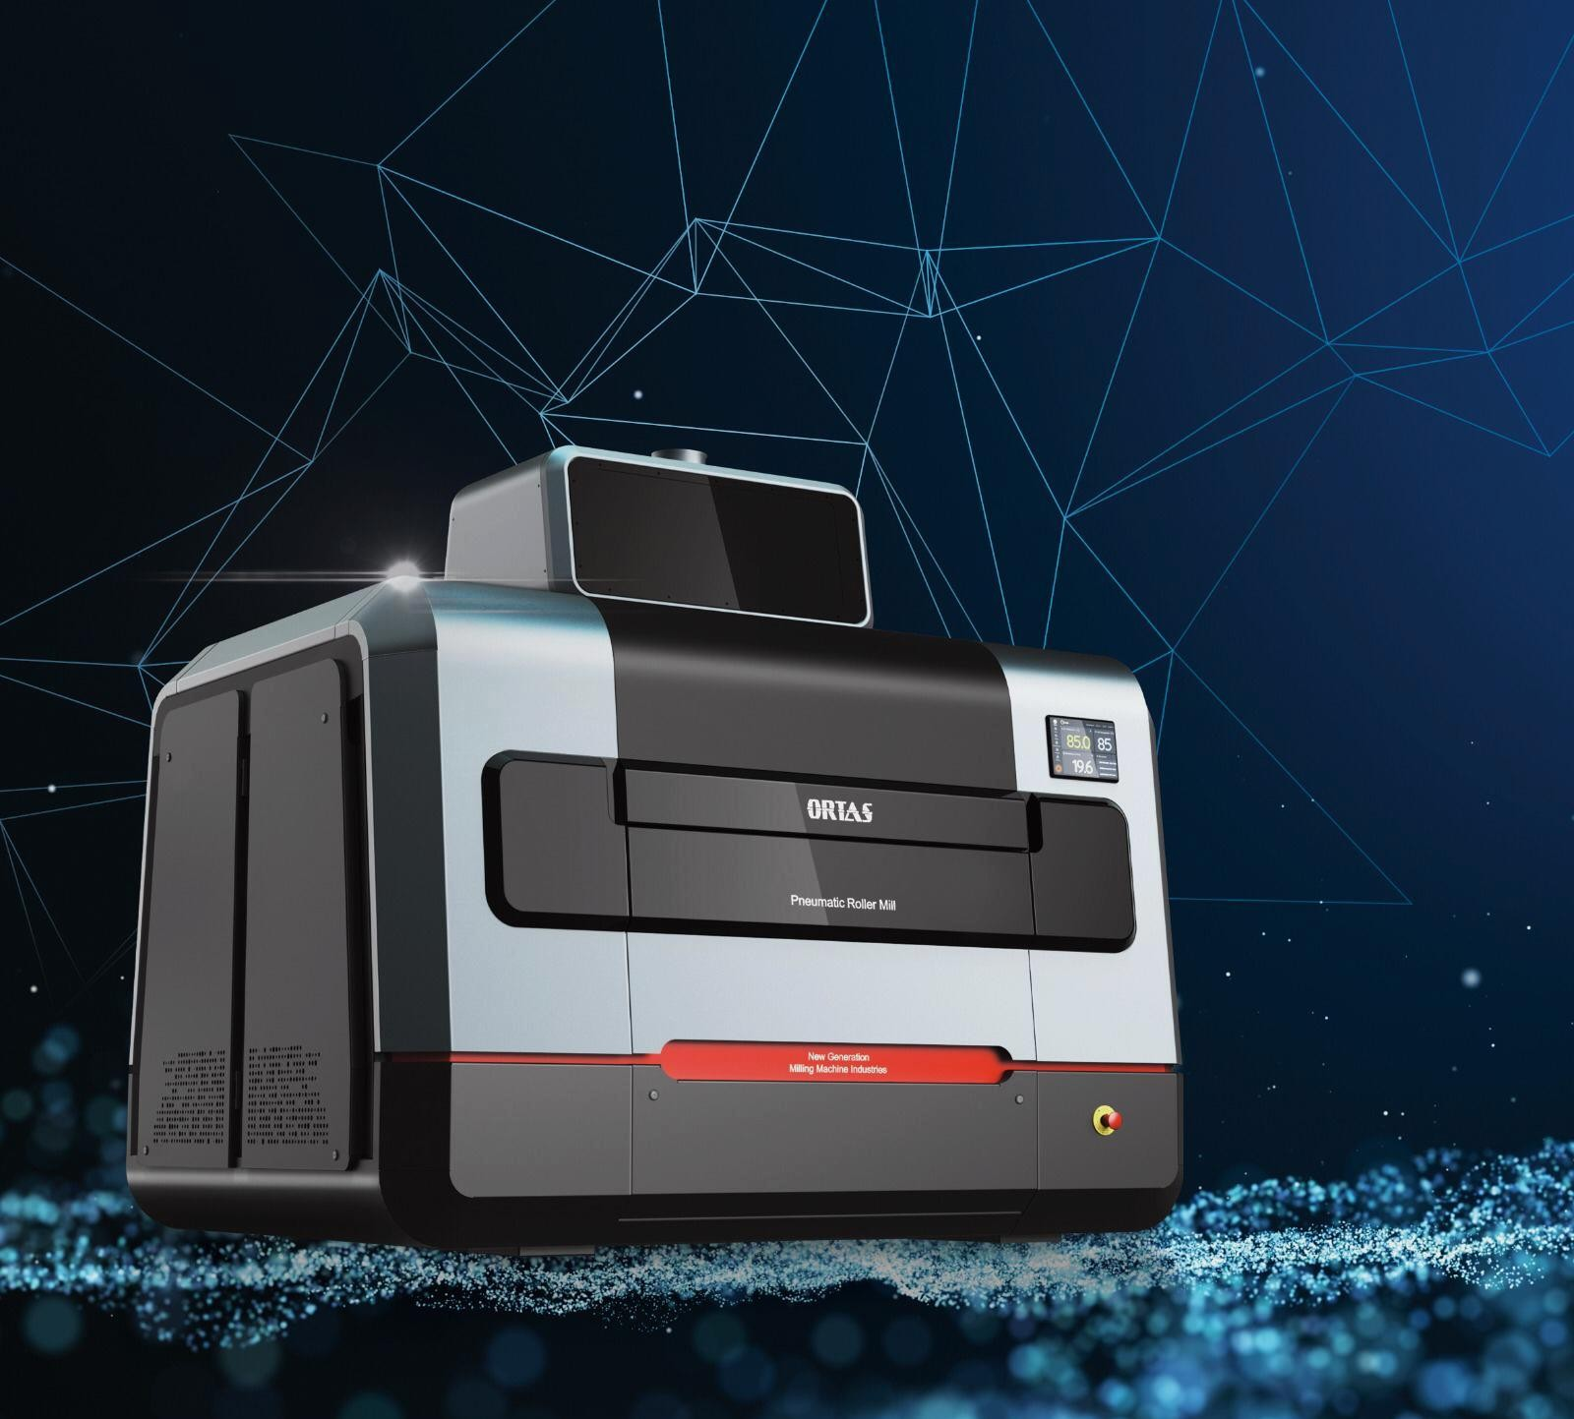
FORTIS Pneumatic Roller Mill
ORTAŞ DEĞİRMEN has added a brand new aesthetic and stylish design roller mill which is far from traditional designs to its machine family.

Slide 8
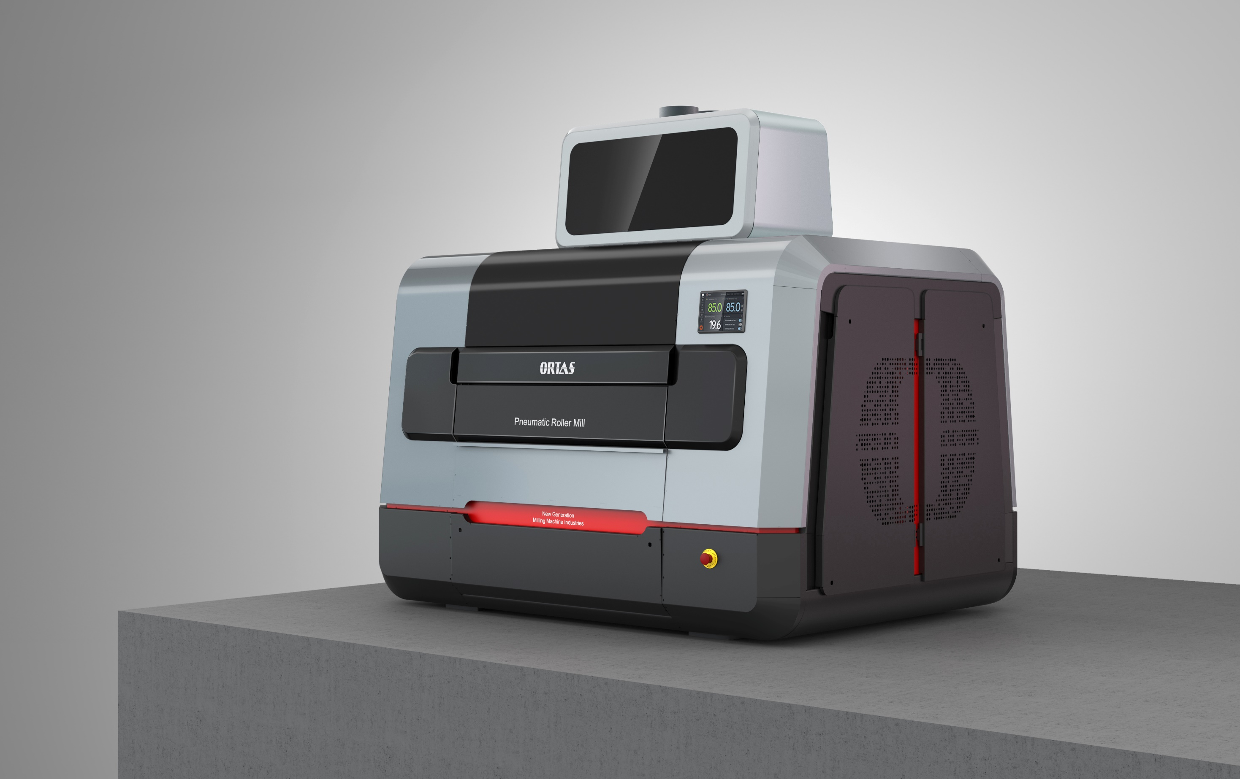
FORTIS Pneumatic Roller Mill
has been designed with a simple aesthetic approach that goes beyond the traditional design concept and emphasizes language of function.
The machine design carries important features such as power, durability and silence to the future with stable lines. The structural components of the product are emphasized with simple flowing forms and color codes so that they are defined on the outer surfaces of the design.

Slide 9
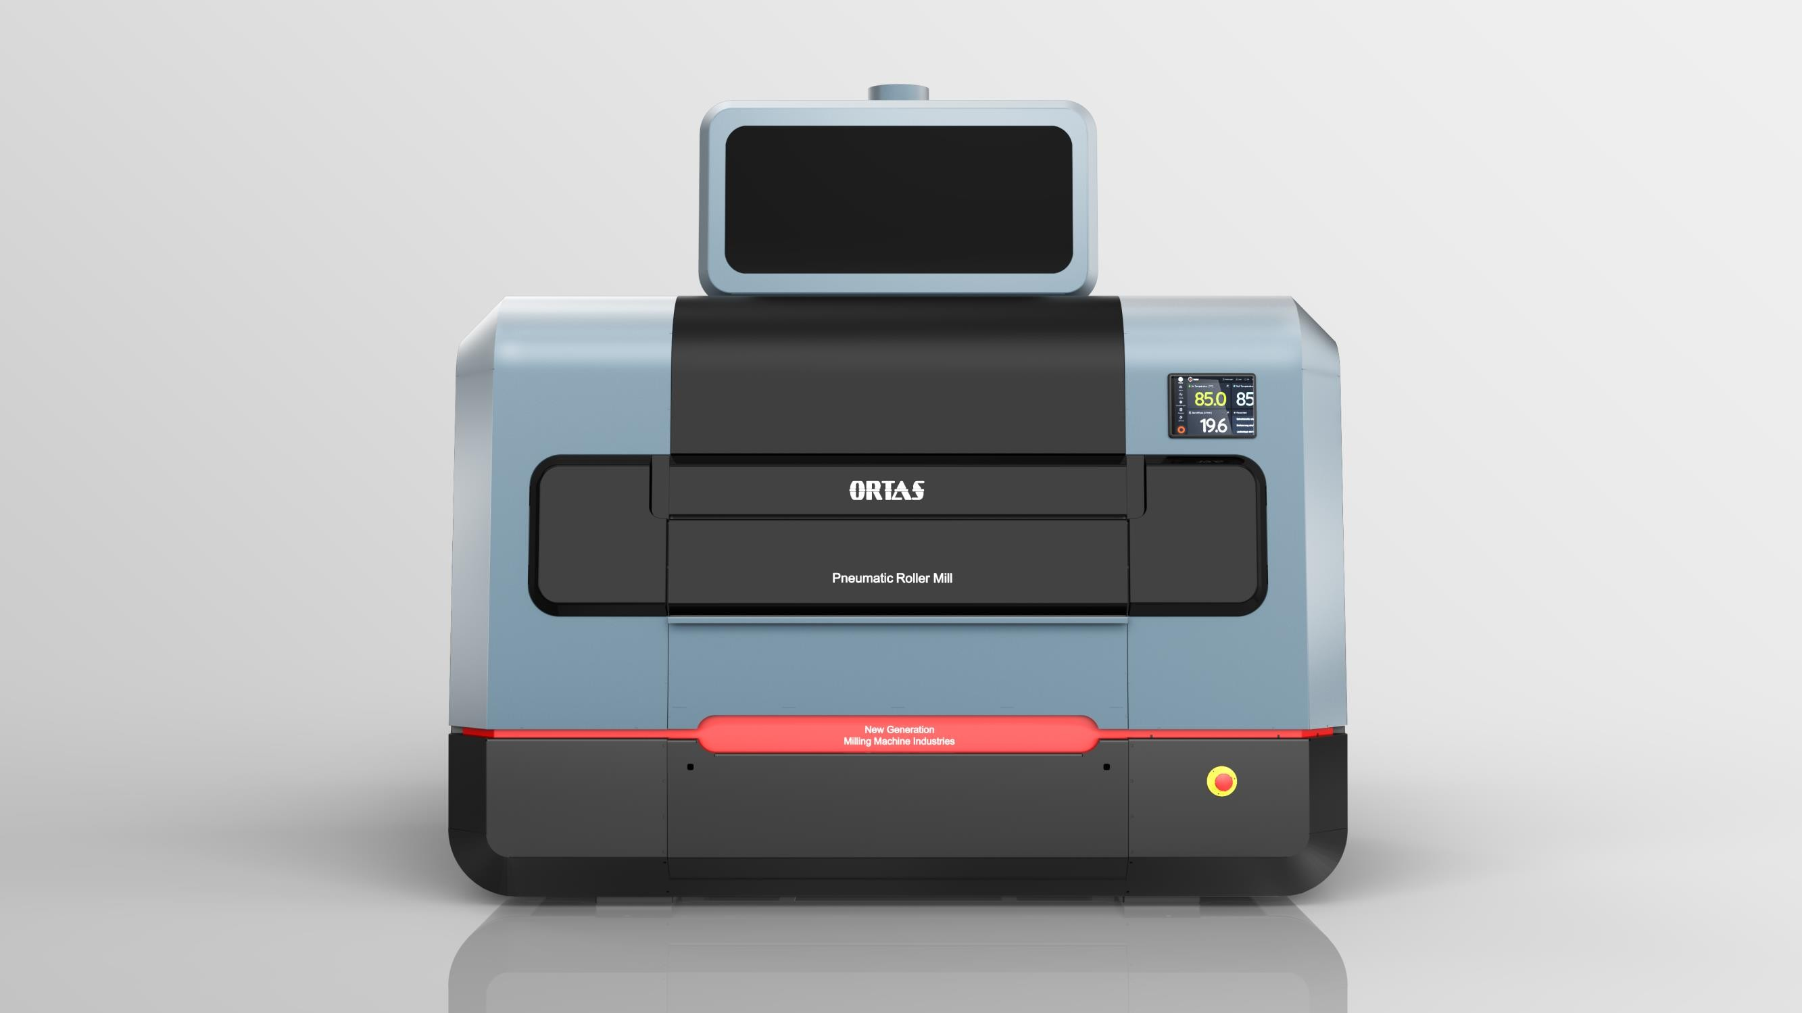
Rolling machine working with new generation smart technology has high performance in terms of efficiency and capacity. It is possible to use the machine in automatic or manual mode with the touch control screen.
Thanks to the rational screen interface, the operator can control the
machine speed, electrical current levels, occupancy levels and critical functions via the
panel.

Slide 10
Fortis Pneumatic Roller Mill, designed by meticulously interpreting the function and
technical information of the designers, symbolizes the strong harmony of design and engineering.

Slide 11
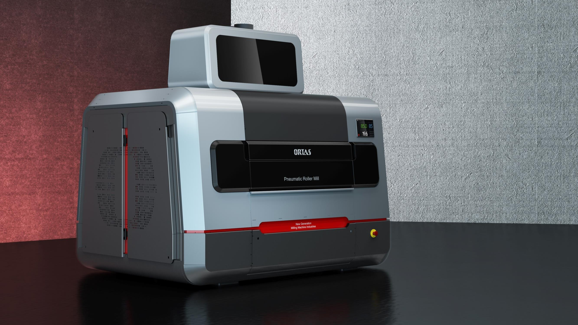
The newest version roller mill, space saving is achieved at the maximum level. Access to the feeding and grinding balls is very simple, with a single button it is possible to remove the covers without using any force. Working with the new generation smart technology, the roll mill exhibits high performance in terms of efficiency and capacity.

Slide 12
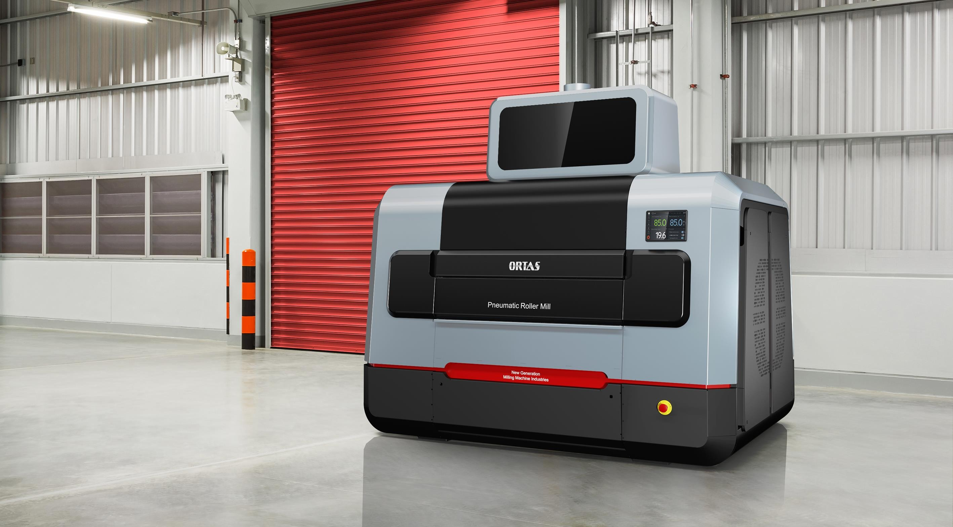
The simple exterior design of Fortis Roller Mill also emphasizes its ultra-quiet operation. The design rhythm, which makes an integrated ecosystem feel when positioned multiple times on the production line, raises the aesthetics of the facilities to the next level.

Slide 13
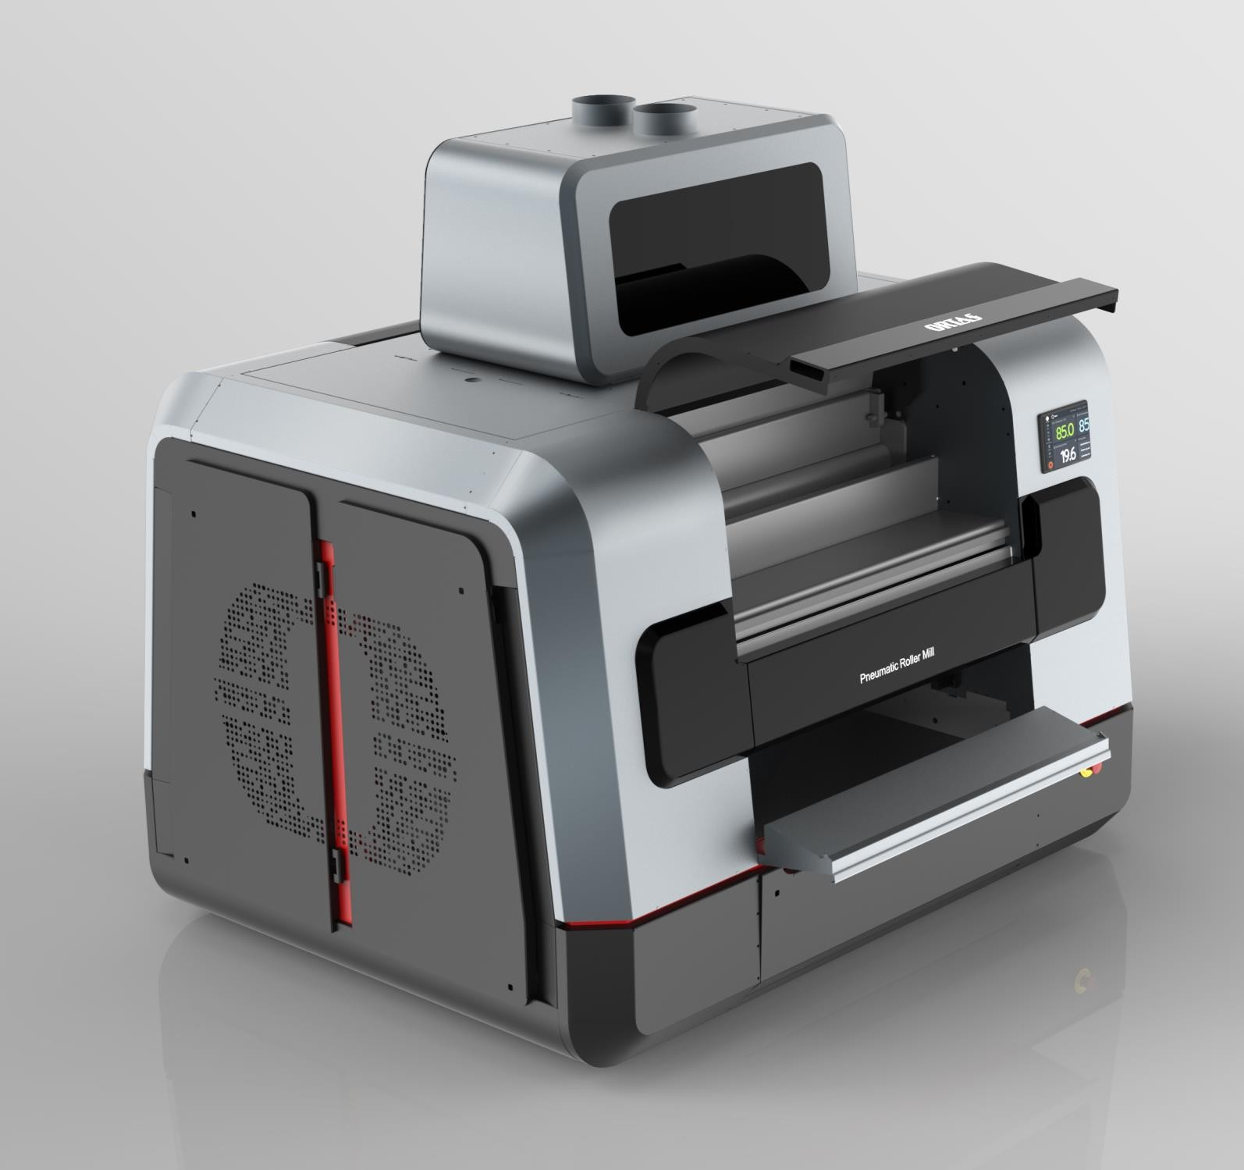
It is possible to use the machine in automatic or manual mode with the Touch Control screen. Machine speed, electric current, occupancy level and Extra functions can be controlled via the panel.
Roller mill works with PLC automation system.
Capacitance: Loadcells in the system automation, the amount of the product between the rollers can be adjusted. Enables the machine to measure the product level.
Roller Speed Sensor: Roller Speed Sensor is effective sensor to detect the revolution of the roller speed during grinding process.
Blockage Sensor: If there is a blockage during the passage of the product through the collecting chamber after the crushing process, the blockage sensor is activated.
The drive system of the rollers is provided by the timing belt, which makes the machine run quieter and cleaner.

Slide 14
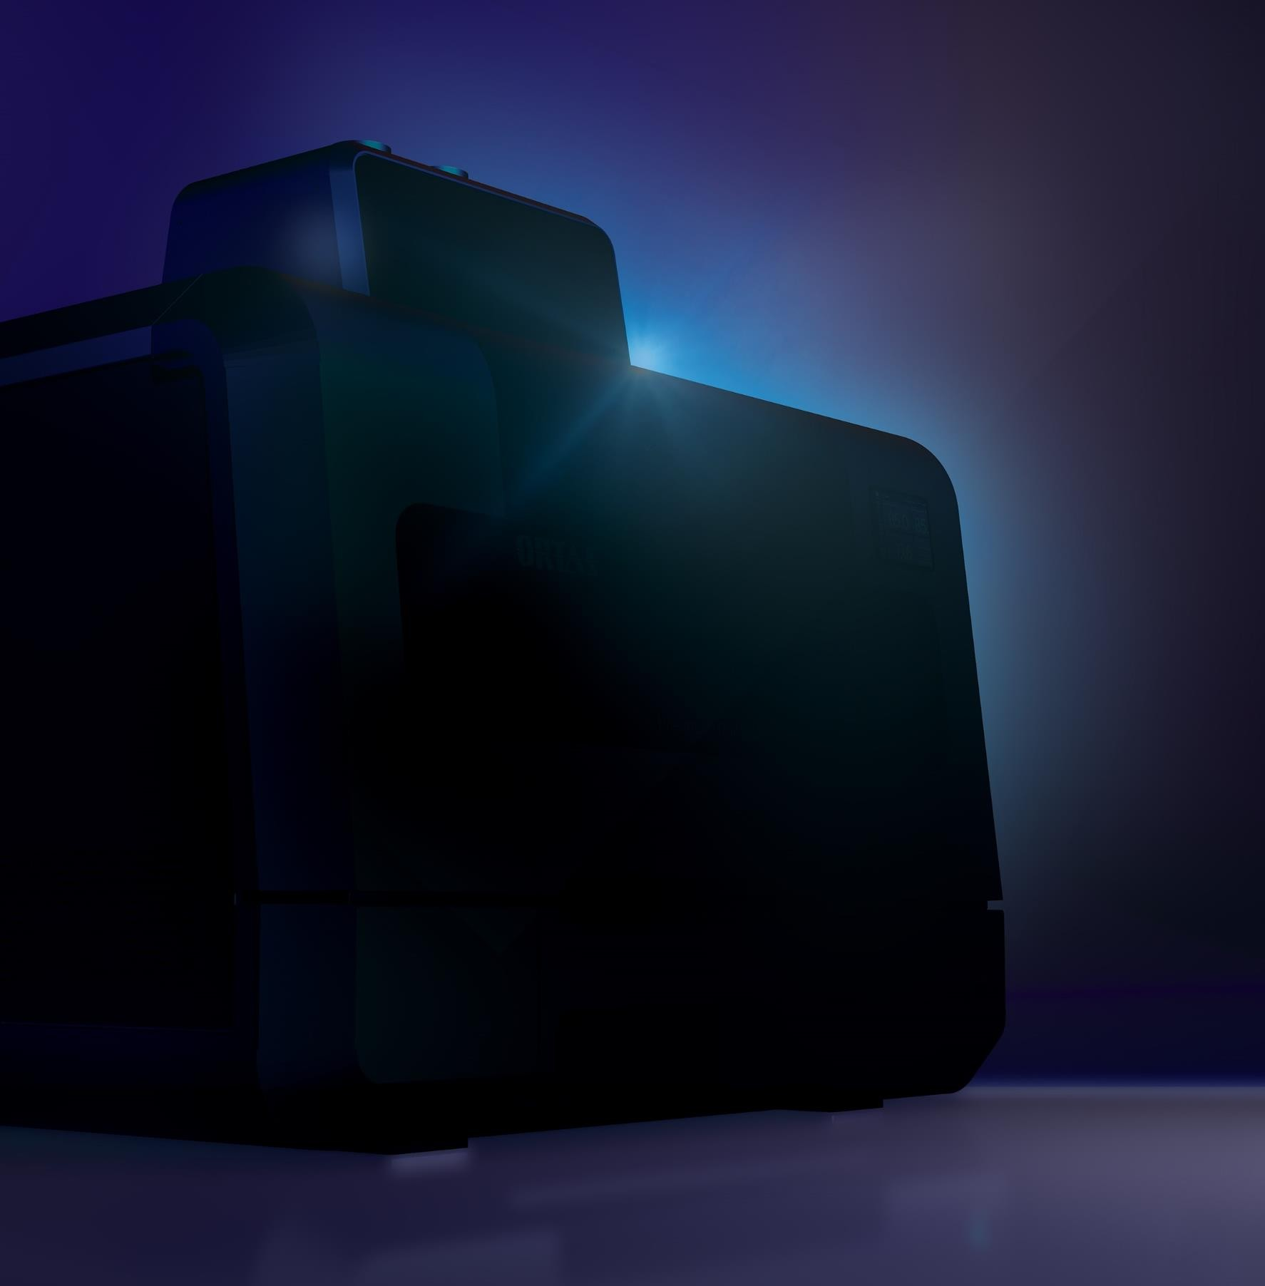
With its easy-to-disassemble interior parts, time is saved and maximum hygiene is also achieved.
The change time of the grinding balls is 18-20
minutes.
Optionally, it allows central lubrication of ball bearings.
There is an aspiration system that ensures the removal of dust in the product inlet chamber.

Slide 15
NEW DESIGN
SEMOLINA PURIFIER - FORTUNA
It is used in cleaning and sorting of semolina in flour and semolina factories. It provides the processes to be more healthy and successful in the factory systems processing hard wheat. It seperates the product whichs flow rate is adjustable to the whole sieve surface smoothly. Sieving process is done with 3 floor telora.

Slide 16
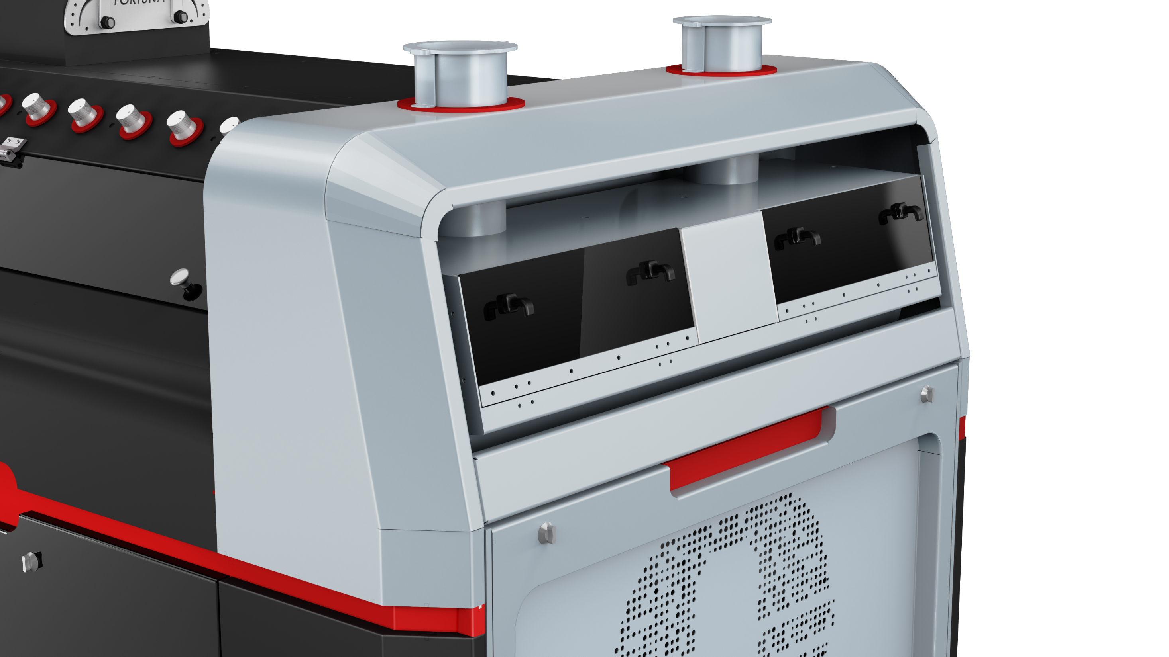

Slide 17
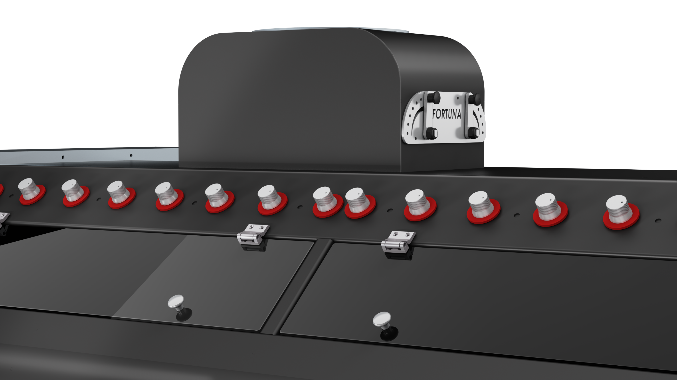

Slide 18
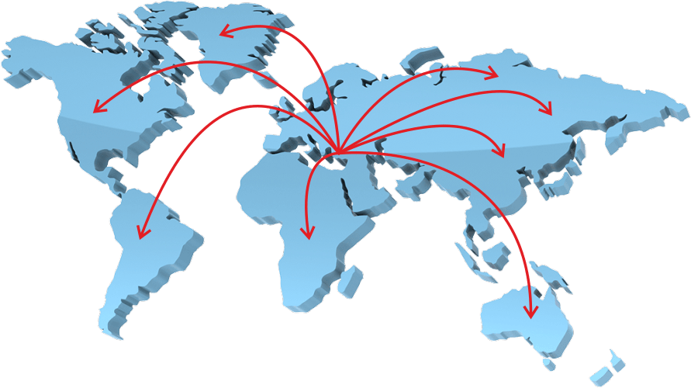
Our production facility is located only in Konya, Türkiye, but the quality and technology of Ortas are known all over the world!

Slide 19
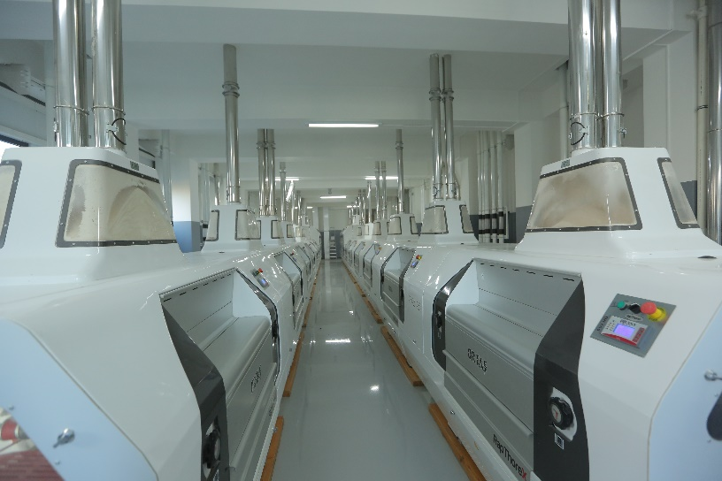
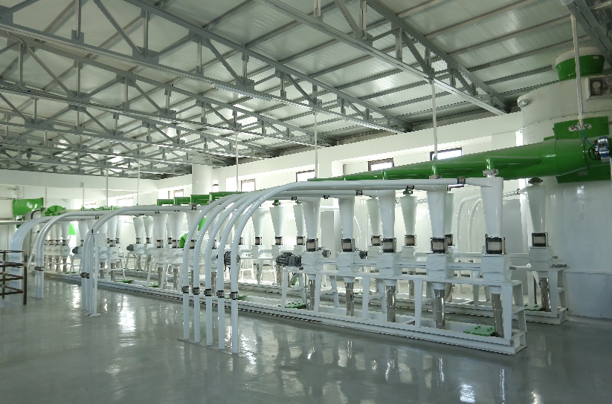
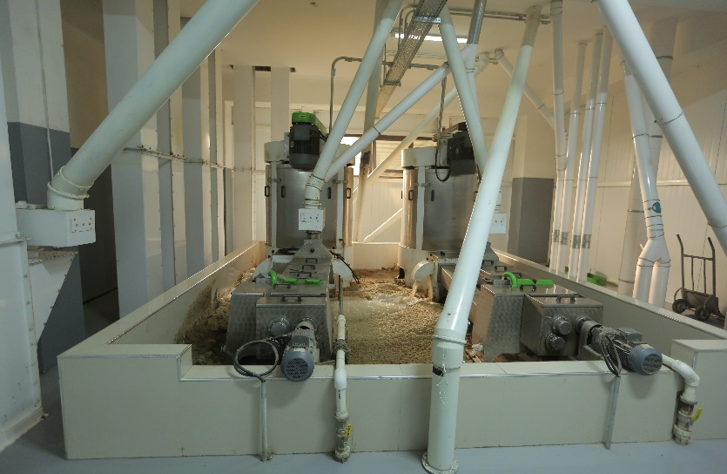
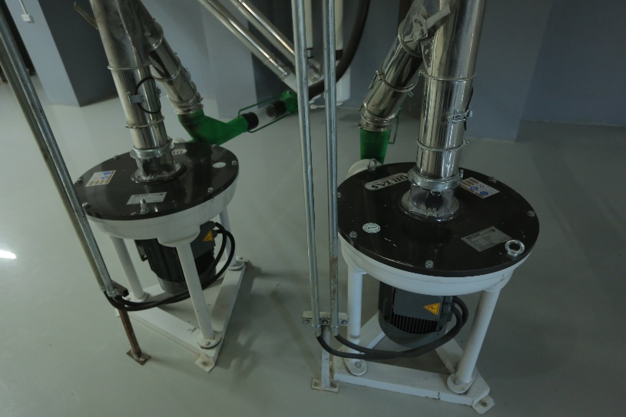
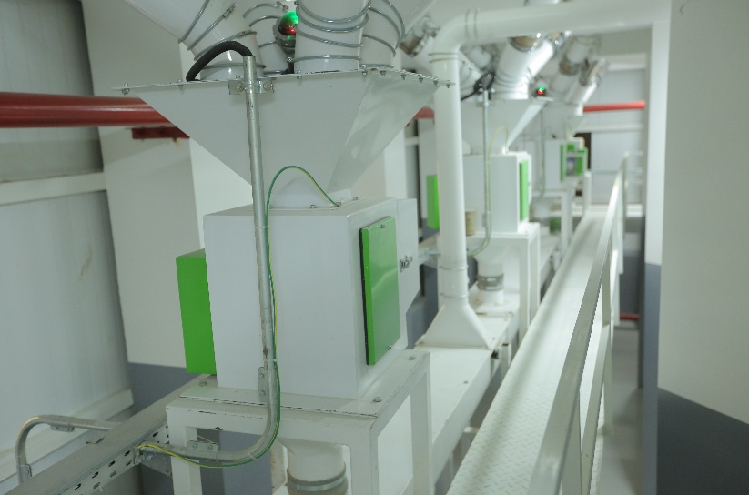
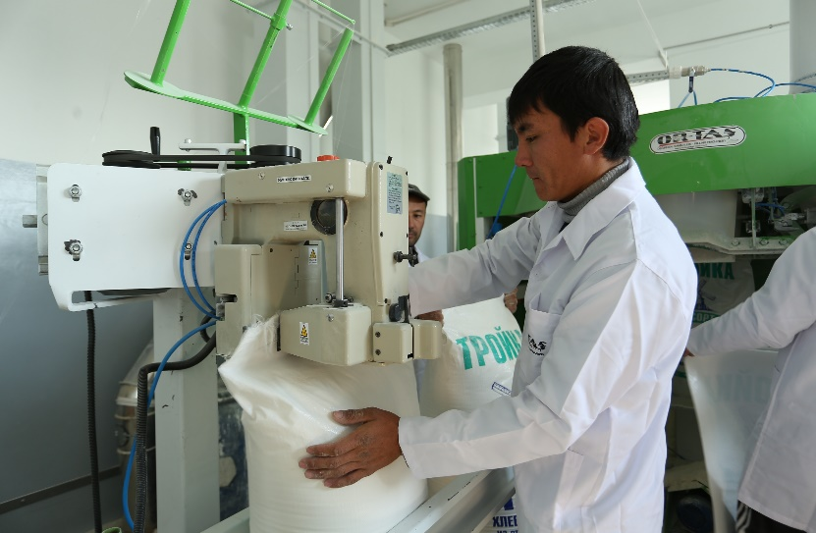
-UZBEKISTAN 750 TPD CAPACITY FLOUR MILL FACTORY

Slide 20
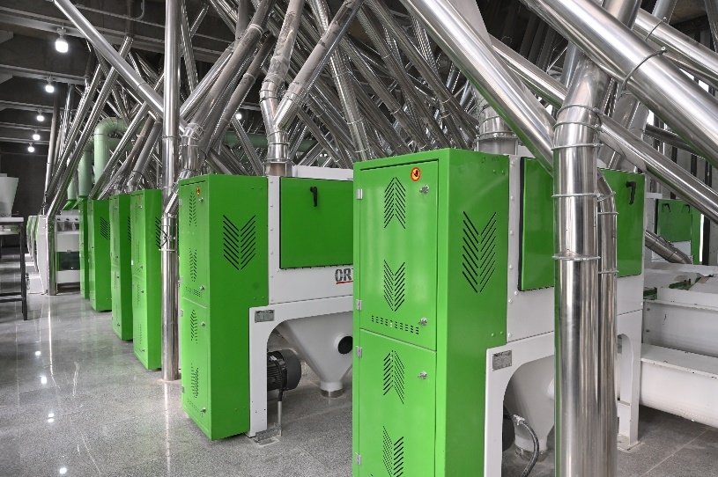
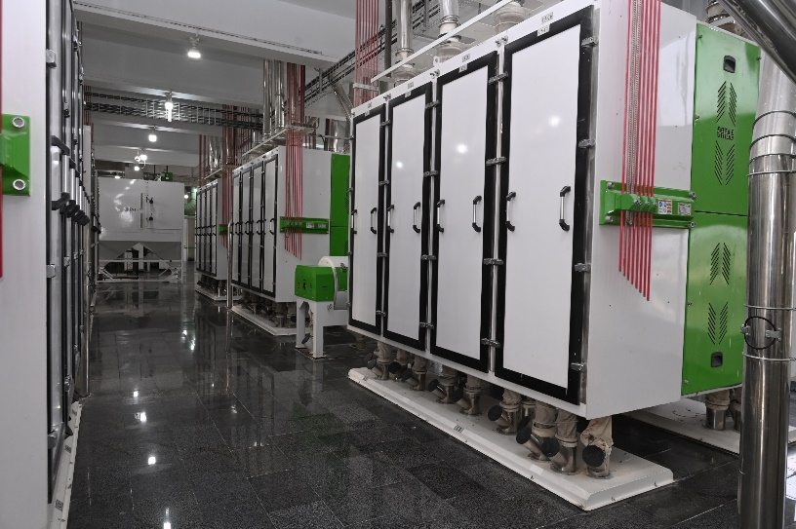
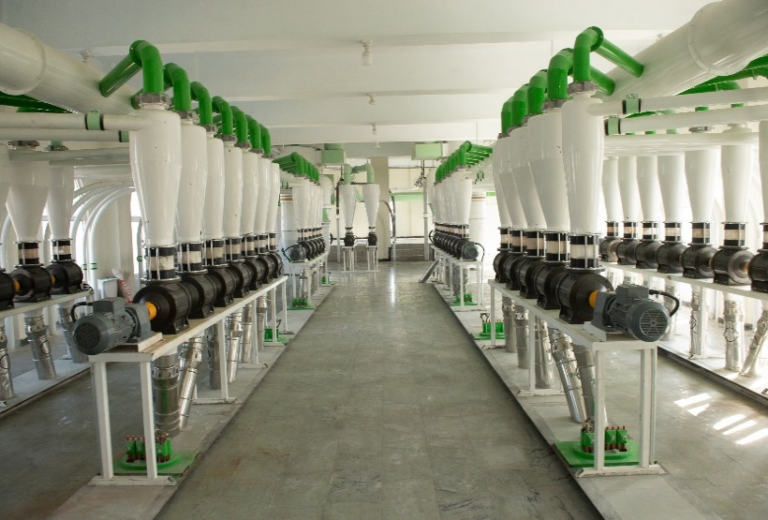
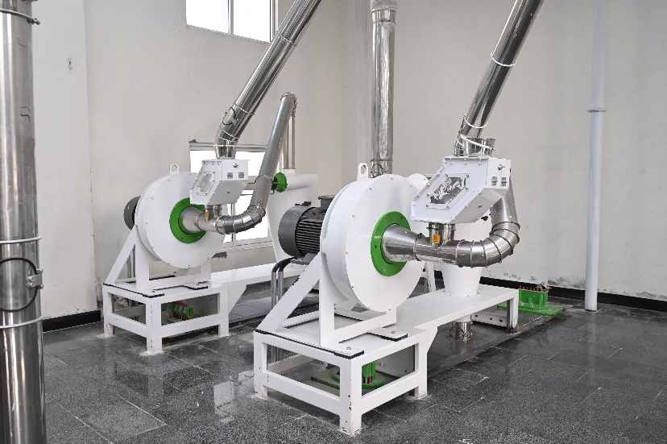
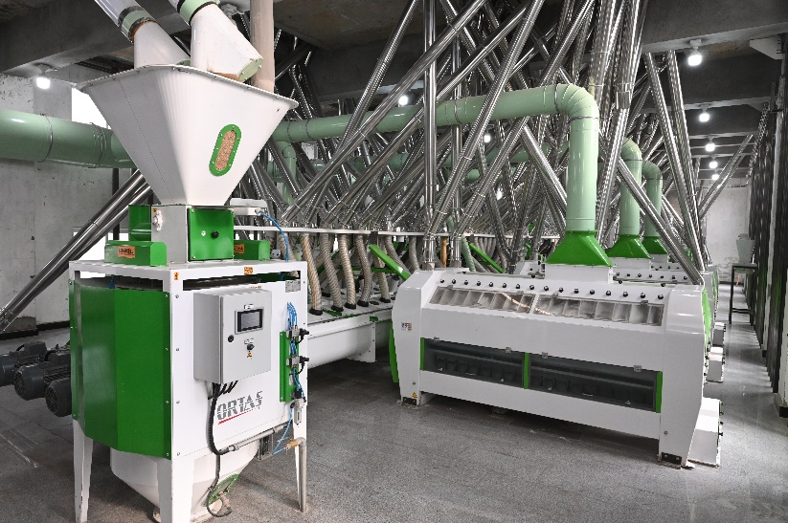
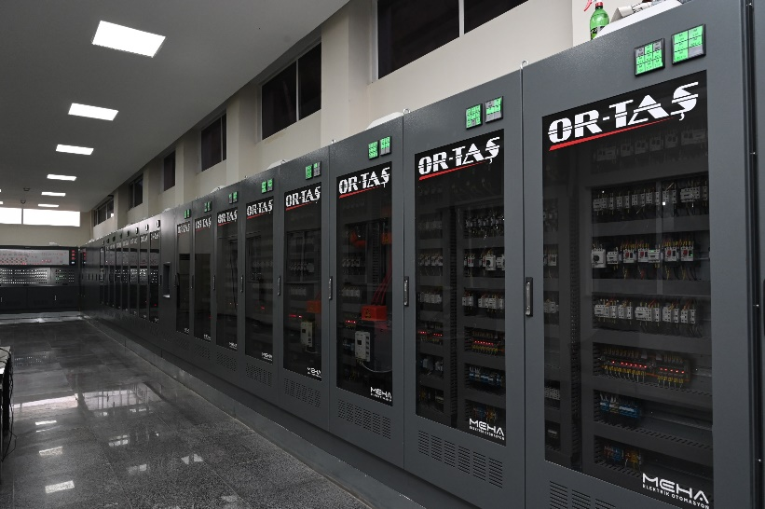
-PAKISTAN 500 TPD CAPACITY FLOUR MILL FACTORY

Slide 21
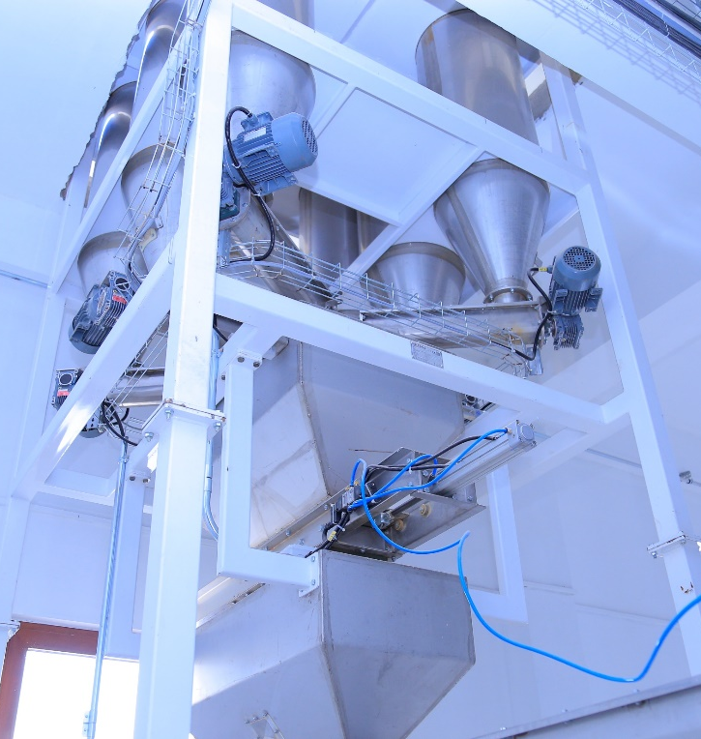
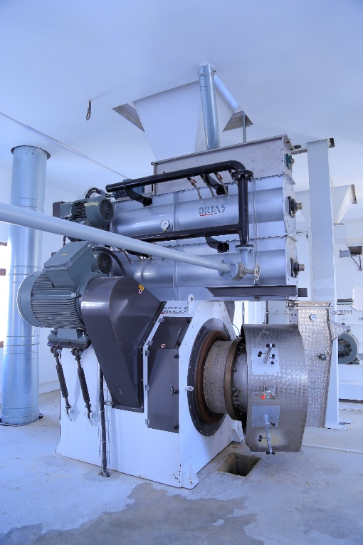
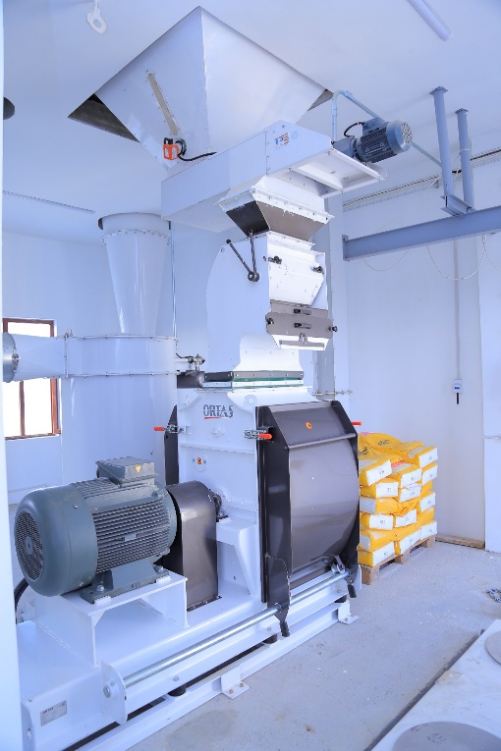
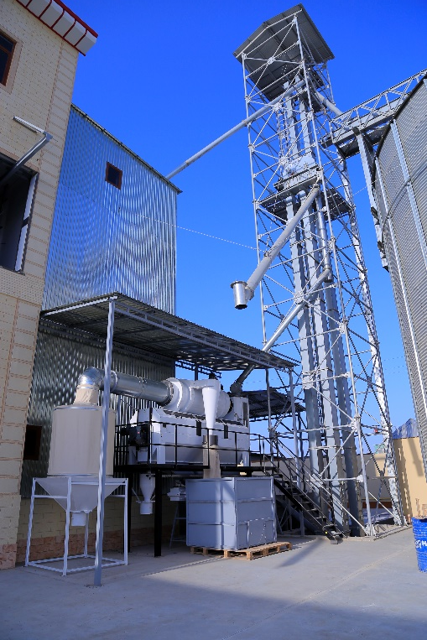
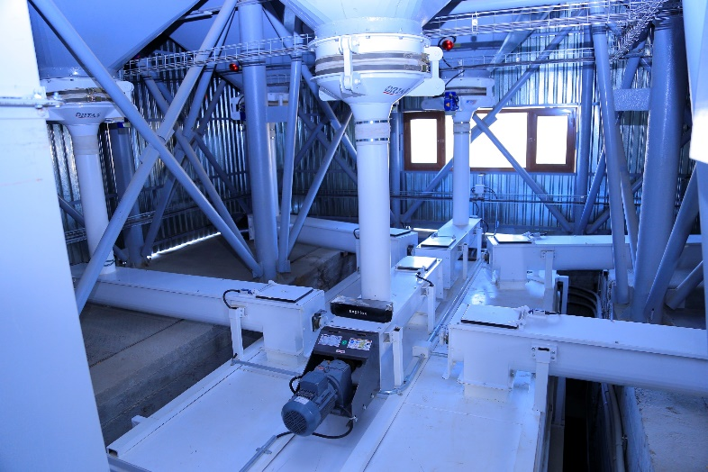
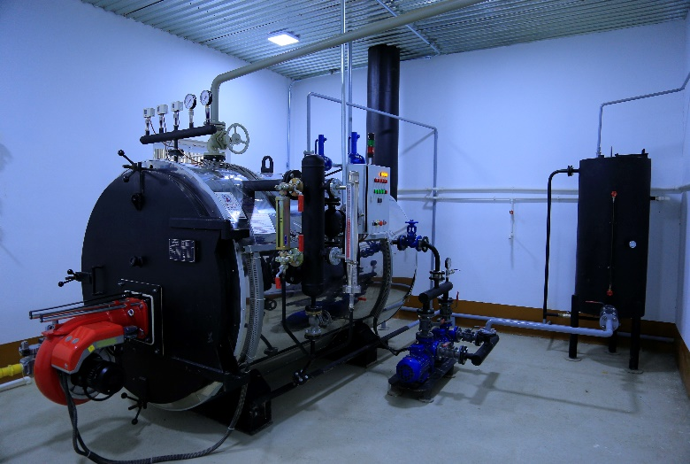
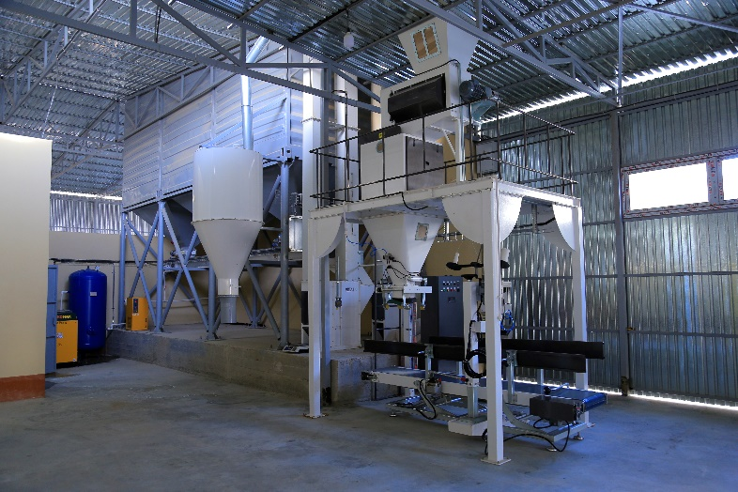
-FEED MILL FACTORIES

Slide 22
On the way to being "always better" with our continuous innovations
25000 MACHINE | 400 COMPANY | 500 HAPPY CUSTOMER

Slide 23
HIGH EFFICIENCY
HIGH QUALITY
LOW ENERGY

Slide 25
