Slide 1
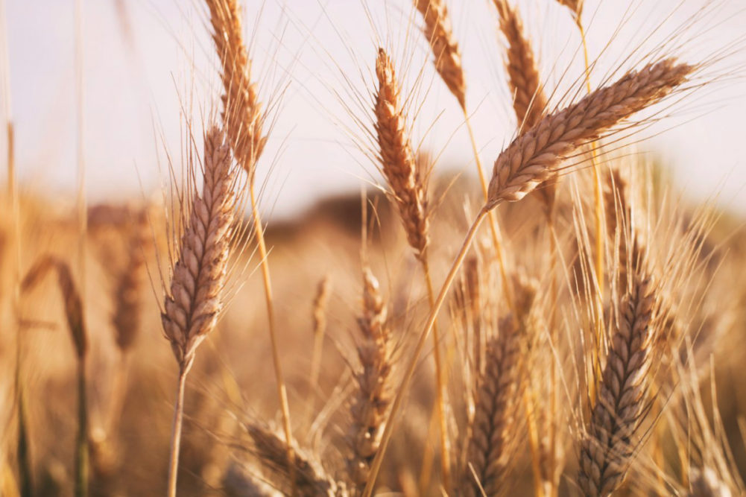
WELCOME

Slide 2
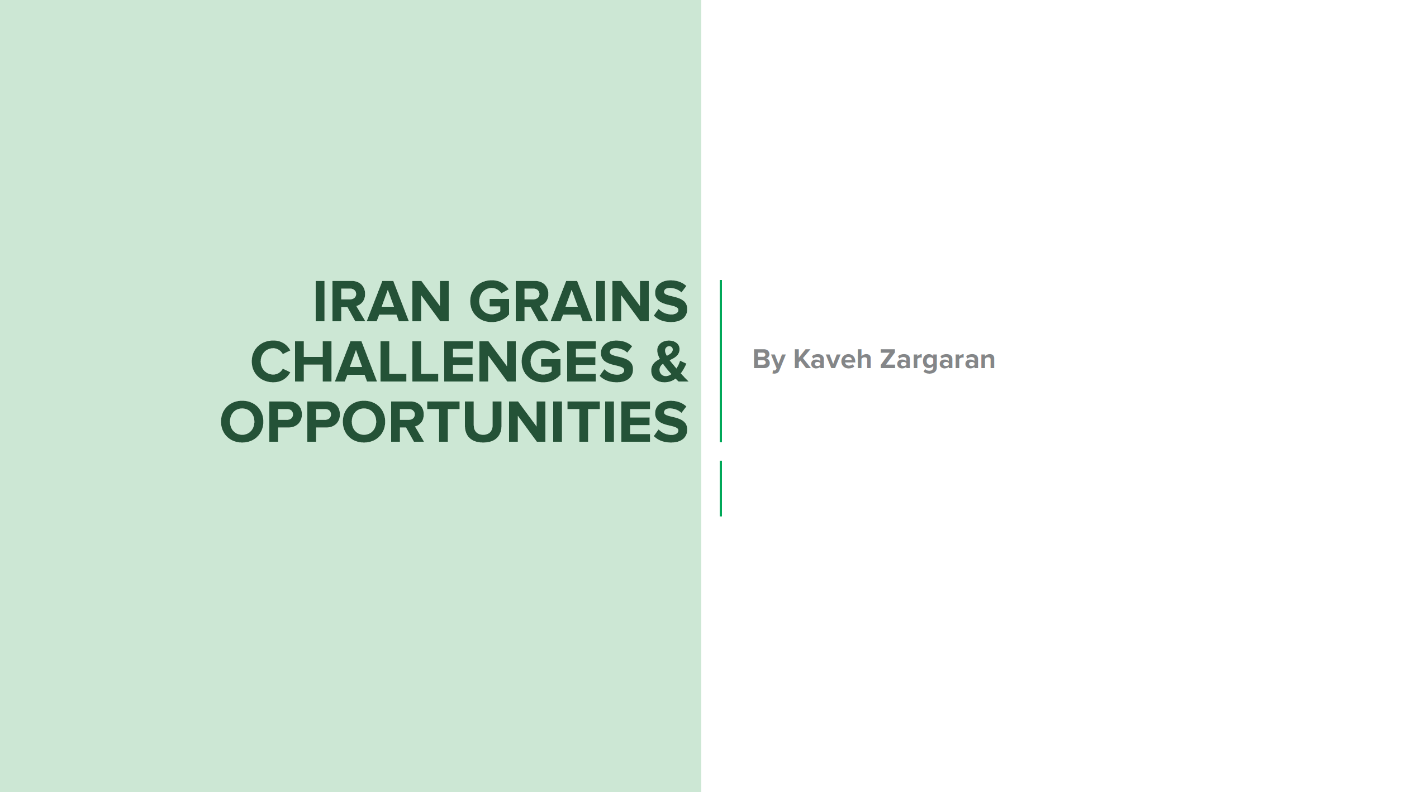
Chairman of Iran Grain Union
Jul 17th, 2023

Slide 3
Area: 1,648,195 km²
Population: 85.83 million
(more than 60% under 30 years old)
GDP: $367.968 billion (nominal; 2023 est.) $1.692 trillion (PPP; 2023 est.)
GDP Growth: 4/7%
IRAN is also the 2nd most-populous country with about 85 million people in the region after Egypt in 2022.
Iran’s economy is characterized by the hydrocarbon sector, agriculture and services sectors, and a noticeable state presence in manufacturing and financial services

Slide 4
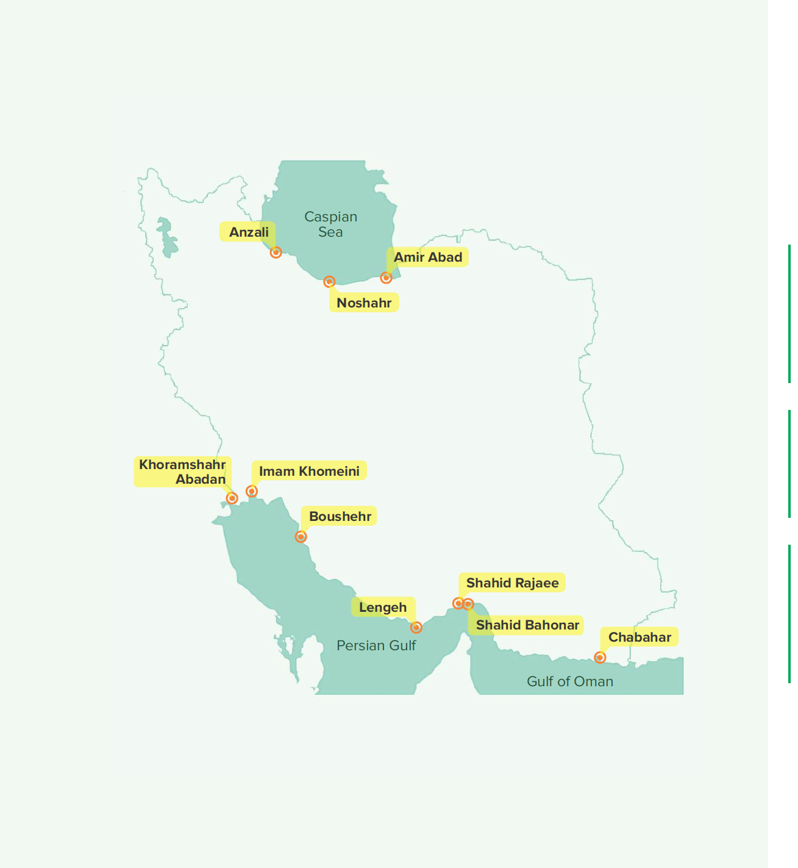
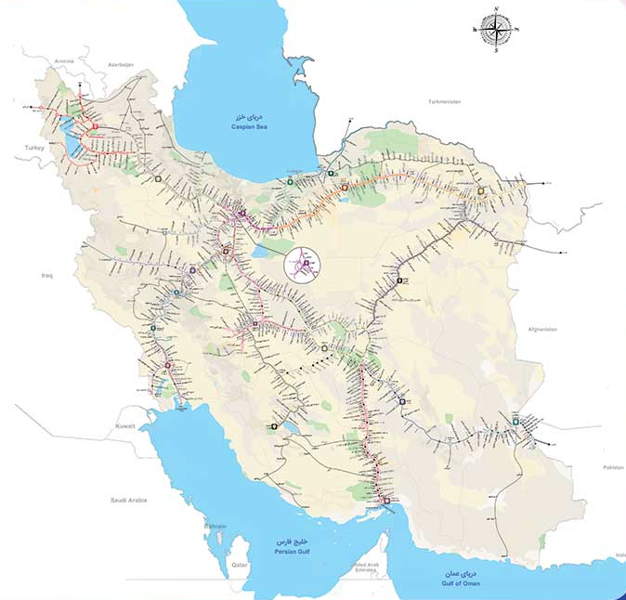
TRANSIT ADVANTAGES
IN IRAN
Iran is placed in the route of north south transit corridor, consequently the transit connection among Russia, Eastern, Central and Northern Europe , Middle East and Caucasus and in the other hand among South Asia , Far East , Oceania and Persian Gulf countries which makes Iran a unique privilege.
Furthermore, because of the shortened route in the north south corridor and the availability of facilities and infrastructures in various transportation sections, the Iranian transit route involves abundant attractions for freight transport.
To be in the geographical center of countries who are members of Organization for Economic Co-operation and Development, Eco, had made Iran as an important country for transit of imports/exports, also very active in making various contracts and memorandum of articles

Slide 5
IRAN GRAINS
Wheat, rice, barley and corn are grown on 70pc of cultivated land, with wheat, the country’s main staple, accounting for more than half of total crop production.
Grains planting area is 8.66 million hectares, 3.64 million hectares of which are done through irrigation and the rest by rain _fed.
Most of Iran's agricultural land area used for grain production(76.2%).
The grains planting area have had downward trend from 9 million hectares to 8.66 million hectares during the past 10 years, a reduction of 4% .
Iranians are among the biggest consumers of bread in the world.
On average, wheat provides 40 - 45% of the required calorie and 50% of the required protein for each individual.
Wheat per capita consumption is 141 kg.
The share of grains consumption is 21% for every family )total household expenditure(.

Slide 6
IRAN’S GRAINS PRODUCTION
IRAN’S GRAINS IMPORTS
Grains Imports 2011/12
Grains imports 2016/17
Grains Imports 2022/23

Slide 7
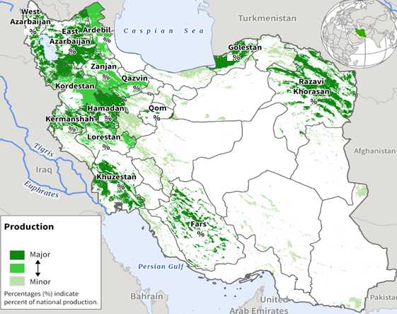
MILLING WHEAT
Bread (72%)
Cakes
Grains
Macaroni / Noodles
IRAN : WHEAT PRODUCTION
Wheat (56% of the total growing area), barley (18%) and rice (3%) are the main annual crops growing in Iran.
Iran's main wheat cultivating provinces are Khuzestan, Golestan, Fars, Kordestan, North Khorasan, Khorasan Razavi and South Khorasan.
The Iranian government buys strategic crops, including wheat, from local farmers on guaranteed prices to build up its reserves and regulate the market.

Slide 8
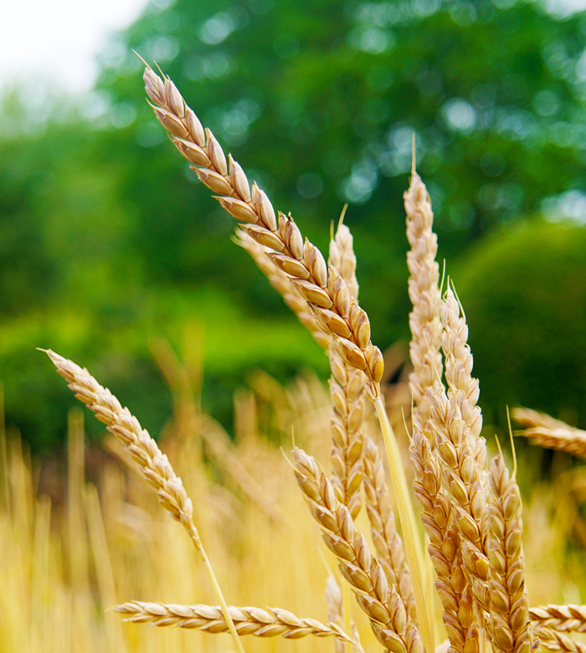
WHEAT PRODUCTION
IRAN’S WHEAT PRODUCTION & IMPORTS
WHEAT IMPORTS

Slide 9
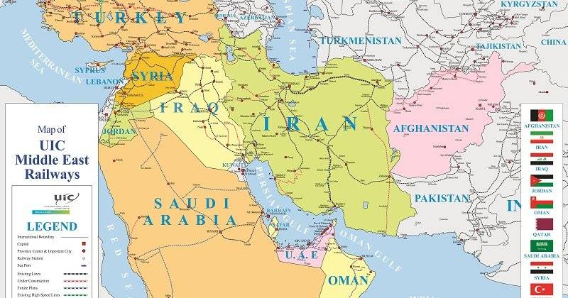
MIDDLE EAST(Wheat Production, Consumption, and Stocks)
Production: 39.27 million tonnes (a 5 -year low)
Imports: 30.65 million tonnes
Consumption: 63.02 million tonnes
Gap Eases Between Middle East Production and Consumption

Slide 10
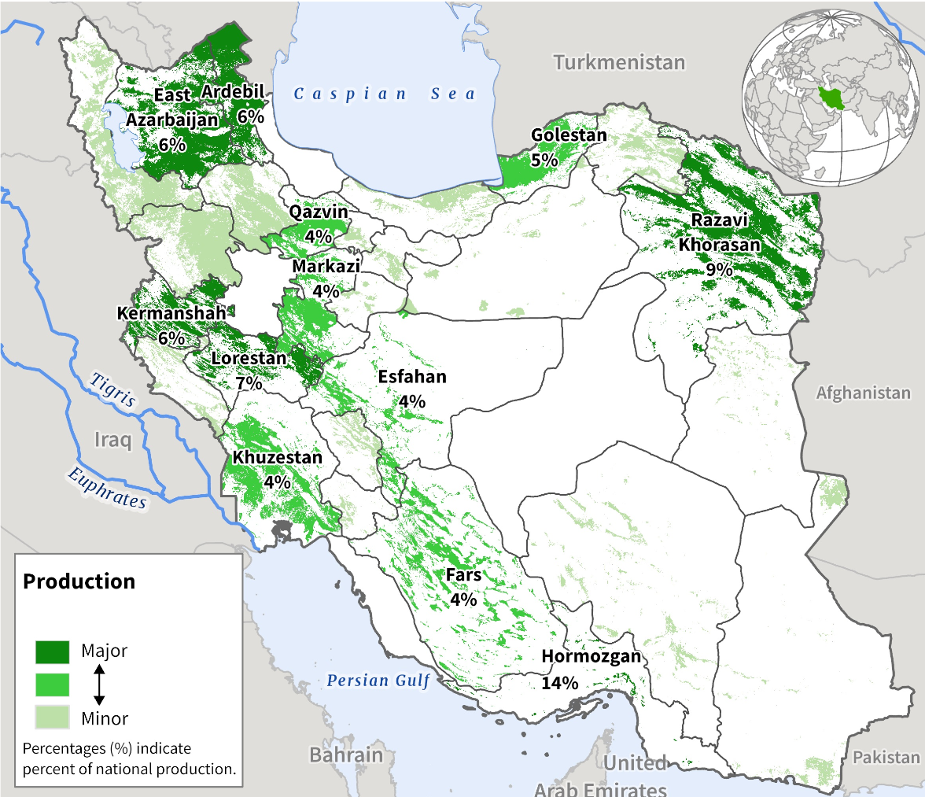
IRAN: BARLEY PRODUCTION
Barley, an essential grain crop, is dominantly applied in animal feed in Iran.
This crop is the second-largest grain crop in harvested areas and production, after wheat, with about 1.43 million hectares and 2.47 million tonnes production throughout the country.
Mostly is used as livestock feed

Slide 11
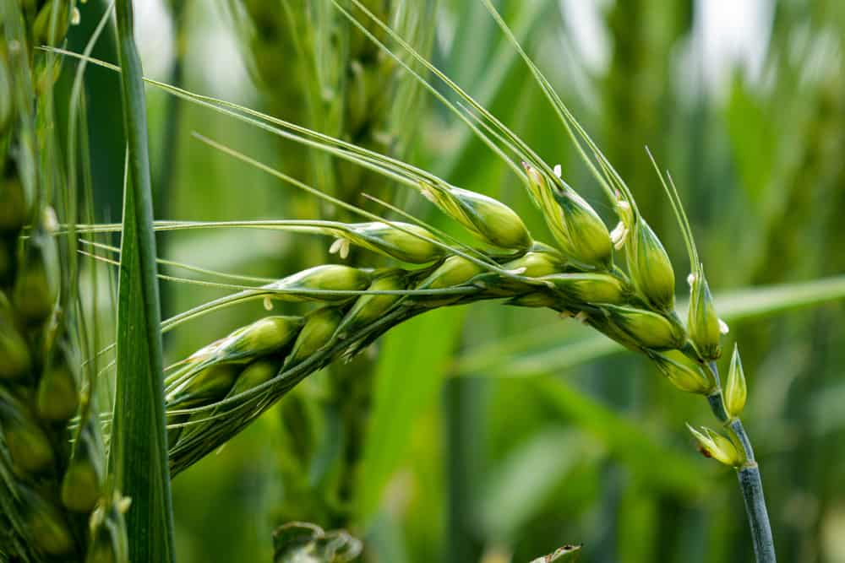
IRAN’S BARLEY PRODUCTION & IMPORTS
BARLEY PRODUCTION
BARLEY IMPORTS

Slide 12
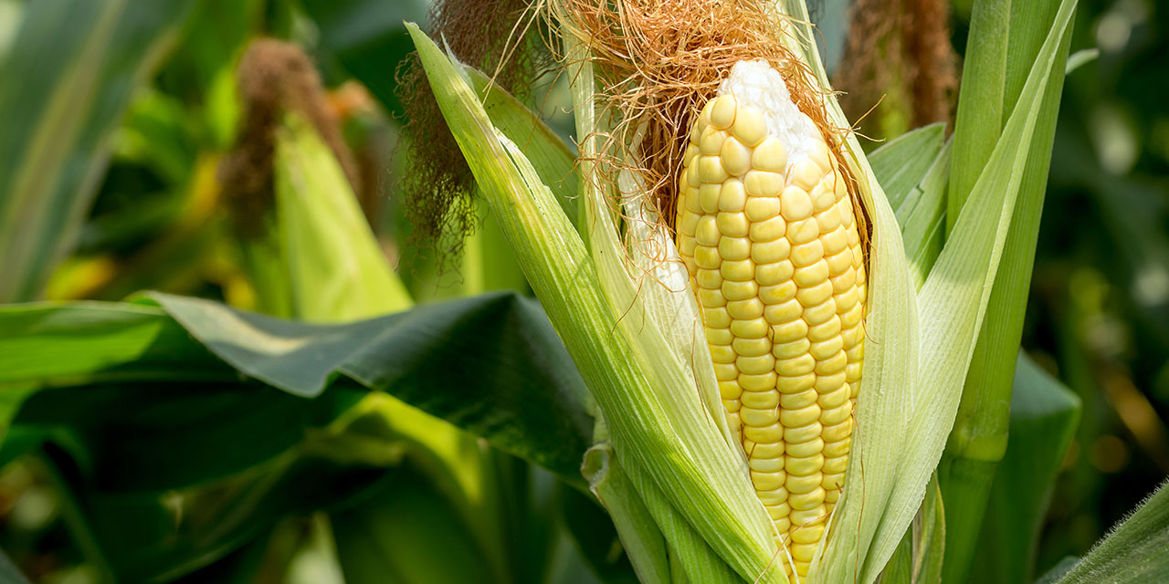
IRAN’S CORN PRODUCTION
IRAN’S CORN IMPORTS

Slide 13
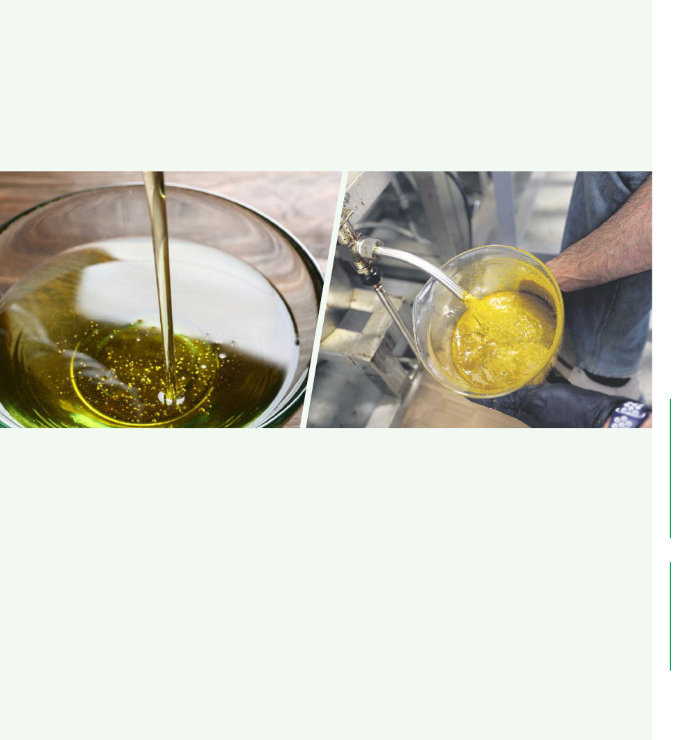
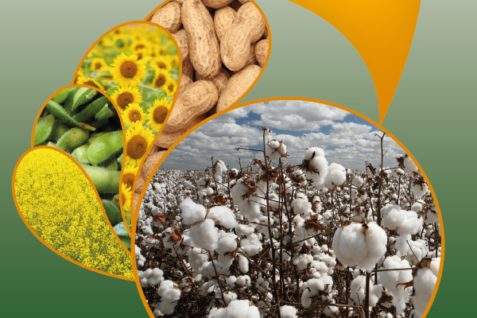
OILSEEDS PRODUCTION
IRAN’S OILSEEDS PRODUCTION & IMPORTS
IRAN’S OILSEEDS IMPORTS

Slide 14
IRAN’S PROTEIN MEALS IMPORTS
Consumption: 4 million tonnes

Slide 15
IRAN’S VEGETABLE OILS IMPORTS
44%
34%
17%
71% of domestic demand for vegetable oils are imported in the form of unrefined oil, 20% in the form of oilseeds and the remaining 9% are produced locally.

Slide 16
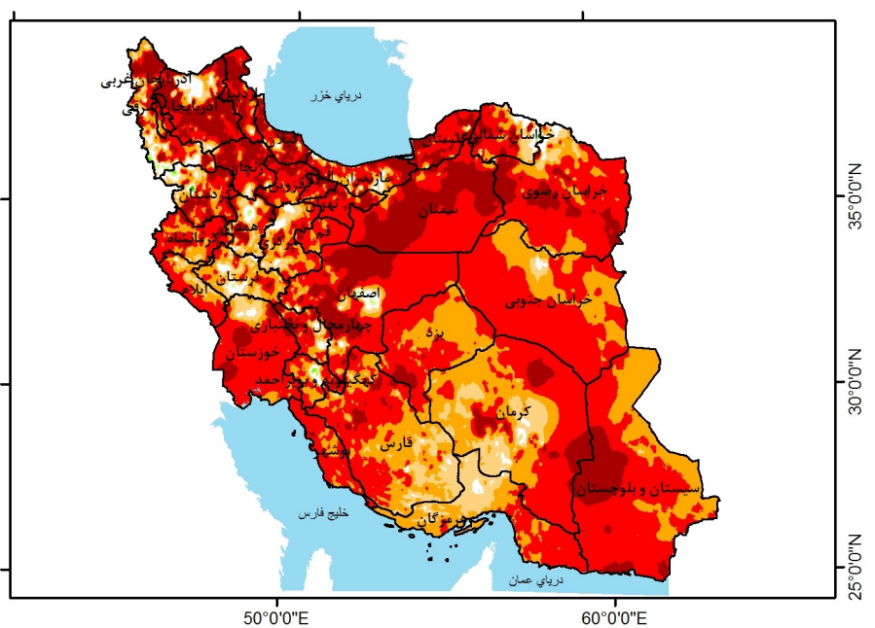
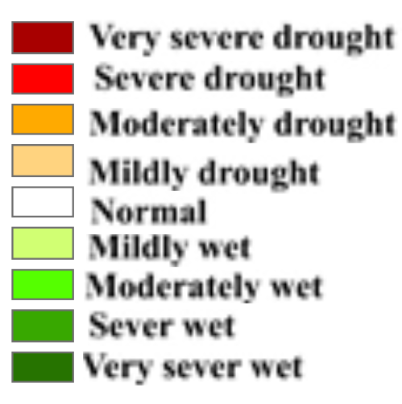
MAP OF DROUGHT
Iran has been battling drought for over 20 years, thanks to declining rainfall, rising temperatures, inefficient farming practices, excessive consumption in metropolises and poor management of resources.
During the 10-year period(between March 20 , 2013 and March 20 , 2023) the highest percentage of drought was related to and very severe (50%) and no drought (3.2%), respectively.
According to the World Meteorological Organization's multiannual forecast, in the next five years, Iran’s average rainfall will decline by 75 percent, and the temperature rises by 50-75 percent compared to the long-term average.

Slide 17
Iran's Agriculture and Drought
The amount of rainfall in Iran's main river basins from March 2022 to March 2023 was, in most places, substantially lower compared with long term averages(9.5 mm less precipitation & The average temperature has increased 3°C ).
The Khuzestan, Fars, Mazandaran, Khorasan Razavi and Golestan provinces had the highest irrigated (about 43.7%) and rain-fed (20.5%) production in Iran, respectively, from 2021 to 2022 .
Mm
Unfortunately, over 70 percent of the country is suffering from severe drought,
The last water year marked the year of low rainfall for the country, causing the continuation of dry years.

Slide 18
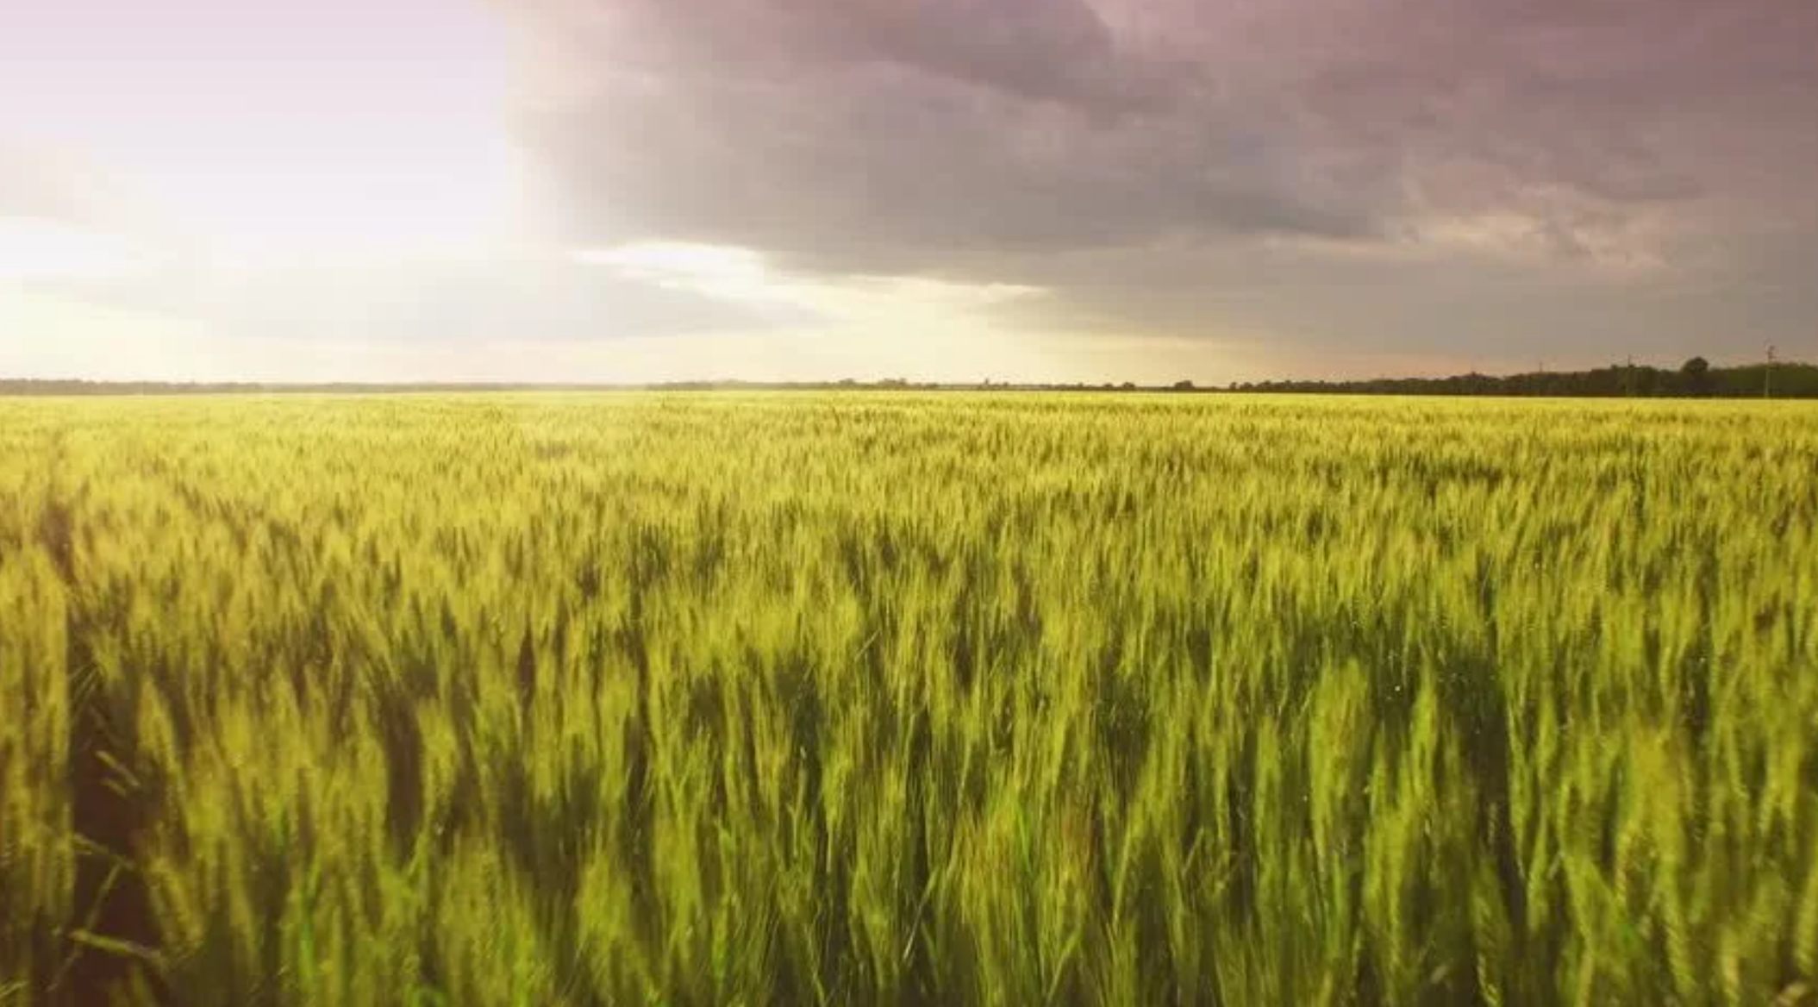
THANK YOU

