Slide 1
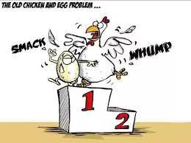
  WHICH ONE CAME FIRST?

Slide 2
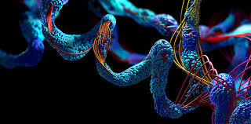
  NONE of Them !!!
  ENZYMES

Slide 3


WHEAT BRAN: A Golden Source of Enzymes and basic Biochemical Products
ACCORDING TO FAO: over one-third (1.3 billion tonnes) of the world’s food production for human consumption is wasted each year, particularly in the case of cereals, accounting for 30% (286 million tonnes) of its total output…
cereal by-products, as cereal bran, are frequently devalued and utilized in animal feed, perceived as waste..
For Iran’s Grain Market: 3 million Tones a year

Slide 4
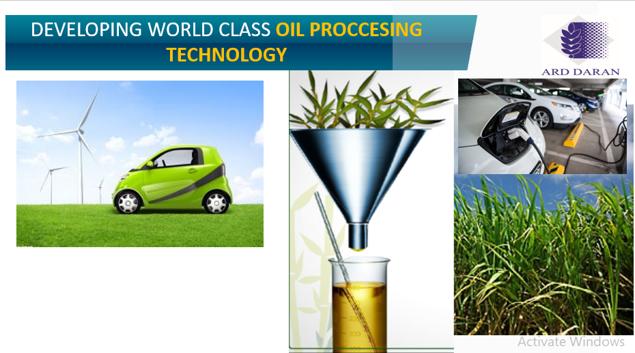
  HISTORICAL FLASH BACK

Slide 5
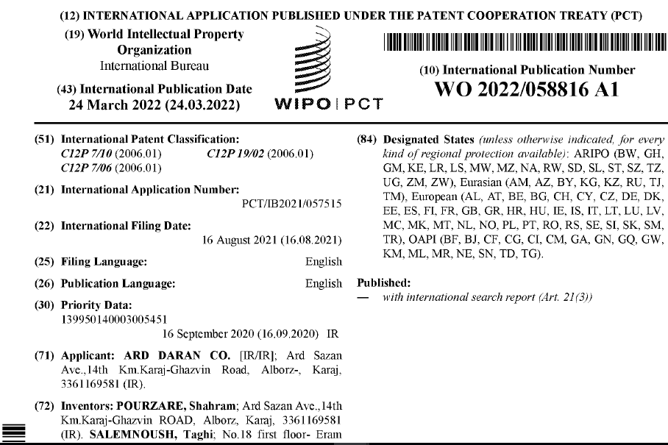
APPROACH: BioTechnological Valorization

Slide 6
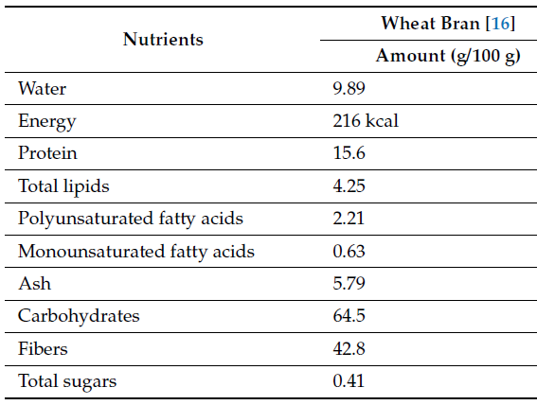
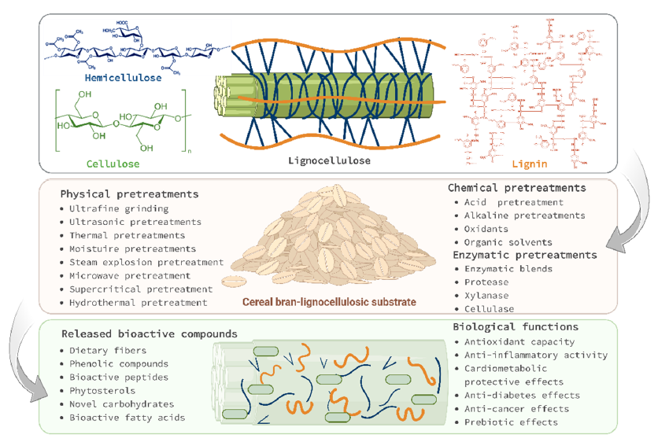
TECH FACT: NUTRITINAL VALUE

Slide 7

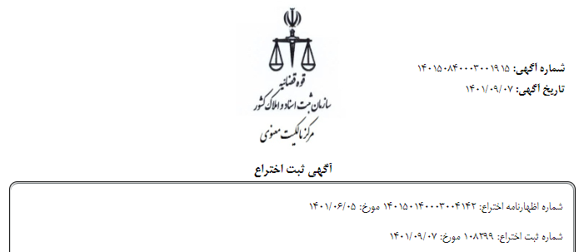
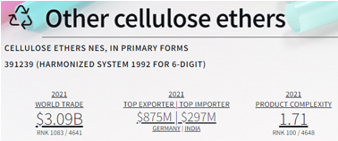
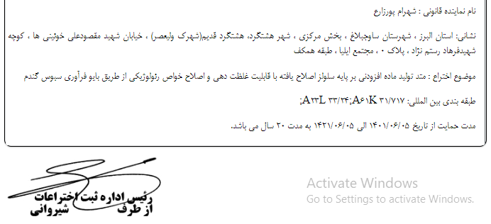
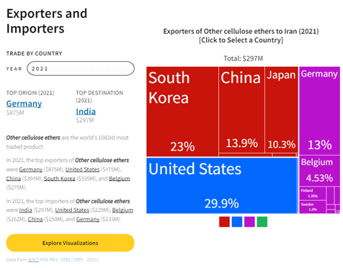
BIOFIBRAN
MARKET STUDY

Slide 8
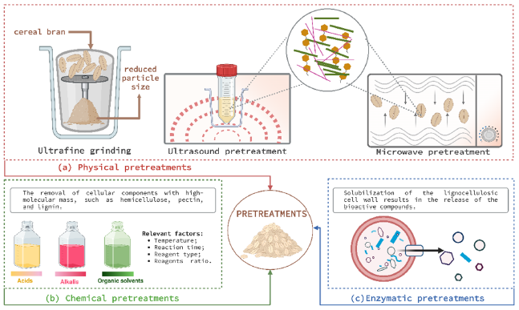
TECH FACT: Biochemical Transformation
Biotechnology – using living organisms, or the products of living organisms, for human benefit to make a product or solve a problem
Historical Examples
  Fermentation
  Selective breeding
  Use of antibiotics

Slide 9
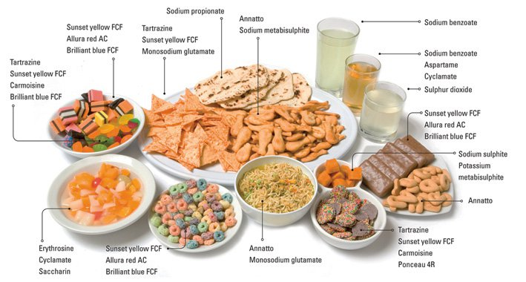
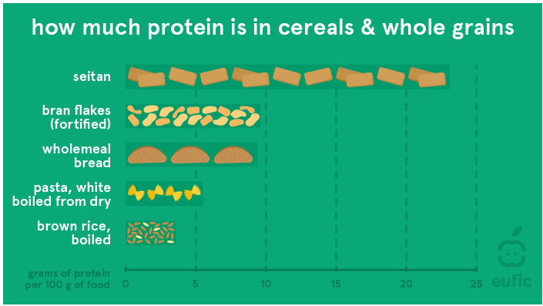
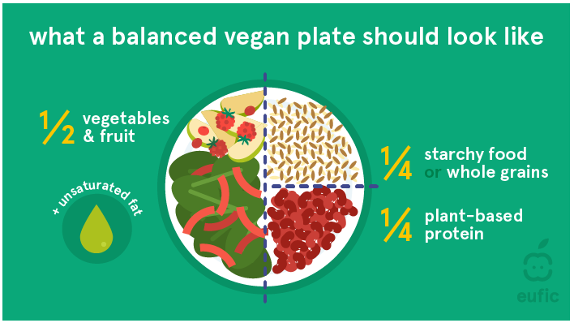
ProSIT a VEGAN PROTEIN

Slide 10
What Future of BRAN LOOKS LIKE

Slide 11

THANK YOU

