Slide 1
GRAIN BUSINESS, RUSSIA OUTLOOK
IRAN GRAIN CONFERENCE 1-2 October 2024 Russia Representative office Hadi Beyk

Slide 2
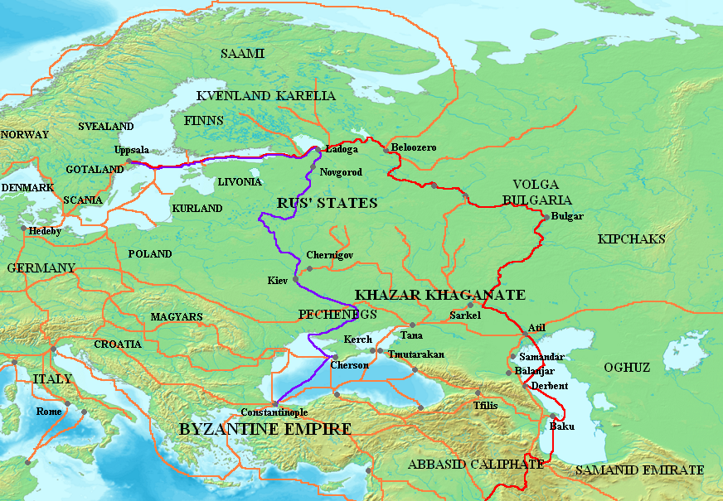
RUSSIA AND IRAN ARE HISTORICAL NATURAL TRADE PARTNERS
Iran has had commercial interests in the territories of Russia since the early I Millenium AD, in the form of the famous “Great Volga Trade Rout” that reached the pick of its glory in the IX Century, giving way later to the “Dnepr Trade Rout” (“From Varangians to the Greeks”).
Later the port of Astrakhan has again become the major center of first Indian and then Persian commercial interests in late XVII Century.

Slide 3
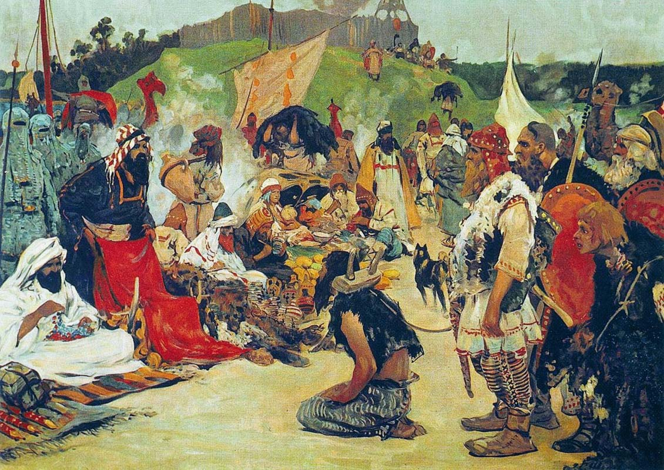
RUSSIA AND IRAN ARE NATURAL HISTORICAL TRADE PARTNERS
Import items: labor force, furs, natural forest bees’ honey, wax, silicon stone, amber
Export items: silk, crafts

Slide 4
RUSSIA AND IRAN ARE HISTORICAL NATURAL TRADE PARTNERS
Navigation period in Caspian area was from March through November, with winter break.
Jafar Kerimov’s Persian Guest House and Trading Yard in Astrakhan (European façade and Persian interior)

Slide 5
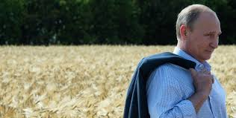
RUSSIA IS A MAJOR WORLD GRAIN PRODUCER
In early XX Century thanks to Duke Vite economic reforms (“gold standard”), introduction of modern commercial agriculture and dramatic development of logistics Russia has become the major wheat producer and exporter, accounting for over 26% of world export in 1913, mainly to Western Europe. Yet WWI undermined Russia’s position in this sphere of world economy effectively over most of the XX Century up till the first decade of XXI Century.
2010 saw the adoption in Russia of the State Food Security Doctrine signed in by President Putin Decree. One of the key-note concept of this Doctrine is an narrative that a developed country for its food security should produce domestically arround one ton of grain per capita.
Since 2010 grain production in Russia has increased 2,5 times reaching 158 million tons (population of Russia is currently 146 million people); Russia has again gained 26% share in the world wheat export market.

Slide 6
RUSSIA IS A MAJOR WORLD GRAIN PRODUCER

Slide 7
RUSSIA IS A MAJOR WORLD GRAIN PRODUCER
Last agricultural season of 2022-23 saw a record export of wheat from Russia amounting to 56 million tons or 26% of world export. The same season Russia also exported 6,9 million tons of barley and 5,3 million tons of corn.
This was a result of two factors – historically second largest wheat harvest of 104 million tons (grains total – 144,9 million tons) and significant carry-over stock from the previous historically largest wheat harvest of 2021-22 of 104,2 million tons (total grains 158 million tons).
2023-24 season ending June 30 grain export is expected to be 70 million tons, including 53 million tons of wheat.
This year agricultural season’s prospects are not as positive. Russian Grain Union still maintains its forecast of 130 million tons, including 82-83 million tons of wheat. Among negative factors are spring frosts, summer droughts and high costs due to higher prices for import seeds, machinery and higher bank interests of up to 25%.
In the longer term period Russian Ministry of Agriculture plans to increase grain exports to foreign markets setting the goal of exporting 80 million tons annually by 2030. The main export markets of Russia have changed recently – now they are Turkey, Egypt, India, Saudi Arabia, Uzbekistan. Russian exporters are entering new markets in Africa, Pakistan and others. Iran is one of such perspective markets.

Slide 8
MAJOR WHEAT PRODUCERS IN THE WORLD
Country | Production | Per Capita | Export
China | 135 mln tons | 0,09 ton
India | 105 mln tons | 0.07 ton
Russia | 104 mln tons | 0,71 ton | 53 mln tons
USA | 48 mln tons | 0,14 ton | 22 mln tons
France | 32,9 mln tons | 0,47 ton | 17,3 mln tons
Canada | 32,4 mln. tons | 0,83 ton | 22,8 mln tons
Iran | Production | Per Capita | Import
Total Grains | 20,4 mln tons
Wheat | 14 mln tons | 0,16 ton | 1 mln tons
Barley | 3 mln tons
Corn | 1,4 mln tons

Slide 9
IRAN AS A MAJOR IMPORTER OF RUSSIAN GRAIN

Slide 10
IRAN AS A MAJOR IMPORTER OF RUSSIAN GRAIN
In 2023 Iran’s import of Russian grain has reached the volume of 3 million tons and has good prospects of further growth.
Iran has the largest grain storage facilities in the Middle East. The total volume of grain storage facilities is 21,4 million tons, of which 18 million tons are long term storage facilities.
Iran's processing capacity is also quite impressive - 350 flour mills capable of producing 24 million tons of flour per year. At the same time, the location of the mills is logistically very advantageous - close to transit lines and ports. This opens up good prospects for Iran in terms of flour exports. Now it is mainly sold to Iraq and Afghanistan.
Iran's Deputy Minister of Economy and Finance for Economic Policy Seyed Ali Rouhani said in an interview with RIA Novosti that Tehran is offering Moscow to use Iranian territory as a safe corridor for exporting Russian grain to third countries. "The idea is that Iran can not only import grain from Russia to meet its own needs, but also provide its territory as a corridor for exporting Russian grain to third countries. The Russian side can count on Iran as a reliable and long-term partner," Rouhani said.
"The conflict in Ukraine and the subsequent Western sanctions against Russia have practically made the Iranian route a safe and alternative route for Russian grain exports. Unfortunately, we are working a little slowly in this direction... This path is certainly a path of long-term partnership and strategy," the Iranian official believes.

Slide 11
IRAN AS A MAJOR IMPORTER OF RUSSIAN GRAIN
The volume of production of agricultural products should increase by at least 25% by 2030, compared to 2021 — this task was set by Vladimir Putin in the decree "On the national development goals of the Russian Federation for the period up to 2030 and for the perspective up to 2036" within the framework of the national goal "Sustainable and dynamic economy". It also states that the export of agricultural products should increase by at least one and a half times.
In particular, foreign grain supplies, taking into account the increase in the harvest, according to Deputy Prime Minister Dmitry Patrushev, should reach 80 million tons. However, the record grain harvest of 135 million tons in 2017 demonstrated that there is not enough logistic capacity for export.

Slide 12
NORTH-SOUTH TRANSPORTATION CARRIDOR
While most of Russia’s grain export (65%) is serviced by deep ports of Azov and Black seas, for deliveries to Iran the North-South International Transport Corridor plays an important role.
The total volume of grain cargo transportation along the North-South corridor in 2023 is estimated at a modest 4.4 million tons. 2.8 million tons were transported along the Trans-Caspian route between the ports of Russia and Iran, 1.5 million tons along the Western route through Azerbaijan, and 0.13 million tons along the Eastern route through Turkmenistan.
Thus, the potential of the North-South ITC has not yet been fully utilized for the export of Russian grain to Iran and other countries gravitating toward the corridor. Part of the export cargo flow goes through the ports of the Azov-Black Sea basin.
Nevertheless, the North-South corridor has significant potential to increase the volume of grain transportation to Iran, Saudi Arabia, Pakistan, other countries of South Asia, the Middle East, and East Africa.”
By 2030, the potential volume of grain transportation along the corridor may increase to 15 million tons, including 12 million tons to Iran. The prerequisites for the implementation of this forecast are the growth of wheat consumption in the above-mentioned countries, including due to the high dynamics of the population, as well as due to the limited capacity of their own grain production.

Slide 13
NORTH-SOUTH TRANSPORTATION CARRIDOR

Slide 14
TOP GRAIN PRODUCING RERGIONS IN RUSSIA – OVER 3 MILLION TONS
2023 season grain harvest was 144,925 million tons, with averge yield 3,3 tons per ha;
Rostov region. 16,170 million tons, yield 4,4 tons per ha;
Krasnodar region. 13,987 million tons, yield 5,6 tons per ha;
Stavropol region. 9,138 million tons, yield 3,8 tons per ha;
Volgograd region. 6,373 million tons, yield 3,0 tons per ha;
Voronezh region. 6,281 million tons, yield 4,4 tons per ha;
Saratov region. 5,925 million tons, yield 2,6 tons per ha;
Kursk region. 5,507 million tons, yield 5,9 tons per ha;
Tambov region. 5,138 million tons, yield 4,9 tons per ha;
Altay region. 4,500 million tons, yield 1,4 tons per ha;
Orel region. 4,142 million tons, yield 5,1 tons per ha;
Belgorod region. 3,656 million tons, yield 5,9 tons per ha;
Lipetsk region. 3,653 million tons, yield 4,8 tons per ha;
Tatarstan. 3,604 million tons, yield 2,5 tons per ha;
Orenburg region. 3,401 million tons, yield 1,4 tons per ha;

Slide 15
TOP BARLEY PRODUCING REGIONS IN RUSSIA IN 2023
2023 season barley harvest was 21,146 million tons; average yield – 2,7 t/ha.
Voronezh region. 1,314 million tons, yield – 3,6 tons per ha;
Krasnodar region. 1,101 million tons, yield 5,6 tons per ha;
Tambov region. 998 thousand tons, yield – 4,1 tons per ha;
Kursk region. 978 thousand tons, yield - 2,3 tons per ha;
Rostov region. 977 thousand tons, yield - 3,3 tons per ha;
Tatarstan. 961 thousand tons, yield - 2,4 tons per ha;
Stavropol region. 882 thousand tons, yield – 3,6 tons per ha;
Bashkiriya. 809 thousand tons, yield – 1,9 tons per ha;
Orel region. 793 thousand tons, yield 4,4 tons per ha;
Lipetsk region. 781 thousand tons, yield – 4,2 tons per ha;
Ryazan region. 681 thousand tons, yield - 3,7 tons per ha;
Crimea. 603 thousand tons, yield – 3,3 tons per ha;
Orenburg region. 587 thousand tons, yield – 1,2 tons per ha;
Tula region. 554 thousand tons, yield – 4,2 tons per ha.

Slide 16
TOP CORN PRODUCING REGIONS IN RUSSIA IN 2023
Corn harvest in Russia in 2023 was 16,624 million tons, with average yield of 6,9 tons per ha.
Krasnodar region. 2,458 million tons, yield – 6,0 ton per ha;
Kursk region. 1,517 million ton, yield - 10,2 ton per ha;
Voronezh region. 1,206 million ton, yield - 6,8 ha per ha;
Tambov region. 1,145 million ton, yield - 9,0 ton per ha;
Bryansk region. 1,138 million ton, yield - 92 ц/га;
Kabardin-Balkar. 1,048 million ton, yield - 7,8 ton par ha;
Belgorod region. 956 thousand ton, yield – 9,6 ton per ha;
Stavropol region. 867 thousand ton, yield – 6,4 ton per ha;
Saratov region. 730 thousand ton, yield – 5,3 ton per ha;
Northern Osetya. 713 thousand ton, yield – 7,9 ton per ha;
Orel region. 681 thousand ton, yield – 10,2 ton par ha;
Rostov region. 583 thousand ton, yield – 5,4 ton per ha.

Slide 17
STRUCTURE OF RUSSIAN GRAIN EXPORT

